Slide 1
Taming the Consumption Beast: Tools for Managing Human Demand
Michelle Maloney, Griffith University and AELA
Peter Daniels, Griffith University and ANZSEE

Slide 2
The burning question
If we woke up tomorrow and every citizen, government and corporation on Earth agreed to live within our ecological limits, how would we do it?

Slide 3
Our argument
It all seems very complex
And it is
We’ve had 250 years (more?) of ‘pro-growth’/
empty world thinking
Our systems are not geared to limit demand
Our governance systems are geared for material growth (endless consumption)
  And our economic systems “appear” to be controlled “from above” (governments and corporations)
BUT … over the last 50 years humanity has been developing new attitudes, methods, approaches.
We have the tools and techniques to help us set limits and manage human societies… we just need to use them

Slide 4
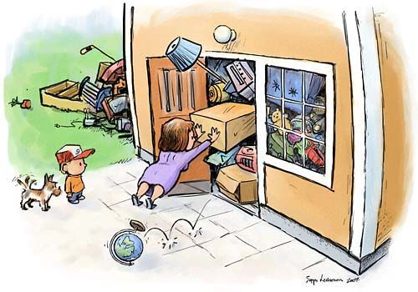
This presentation
The problem of consumption
An Earth Jurisprudence perspective
Some questions for economics, law, governance
Tools for understanding and tracking ‘demand’ within the world of ecological economics
Limitations on the use of these tools
How law might work better to support such mechanisms

Slide 5
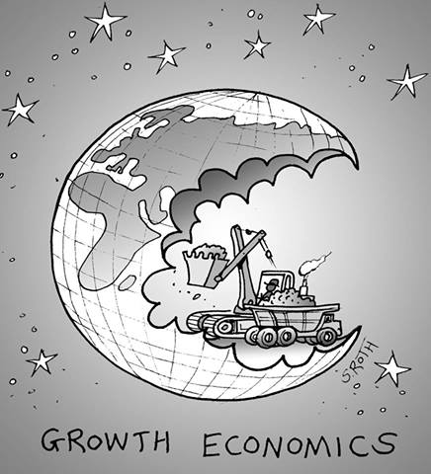
The problem of consumption
We’re now using 1.5 earths
By 2030 we’ll need 2 earths
For the global population to live like North Americans, we’d need 4 planets
  Global Footprint Network (2013)
“Humanity has used more resources since 1950 than in all of previous human history”
  Alan Durning ‘How Much is Enough? The consumer society and the future of the earth’ (1992)

Slide 6
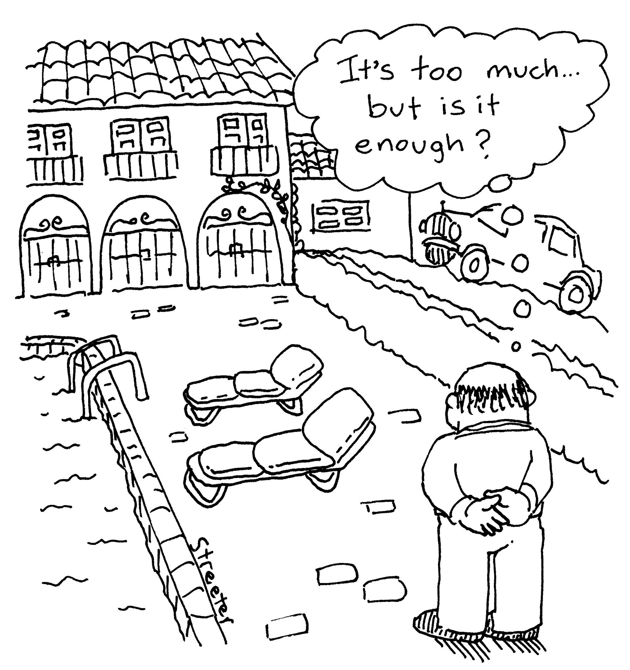
How do we limit demand in a limitless society?
Notes:
Our ‘tools’ are limited by our own social/cultural values, expectations
Industrial societies have come to expect:
Ideas of perpetual ‘growth’
Standards of living that exceed the capacity of the natural resources we draw on
That there will be no consequences of having whatever we want – socially (inequities) or environmentally
Charles Sampford spoke yesterday about ‘redefining the good life’ – this is a critical FIRST step to rethinking human demand
Already an excellent body of work in this space –
“Post-growth” - rethinking work life, work hours
Rethinking material expectations – ‘voluntary simplicity’
Rethinking social and public health implications of industrial society

Slide 7
An Earth Jurisprudence approach
Thomas Berry said by trying to create a ‘wonderworld’ industrial society has created a wasteworld
We need to live within the boundaries of the earth & support and nurture the Earth Community
How?
Focus on ecological health as a starting point
  Planetary Boundaries give us upper limits; can implement at national/regional/local levels
Then it’s about choices – choosing to nurture the natural world then puts limits around human activities
Key questions for law and economics
  What economic tools and mechanisms can we use to better understand and control human consumption?
  What do we already have and use?
  What do we need that we don’t have?
  How can law support these tools and mechanisms? Can law play a role in encouraging reduced demand?

Slide 8
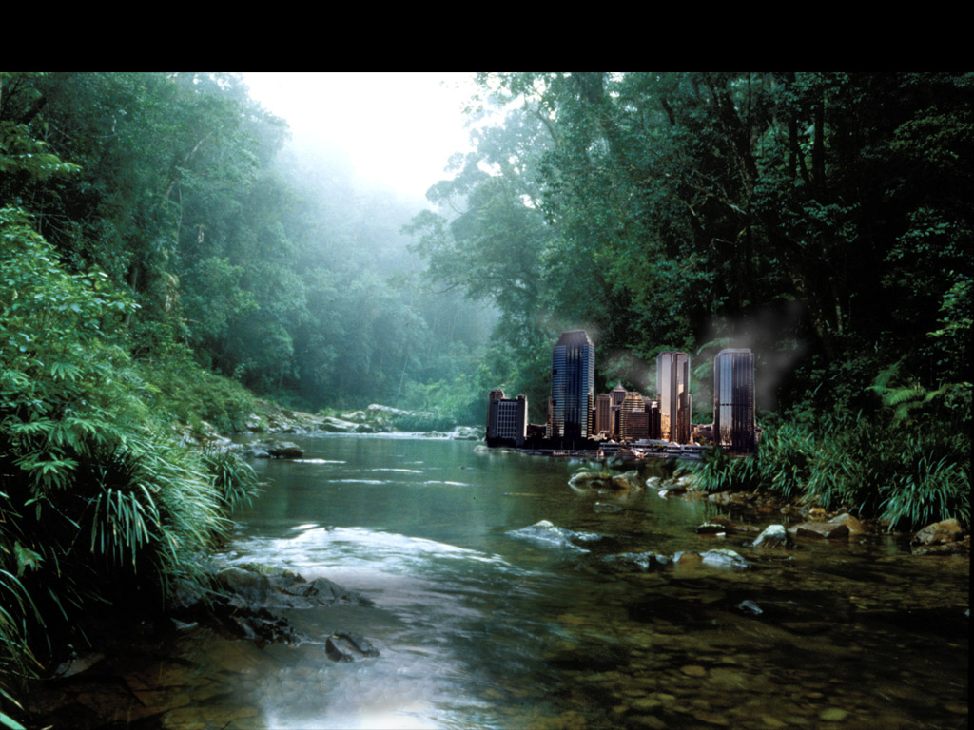
Tools for understanding, tracking and reducing natural resource demands - gems from ecological economics
Tools from ECOLOGICAL ECONOMICS (EE)

Slide 9
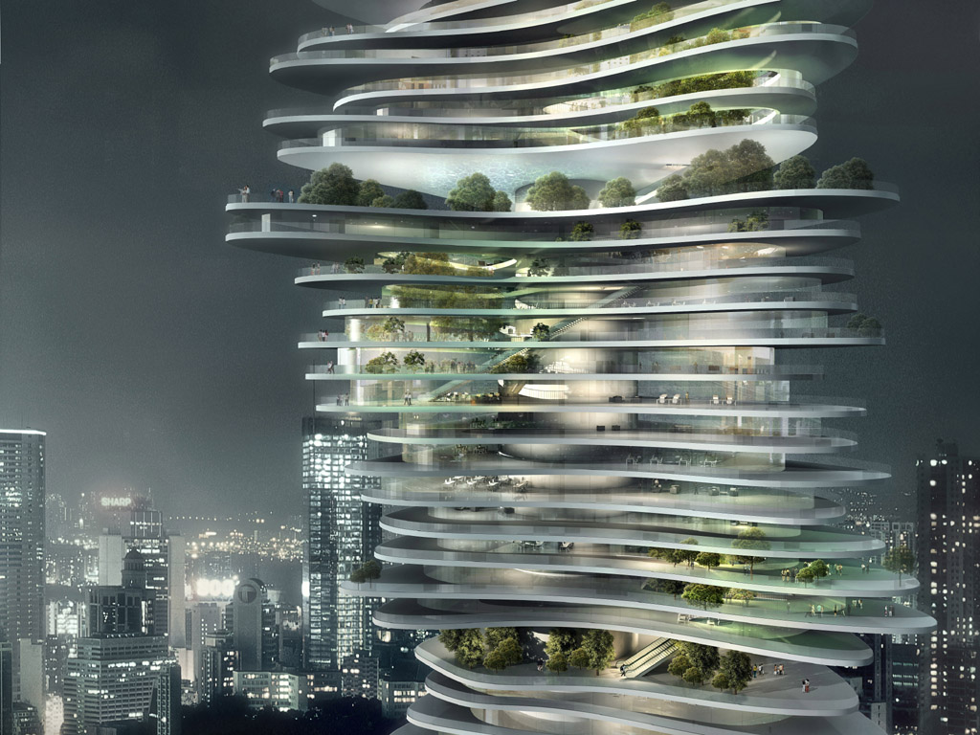
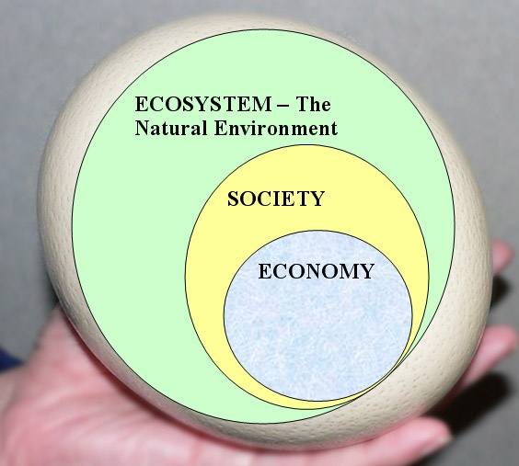
ECOLOGICAL ECONOMICS (EE) – What is it ???
Some Key Assumptions
the “sustainability egg”
(4) the scale of the human realm and activity on the Earth’s surface is damaging nature
(3) the stock of natural assets and related services is finite
(2) the human economy is highly dependent on nature as a major source of its welfare
(1) the economy is part of society which is part of nature
- the economy is embedded in nature

Slide 10


Tools for understanding, tracking and reducing natural resource demands - gems from ecological economics
the three main disciplines in EE come from the logical approach it adopts as the means for achieving sustainability
The SDA approach
(sometimes called the “SAD” approach)
Scale and Distribution then Allocation

Slide 11


ECOLOGICAL ECONOMICS (EE)
TRANS-DISCIPLINARY
= goes across or beyond individual disciplines; transcends and joins them
seeks integrated and new shared theory rather than an ad hoc collaboration of scientists from different fields (SCALE – ECOLOGY, DISTN – ETHICS, ALLOCATION – ECONOMICS)

Slide 12
ECOLOGICAL ECONOMICS (EE)
2 major conceptual frameworks for the tools
society’s metabolism
material balance, laws of thermodynamics

Slide 13
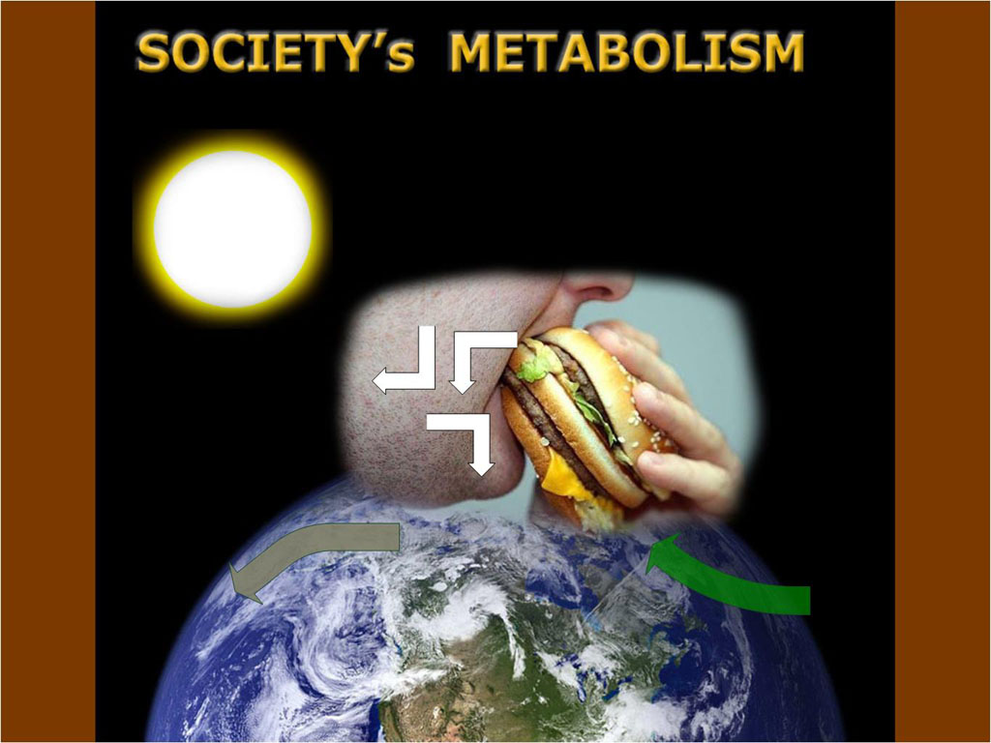
Societies are like organisms; they have to organize a constant throughput of matter for energy and “body” maintenance and growth – their “metabolism”
Society ingests, transports, metabolises, stores, excretes – “throughput as food”
Metabolism pathways maintains society and its stocks and services
SOCIETY
a major aim of environmental management is to get sustainability by reducing the socioeconomic metabolism or throughput

Slide 14
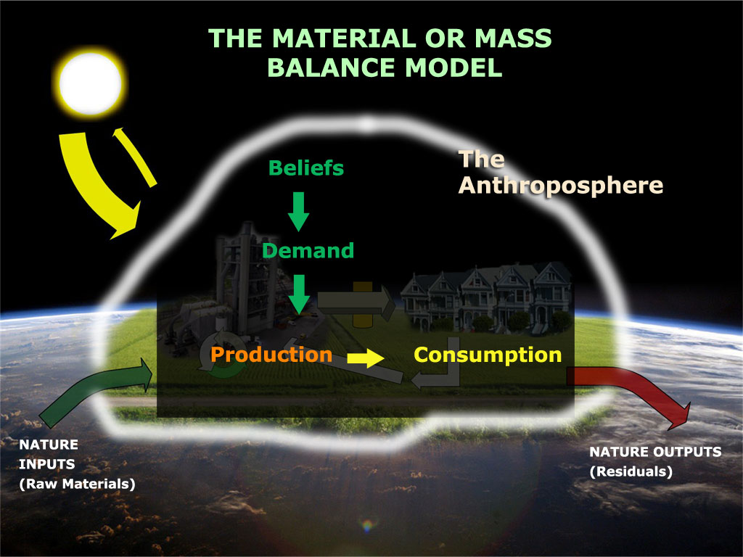
the biophysical economy

Slide 15
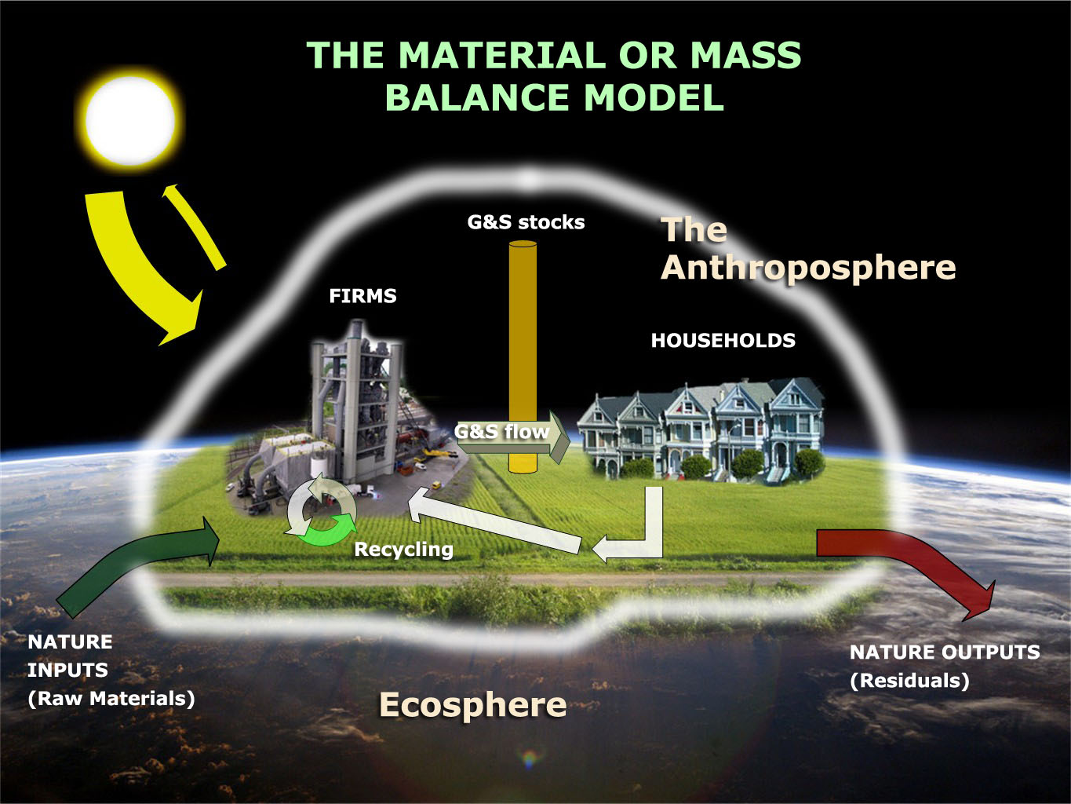
Tools for Monitoring Natural Resource Pressures from the Ecological Economic Perspective
1. material flow analysis (MFA)
2. environmental input-output analysis
3. life cycle assessment
4. alternative progress measures to GDP
e.g. Index Sust Econ Welfare
5. net primary product (NPP) appropriation
6. environmental and economic accounting
e.g. UN

Slide 16

Limitations of footprinting and other biophysical economy tools
large information requirements ; uncertainty and complex interdependence between natural systems and cycles
simplicity and limited information for useful strategies and policy (in original footprinting measures)
socio-psychological impacts underplayed in the biophysical emphasis
are tools enough without changing people’s wants? - need to reconsider the theories of happiness that drive “consumer” demand and throughput

Slide 17
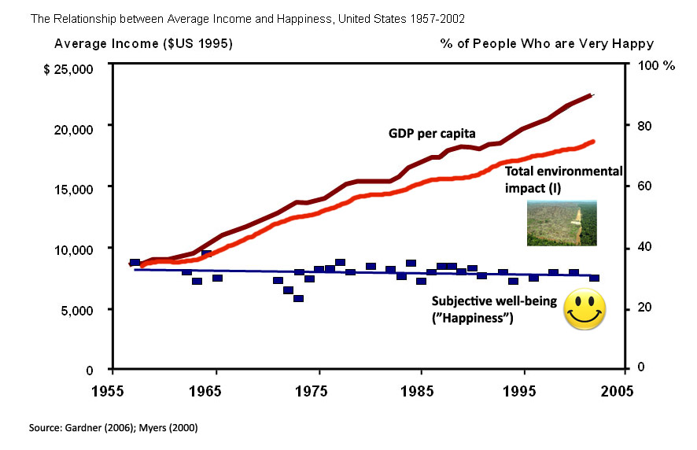
The “double whammy”
The “double whammy”
more environmental pressure, no gain in true welfare

Slide 18
So … all these tools can be a bit confusing to non-economists
the use of environmental input-output methods and life cycle analysis to assess sustainable consumption relating to water and energy
urban and household metabolism
(environmental resource flow analysis)
industrial ecology assessment and planning
utilities – demand management
the economic valuation of environmental impacts (externalities)
material and energy flow analysis – focus upon water, energy and greenhouse gas emissions
sustainability indicators – including ecological footprint analysis, environmental-economic accounting
water allocation/planning
pollution control laws
life cycle assessment and hybrid life cycle and input-output analysis techniques for assessing the sustainability implications of goods and services, organisations, industries, infrastructure and urban form
infrastructure planning
land planning laws

Slide 19
Beware the solutions …
“ (Today, environmentalists) … construct integrated multiscale ecological-economic models and assessments online, utilizing the results of adaptive, biocomplex, computational, cross-cutting, holistic, integrated, interactive, interdisciplinary, multifactorial, multifunctional, multiscale, networked, nonlinear, simulational, synthetic, externally funded research, addressing uncertainties, vulnerabilities, complexities, criticalities, and surprise scenario forecasts. Thus they adopt in a contemporary form the very economic and utilitarian approach their predecessors deplored”
  Sagoff 1994, p.155
Notes:
Interested in identifying approaches to help humanity reign itself in
But aware of the irony …
READ QUOTE
Fair call, but moving from where we are now, to where we need to be … needs us to start somewhere …

Slide 20
Beware the solutions …
“ (Today, environmentalists) … construct integrated multiscale ecological-economic models and assessments online, utilizing the results of adaptive, biocomplex, computational, cross-cutting, holistic, integrated, interactive, interdisciplinary, multifactorial, multifunctional, multiscale, networked, nonlinear, simulational, synthetic, externally funded research, addressing uncertainties, vulnerabilities, complexities, criticalities, and surprise scenario forecasts. Thus they adopt in a contemporary form the very economic and utilitarian approach their predecessors deplored”
  Sagoff 1994, p.155
Fair point … but to move modern societies to
a world with limits, we need to start somewhere
Notes:
Interested in identifying approaches to help humanity reign itself in
But aware of the irony …
READ QUOTE
Fair call, but moving from where we are now, to where we need to be … needs us to start somewhere …

Slide 21
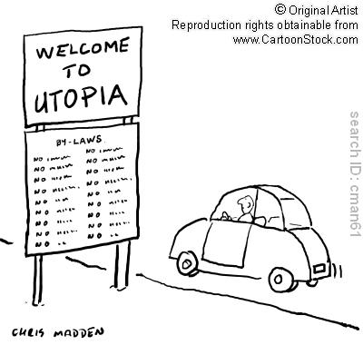
Role of law and governance?
In the area of demand, or consumption, free marketeers claim that law should not be used to limit demand (claims of ‘nanny state’, ‘big brother’)
But our legal system already plays a critical role in setting the parameters for our economic and social systems
What’s possible in a brave new future?

Slide 22
Right now … What if ….
Planning and development laws are not linked to broader parameters of ecological health
Right to shop?
Industrial developments have limited environmental requirements imposed on them
We understood and worked within ecological ‘boundaries’ to help set parameters for development+ used EE tools to understand the impact of choices + reverse the onus of proof (developers must prove their projects are beneficial)
We inject values into consumption and production; governance frameworks for deliberative democracy – making choices about what we ‘allow’ in our society
Those developments that ARE allowed in this brave new world, have approaches like industrial ecology imposed on them as part of the approval/governance processes
Notes:
RIGHT NOW – there are no limits – industrial society thinks it has a right to shop; whatever industry decides it can make, it’s allowed to make, regardless of cumulative impacts.
WHAT IF we imposed limits based on environmental harm. It might seem far fetched, or all too hard – but we have systems for banning products based on harm to human health – eg pharmaceuticals banned for human harm – we also have ‘precedents’ for chemicals such as DDT etc. Bottom line – need to push for deliberative democracy; processes that involve greater choices by citizens
RIGHT NOW – planning and development laws, especially in Australia, are really just the rules of development, endless development. Approvals do not happen within a broader framework that monitors and understands ecological health – but it really must.
WHAT IF - Planetary boundaries were used/applied – they can be scaled down and scaled back up again; there are ways to try to understand this (of course there are HUGE barriers with free trade, but hey, that’s another story). WHAT IF we accepted the ecological economics idea of ‘closed world’ and reverse the onus of proof in our legal and cultural decision making systems, so that new developments have to jump through hurdles of being beneficial. How decide? Citizen juries
RIGHT NOW -

Slide 23
Conclusions – so what?
Huge body of work ‘out there’, created by ecological economists - can help us understand and monitor consumption and production
  EE can help create ‘stepping stones’ towards the future societies we want
Law and governance, at every scale, needs to:
  Integrate these tools into our planning, management
  Use this information to set limits (regulatory responses: bans, economic incentives, information/communication)
Role of civil society in the face of government ‘disinterest’ in sustainability?
  Take back the economy
  Understand and harness tools from ecological economics
  Work together, draw in multi-disciplinary teams, create alternative, thriving ‘models’ and practical examples of successful, healthy systems

Slide 24

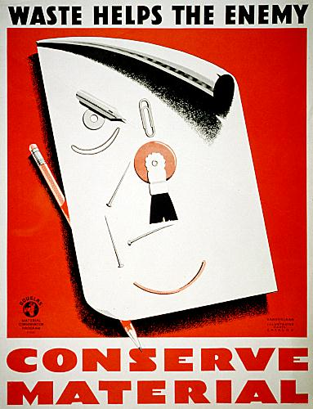
Finally … just a reminder that state sponsored frugality isn’t impossible

