Slide 1
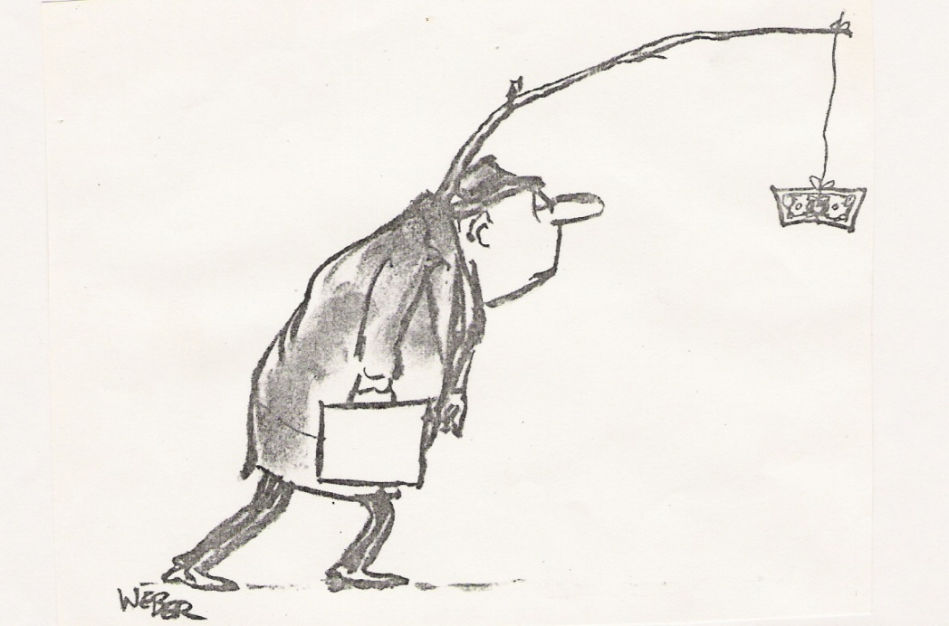
Conference question
How do we change our current economic, political & legal systems to create human societies that live in harmonious relationship with the Earth community?
Question.1
incremental reform .. or
fundamental system change?
Towards a global responsibility-based world constitutional system featuring an Earth Resource Trust
Australian Earth Law Alliance, Conference 2013 Brisbane
Dr Richard Mochelle mochelle@acenet.net.au

Slide 2
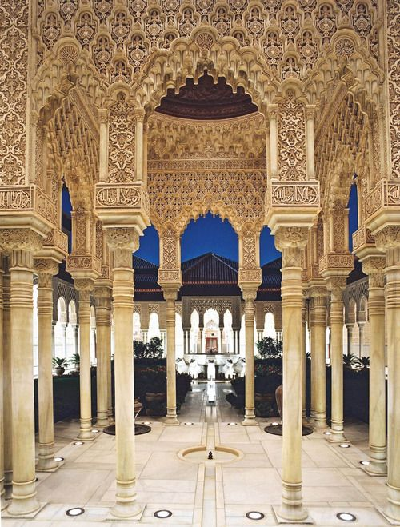
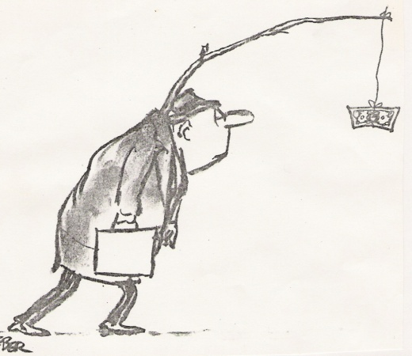
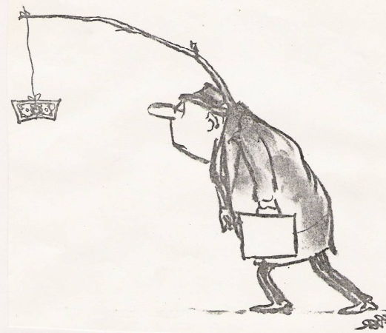
If fundamental system change is imperative,
need to co-design and consider viable system alternatives ... where? How can millions be engaged?
and
build agreement on preferred model(s) for reality-testing and showcasing on global civic scale?
The web offers unprecedented opportunity to create a new architecture for global democratic engagement
System Design Lab
and
World Constitutional Forum
With educational & info provisions
able to attract and engage large numbers, incl. kids
Lead design role for AELA
road well travelled
Left
Right

Slide 3
If achieving fundamental system change will require a system design lab & democratic constitutional forum.
Who will make it happen? Up to us. Govts won’t do it.
I’ve pursued a 3 decade system design project, solo, unpaid, both to conceive such facility, as well as a system design to submit to it for multidisciplinary development.
Will need moral, political & legal theorists, systems thinkers, information architects, educators, etc, ... a diverse pool of thought leaders to collaborate.
I’d like to inspire AELA to play a lead catalyst role.
To this end, I’ll briefly sketch a system vision I’ve been playing with, its global responsibility foundation, the system architecture, its key institution – the Earth Resource Trust – and the implementing vision.

Slide 4
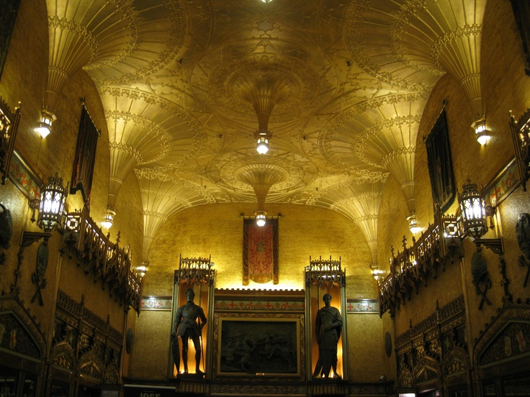
System Design Starting Point
the call for Global Responsibility

Slide 5
Call for global responsibility
Golden Rule > Kant’s Categorical Imperative (1785)
Act only according to principles that you figure others globally should enact, as if universal law
Commission on Global Governance Report ‘Our Global Neighbourhood’ (1995)
foremost recommendation – ‘a global civic ethic’ - global responsibility to be enacted by all – leaders 1st - to protect rights
Universal Declaration of Global Responsibilities (1997) Interaction Council - former heads of state, incl. Malcolm Frazer
‘Article 4: all people must accept a responsibility to each and all’ Enact Golden Rule
Earth Charter (2000)
“We must join together to bring forth a sustainable global society…
imperative that we, peoples of Earth, declare our responsibility to one another, to the greater community of life, and to future generations.”

Slide 6
System Design Starting Point
‘What if’ we took seriously
the calls for Global Responsibility
The implications are radical, transformative
For the constitution of the world system
and
the constitution of self - the norms constituting our integrity
Successful system transformation will depend on whether ‘we the globally responsible’ can agree on the core implications in the world constitutional forum that we create >> EG >>

Slide 7
Could we agree on these?
Four challenging ethical implications of
commitment to global responsibility
Responsibility to fulfil/protect interests of all without favour to nations, races, ethnic, or religious groups – implies refusal of national allegiance & defences
Global impartiality
Priaction ethic
Responsiveness to priority needs of all & environt. – attend to worse-off prior to the better-off
Earth trusteeship/ custodianship
Holding, care and free-transfer of property/resources by and for those committed to impartial, priactive and honorary responsibility
Honorary world service
Exercise of above responsibilities 24/7 without condition of payment or external incentive
A constitutional platform for an unprecedented, post-capitalist, world system

Slide 8

How to bring a GR-based pol-econ system into our world?
violent global revolution?
unlikely by conventional political means
Lobby for fundamental policy/law reform – globally?
Establish a World Party! – gain electoral majorities in democratic countries?
Constitutional referenda – in all countries?
UN Assembly vote – eg, Convention on Global Responsibility of Leadership? Radically amend UN Charter?
Entrepreneur Constitution – promote it globally, lobby nations to ‘buy’ it?
Eg. Earth Constitution A rights-based, world federalist constitution half century project by WCPA – zero prospect of ratification by nations.
GR-based exemplar communities - co-ops, ecovillage networks?
feasible – from little things, big things grow – but today’s exemplars inadequate – lack coherent whole system conception

Slide 9
How to reality test an unprecedented GR-based whole system and showcase on a global civic scale without imposing on the unwilling?
Can be done with integrity
Day 1 - collaborative action planning to
DIY design/build and enter a
world system design lab and constitutional forum
to
co-design & constitute a model world political economy based on principles of global responsibility
and then
embody the DNA design in a world service consortium (clothed in legally protective shell)
Seed into ‘cultivated’ areas for reality testing and showcasing

Slide 10
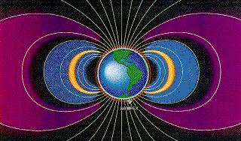
CIVIVA Concept
Example of system concept
Need 3D info maps for system transparency, see relationships, & easy navigation
holonic, multicellular, self-organising system architecture (priocracy prototype A)
‘crows nest’
whole system design review
Earth Resource Trust - title holding & transfer system receives property bequests, transfers titles
Priactive information & communication system
research & review
carrying capacity constraint
Self/world constitution-building/ learning gateway
Planning, design, art & tech. innovatn system
macro > micro scale
World Service Trusteeship educn. & qualifying system
Skills training & qualifying system
Care, Managt. Services admin. services, eco-care, medicare, child care, aged care, emergency, repair & maintenance - all scales
conflict resolution (mediation/arbitration) system
Priora Bank receives monetary bequests, donations, payments for goods & services from traders, administers honorariums & distributes funds internally & externally

Slide 11
CIVIVA Concept
CIVIVA
EARTH RESOURCE TRUST
A comprehensive global ‘property trust’ & custodian title system
Global super-library – integrating conservation trusts, community housing trusts, etc, to provision whole system
Global mosaic of land, forests, farms, mines, industrial plants, buildings of every kind, land & water vehicles, tools & equipment, furniture, all non-perishables,
PRIMARY PURPOSE: to resource honorary world service trustees
Resources not purchased – bequeathed to Trust in support of GR system – withdrawn from speculative market in perpetuity

Slide 12
CIVIVA Concept
EARTH RESOURCE TRUST
& World Service Trusteeship
Ability to attract property bequests -
highly dependent on trustworthiness & capabilities of Trustees
high integrity - clear commitment by trustees to global responsibility ie, honorary, impartial, priactive, custodial world service
capability - high grade competencies in sustainable resource development, retrofit, care, restoration & repair
- omni-diverse globally responsive, skills pool
Will require a GR-based educational gateway >
Challenge to develop a new global education system for all ages enabling learners to consider their constitutional relationship with the world of others, as called for by the Golden Rule & Categorical Imperative.

Slide 13
potential trustees, partners & mutual beneficiaries
World aid & disaster relief volunteers
Oxfam, MSF, Engineers w/o borders
Service clubs
Eg. Rotary, APEX, Lions, Freemasons
Refugees & environmental migrants
CIVIVA
WORLD SERVICE TRUSTEESHIP
EARTH RESOURCE TRUST
Philanthropic bodies
Retired, unemployed,
resource-rich
love/service-oriented, religious groups Christian, Hindu, Buddhist, Sikh, etc
Poverty & homeless relief volunteers
Wildlife & Habitat Conservation volunteers

Slide 14
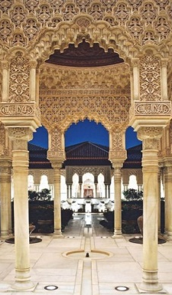
Summing up
How can we change our current economic, political & legal systems – fundamentally?
With integrity – ‘be the global change we want to see’
1 Collaborate to create and dialogically engage in
a system design lab – to develop and consider alternative systems, such as sketched here,
a world constitutional forum – to find agreement on preferred world system design
2 Reality-test the constitutional agreement
within an
an exemplar global civic organisation
featuring a Global Property Trust to resource the initiative, with
a trustee education & info system
Embarking Now

Slide 15
A draft invitational poster
for a
world constitutional happening
to arouse public curiosity and invite engagement

Slide 16
CIVIVA SPECTACULA
Coming Soon To a Place very Close to You
before the world as you know it ends
A thoroughly escapist,
mind-bendingly unreal,
but so globally responsible,
world constitutional craft festival
featuring
the absolutely priceless Earth Trust
And …the Good for Nothing Trustees.
seriously theatrical & refreshing

