Slide 1
Gai’s Veil
Empowering those organisations that provide a voice for nature
Ariane Wilkinson
Solicitor – Environment Defenders Office (Victoria) Ltd
29 October 2013, Brisbane

Slide 2
David Suzuki
“There are some things in the world we can’t change – gravity, entropy, the speed of light….. Other things, like capitalism, fee enterprise, the economy, the market, are not forces of nature, we invented them. They are not immutable and we can change them.”
Suzuki highlights an important fact – we invented our economic, political and legal systems and we have the power to change them.

Slide 3
One of Law’s inventions - The Corporate Veil
Windeyer J, in the High Court in Peate v Federal Commissioner of Taxation, stated that a company represents:
  “[A] new legal entity, a person in the eye of the law. Perhaps it were better in some cases to say a legal persona, for the Latin word in one of its senses means a mask: Eriptur persona, manet res.”
Notes:
Ramsay and Noakes, Piercing the Corporate Veil in Australia (2001) 19 Company and Securities Law Journal 250-271 (available online - http://www.law.unimelb.edu.au/files/dmfile/Piercing_the_Corporate_Veil1.pdf )

Slide 4
The Corporate Veil – Limited Liability (mostly)
The separate legal entity principle has continued unexpurgated from Anglo-Australian corporate law for more than one hundred years. When a company acts it does so in its own right and not just as an alias for its controllers. Similarly, shareholders are not liable for the company’s debts beyond their initial capital investment, and have no proprietary interest in the property of the company.
At the same time, courts have acknowledged that the corporate veil of a company may be pierced to deny shareholders the protection that limited liability normally provides. “Piercing the corporate veil” refers to the judicially imposed exception ….’ a discussion for another time
Notes:
Ramsay and Noakes, Piercing the Corporate Veil in Australia (2001) 19 Company and Securities Law Journal 250-271 (available online - http://www.law.unimelb.edu.au/files/dmfile/Piercing_the_Corporate_Veil1.pdf )

Slide 5



Who gets to wear the corporate veil?

Slide 6
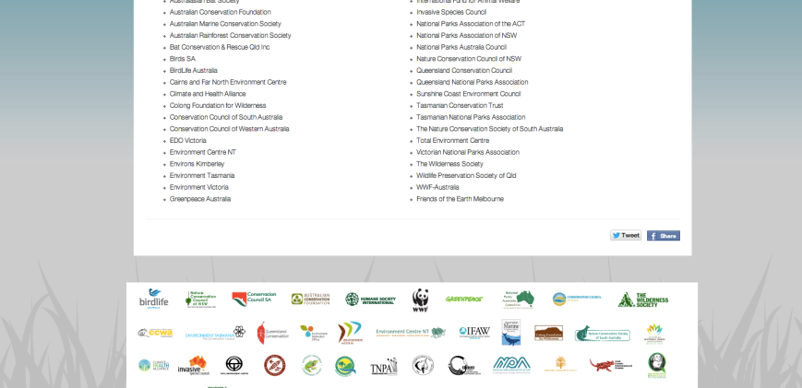
And…..many of the organisations dear to our hearts

Slide 7
ENGOs – One of the voices for nature
The natural world provides us with the data required to know what these ecological limits are, and environmental non-government organisations (ENGOs) are most often the voice for the natural world. Therefore the rules that govern ENGOs, how they are structured, and how they are financed are critical in supporting a voice for nature in our society.
I note there are also many non-incorporated ENGOs and individuals who are tireless advocates for the natural world

Slide 8
Benefits to ENGOs of wearing the corporate veil
1. A separate legal entity – can enter contracts, buy and sell assets, take legal action in its own name;
2. Limited liability - responsibility such as debts and legal costs that the group is ordered to pay, is limited to the assets held by the group, protecting the individuals within from being personally liable.*
*There are exceptions to limited liability where members of the group act improperly or unlawfully, or when they act in a personal capacity ie. Subject to ‘piercing of the corporate veil’ just like any other co.
3. Perpetual Succession – continue to exist even when members change

Slide 9
Benefits to ENGOs of wearing the corporate veil cont….
4. If you meet certain conditions, ability to Register on the ‘Register of Environmental Organisations’ with SEWPAC and become a deductible gift recipient though the Australian Taxation Office.
Therefore you can fundraise and attract more donations and gifts…
http://www.pilch.org.au/DGR/#3
Notes:
Before you go to the trouble of applying for endorsement as a DGR, it is worth noting that your organisation will only benefit from being endorsed as a DGR if:
it receives gifts from the public; or
it wants to attract funds from organisations (from certain grant makers and philanthropic bodies) which only give to DGRs.

Slide 10

And even though Jesse J tells us its not about the

Slide 11
Lowe agrees with Jesse J but Ritter points out….
No amount of money can bring back a threatened species – Lowe
A well resourced ENGO can be very powerful as a voice for nature, and a player in the political game. For example, as Ritter noted on Friday – it is always about politics - how people deal with each other in relation to power and assets.
Though there are many types of power (eg. Community power of Lock The Gate), financial power is one of the important types. How ENGOs are financed is critical in supporting a POWERFUL voice for nature in our society.
Notes:
A little blown out the water by the amazing talks of Drew Hutton and Mari
Margil and Thomas Linzey, Community Environmental Legal Defence Fund (CELDF) this morning – however, even they talked about these new organisations incorporating – Lock the Gate and community organisations, even Drew talked about draining his Super fund and the need for support – it still costs cash to get the Winnebago to send the Lock the Gate organiser out into the community….

Slide 12
What’s one way that ENGOs can become more financially powerful?
One area in which our economic, political and legal system needs to change to support human societies that live in a harmonious relationship with the Earth community is to amend our taxation and charity laws to allow environmental non-government organisations (ENGOs) to be public benevolent institutions (PBIs).
All ENGOs can become Deductible Gift Recipients (DGRs) if they meet certain criteria, but none can be PBIs.

Slide 13
What’s the difference?
Public Benevolent Institution
Charity, or just a DGR
ENGO can be DGR if registered with ATO
Full FBT exemption
DGR status
No FBT full exemption available

Slide 14
Overview of Australian Tax Exemptions

Slide 15
PBIs – Gold star expemptions available from the ATO
Public Benevolent Institution (‘PBI’) is a charity whose main purpose is to work directly to relieve poverty, sickness, suffering or disability.
A PBI receives the greatest tax concessions of all groups that can register with the Australian Charities and Not-for-profits Commission (‘ACNC’). A PBI is entitled to a capped exemption on fringe benefits tax up to $30,000 per employee.

Slide 16
PBIs – 4 Hoops to the Holy Grail
To be a PBI, a charity must meet the legal meaning of ‘charity’, it must be an ‘institution’ that has ‘benevolent relief’ as its main purpose and that relief must be provided to ‘people in need’
(see ACNC Act and common law - http://www.acnc.gov.au/ACNC/FTS/Fact_PBI.aspx).
Perpetual Trustee Co Ltd v Federal Commission of Taxation (1931) 45 CLR 224, 236.
Notes:
The meaning of a Public Benevolent Institution (‘PBI’) was first tested in Perpetual Trustee Co. Ltd v Federal Commissioner of Taxation [1931] 45 CLR 224 where it was described by Starke J
as “an institution organized for the relief of poverty, sickness, destitution, or helplessness’. Dixon J added the relief of ‘suffering, distress or misfortune’.
[1931] 45 CLR 224
Perpetual Trustee Co. Ltd v Federal Commissioner of Taxation [1931] 45 CLR 224 at 232 and 233.

Slide 17
Criteria 1 – A Charity ☑
Under the Charities Act 2013, which will commence on 1 January 2014, the definition of charity is a not-for-profit entity whose purposes are all charitable, or incidental or ancillary to the furtherance of charitable purposes, and for the public benefit.
Charities Act 2013 (Cth), s 5.
Charitable purposes are listed in the Act, one of which is ‘advancing the natural environment’.
TICK! ✔
Charities Act 2013 (Cth), s 12(1)(j) (new – June 2013) (Charities Act codified the common law)
Notes:
See Slide no 21

Slide 18
Criteria 2 – An institution ☑
A charity is an institution if it does more than just distribute funds or make property available for others. To be an institution is must have a separately identifiable structure and engage in its own activities.
Tick – just pop on the corporate veil.
Notes:
See Slide no 21

Slide 19
Criteria 3 – PBI Part 1 - Benevolent Relief☒
Benevolent relief is work which aims to relieve: poverty, sickness, disability, destitution, suffering, misfortune or helplessness.
To be considered ‘benevolent relief’, the degree of suffering that is being alleviated must be significant enough to arouse compassion in people in the community and it must be beyond the suffering experienced as part of ordinary life. The test for benevolence is “whether their disability or condition is of such seriousness as will arouse community compassion and thus engender the provision of relief.
Notes:
See slide no 21

Slide 20
Criteria 4 – PBI Part 1 - People in need ☒
To be a PBI, the benevolent relief being provide must only be for people , specifically people who need help. Due to this requirement, even a charitable organisation such as the RSCPA is not considered a PBI, because the relief for sickness, suffering and distress is provides is for animals and not human beings.
Notes:
See Slide no. 21

Slide 21
The 4 Criteria -
A Charity
An Institution
PBI Part 2 –
To People In Need
PBI Part 1 - Benevolent Relief

Slide 22
Working with the criteria – what can be done?
Criteria 3 – Benevolent Relief
Perpetual Trustee refers to the targets of public benevolence as being one which ‘arouses pity’ [1931] 45 CLR 224 at 236
An entity is not a PBI if the condition it seeks to relieve does not arouse compassion in the community. Needs that are met by education or training are not considered sufficient to arouse pity
Australian Taxation Office (ATO) 2000, Draft Taxation Ruling, Income tax and fringe benefits tax: public benevolent institutions

Slide 23
Criteria 3 – Benevolent Relief
An individual, group or even an entire society that finds itself in a ravaged and inhabitable natural environment, is certainly a target that would arouse pity and compassion, and it is such an environment that ENGO’s are working to avoid.

Slide 24
Working with the criteria – what can be done?
Criteria 4 – The sticking point – ‘To people in need’
  Solution 1 – Environmental Justice work of ENGOs
  Solution 2 – Rights for Nature! Animals, and rivers are people too

Slide 25
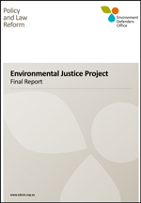
Solution 1 - Environmental Justice – Benevolent Relief to People in Need
Environmental justice still deals with
two main questions:
1. how environmental risk is distributed
and
2. to what extent the public can
participate in decisions about
the environment.

Slide 26
Solution 1 - Environmental Justice – Benevolent Relief to People in Need
….several environmental issues in Australia that could be analysed in ‘traditional’ environmental justice terms, giving rise to questions about the fairness in the distribution of environmental harms. Michelle Maloney suggests several in her recent report for the Queensland Government:
‘...contamination of water in the artesian basin from coal seam gas exploration ...;
... lead poisoning in Mr Isa ...;
... high levels of cancer and respiratory disease in communities in the Hunter Valley who have been surrounded by coal mining ...;
... Community resistance to the siting of hazardous waste storage and disposal facilities in Botany Bay and Perth ...;
... the re-opening of a copper smelter in Port Kembla ...
Indigenous community resistance to siting nuclear dump sites in the South Australian desert...;’

Slide 27
Solution 1 - Do ENGOs prioritise social justice?
In general, the discussion around ‘saving the environment’ conducted by most environmental NGOs does not identify, or prioritise, social justice and equity issues: prominent environmental non-government organisations treat the interrelation between environment and justice as incidental rather than inextricable.
Friends of the Earth Australia must be cited as the exception to this, having strong environmental justice threads in its operations and running specific campaigns linking environmental protection to broader social concerns.

Slide 28
Solution 1 - Environmental Justice – Benevolent Relief to People in Need – But is the relief ‘direct’ enough?
It could also be argued that the work of ENGOs provides indirect relief or reduction in poverty and in particular, distress, however it has been held that it is not sufficient that the consequences of a group’s activities tend to relieve distress and suffering
Tangentyere Council Inc. v Commissioner of Taxes (1990) 21 ATR 239.

Slide 29
Solution 1 - Environmental Justice – Benevolent Relief to People in Need – But is the relief ‘direct’ enough?
Exception: Preventative Relief – A way for ENGOs to be considered PBIs
In Federation of NSW Police Citizens Boys Club v Council of the City of Greater Wollongongit was held that an entity can be a PBI when its relief purpose is preventative. It was stated that “there would appear no good reason for holding that any action…to alleviate or remove the conditions which give rise to it is not equally benevolent…it is difficult to see why prophylaxis should not be regarded as an activity just as benevolent as therapy”. The preventative relief in that case involved the re-establishment of individuals discharged impecunious after a sojourn in jail (1957) 2 LGRA 54

Slide 30
Solution 1 - Environmental Justice – Benevolent Relief to People in Need – But is the relief ‘direct’ enough?
In support of the idea that ‘preventative relief’ should be considered benevolent, the Geelong Ethnic Communities Council argued in a submission for the Charities Definition Inquiry, that “if we value prevention as being equally important as treatment, cure or direct assistance, then the distinction is irrelevant and inappropriate”.
Charities Definition Inquire, Chapter 29: Benevolent Charities, 254, http://www.cdi.gov.au/report/cdi_chap29.htm

Slide 31
Solution 1 - Environmental Justice – Benevolent Relief to People in Need – But is the relief ‘direct’ enough?
In the ENGO context, much of the work done to preserve and protecting the natural environment and encouraging sustainability can be considered preventative. Whether the target of an ENGO’s work is a community impacted by a local air pollution or a bigger picture issue such as climate change, these are issues that if prevented, will alleviate the risk of future destitution, distress, suffering and poverty.

Slide 32
Solution 1 - Environmental Justice – Benevolent Relief to People in Need – But is the relief ‘direct’ enough?
http://www.claytonutz.com.au/publications/edition/01_august_2013/20130801/no_requirement_that_a_public_benevolent_institution_must_provide_direct_relief_says_federal_court.page
“The decision turned on whether a public benevolent institution must give aid directly to those in need or distress. To date, the ATO's position has been that directly charitable activities are a prerequisite. This decision means that there is no such requirement, so that organisations engaged primarily in fundraising activities could qualify as a public benevolent institution.”
“Contrary to the assertion of the Commissioner, there is no authority for the proposition that the expression public benevolent institution requires such an institution directly to dispense aid.’

Slide 33
Solution 1 - Environmental Justice – Benevolent Relief to People in Need – But is the relief ‘direct’ enough?
The Hunger Project Australia v Commissioner of Taxation [2013] FCA 693; Clayton Utz acted for The Hunger Project Australia).
No requirement that a public benevolent institution must provide direct relief, says Federal Court
By Mark Friezer and Louisa Wu.

Slide 34
The Hunger Project Case
“The decision turned on whether a public benevolent institution must give aid directly to those in need or distress. To date, the ATO's position has been that directly charitable activities are a prerequisite. This decision means that there is no such requirement, so that organisations engaged primarily in fundraising activities could qualify as a public benevolent institution.”
“Contrary to the assertion of the Commissioner, there is no authority for the proposition that the expression public benevolent institution requires such an institution directly to dispense aid.
Decision appealed – currently awaiting decision of Full Federal Court - http://www.ato.gov.au/Non-profit/Non-profit-News-Service/In-detail/Articles--2013-14/Non-Profit-News-Service-No--402---Hunger-Project-Case--Federal-Court-allows-appeal/

Slide 35
Solution 1 - Environmental Justice – Benevolent Relief to People in Need
Options to develop the law under solution 1 -
  Law reform campaign for changes to legislation; and/or
  Run a test case – Make an application to the Tax Commisioner for PBI Status – Then appeal the probable refusal.
Notes:
Ask for a private ruling? Providing detailed submissions for a barrister?

Slide 36
Working with the criteria – what can be done?
Criteria 4 – The sticking point – ‘To people in need’
  Solution 1 – Environmental Justice work of ENGOs
  Solution 2 – Rights for Nature! Animals, and rivers are people too

Slide 37
  Solution 2 – Rights for Nature!
An organisation that exists to promote social welfare in the community generally, lacks the quality of ‘directness’ and is therefore not a PBI. There needs to be ‘direct beneficiaries of such benevolence’ - Australian Council of Social Service v Commissioner of Pay-roll Tax (NSW) 85 ATC 4236
The direct beneficiaries must be ‘people in need’ - Perpetual Trustee Co Ltd v Federal Commission of Taxation (1931) 45 CLR 224, 236.

Slide 38
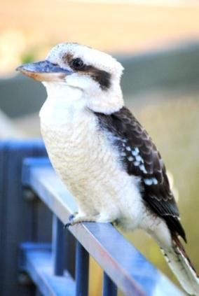
Meet ‘people’ who are the direct beneficiaries of an ENGOs benevolence -

Slide 39
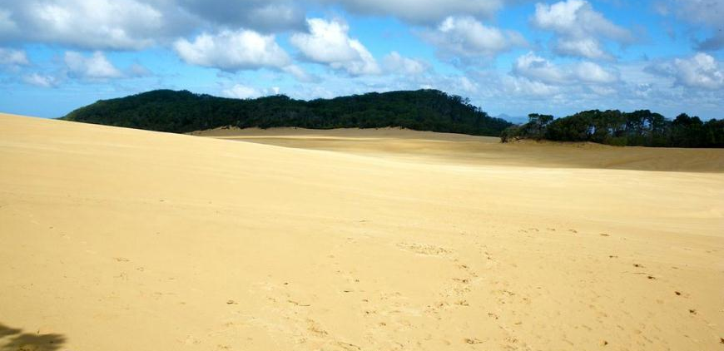
Meet the people’ who are direct beneficiaries of an ENGOs benevolence -

Slide 40
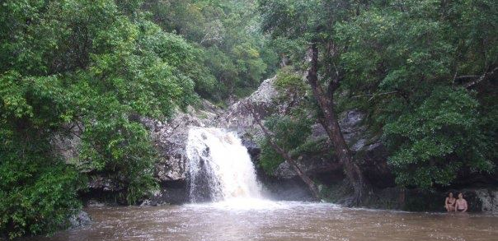
Meet the people’ who are direct beneficiaries of an ENGOs benevolence -

Slide 41
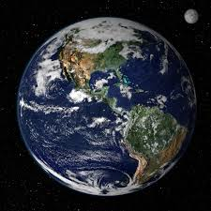
Meet the people’ who are direct beneficiaries of an ENGOs benevolence -
Notes:
Earth from Space : Image of the Day
earthobservatory.nasa.gov

Slide 42

Meet the people’ who are direct beneficiaries of an ENGOs benevolence -

Slide 43
Ritter - Critical lawyering means you make plain the absurdities…. Meet Patrick. Patrick lives in Ballarat. He’s 29.
Notes:
\

Slide 44
How come…this is a legal person, with rights before the law

Slide 45
..and Patrick is not?
Notes:
How the system is illegitimate and unjust

Slide 46
Waterfalls are people too…

Slide 47

Fruit and Veg are people too!

Slide 48
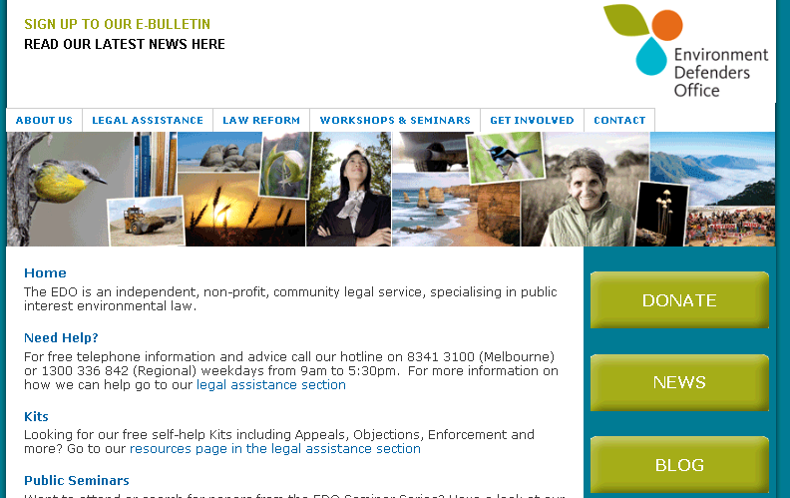


Thank you!
Thanks to EDO Victoria law student volunteer Ben who provided valuable research assistance and drafting for this presentation.
Thank you to Dr Mervyn Wilkinson for many of the photographs.
Thank you to Patrick from Ballarat for the inspiration you provide.

