Slide 1
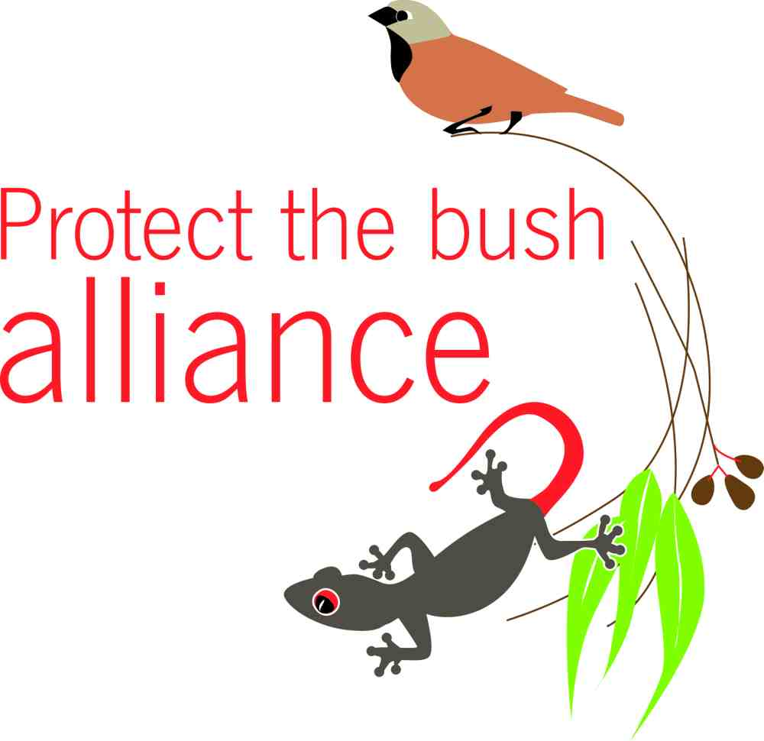
Presents:
Strategies for Protecting the Bush

Slide 2
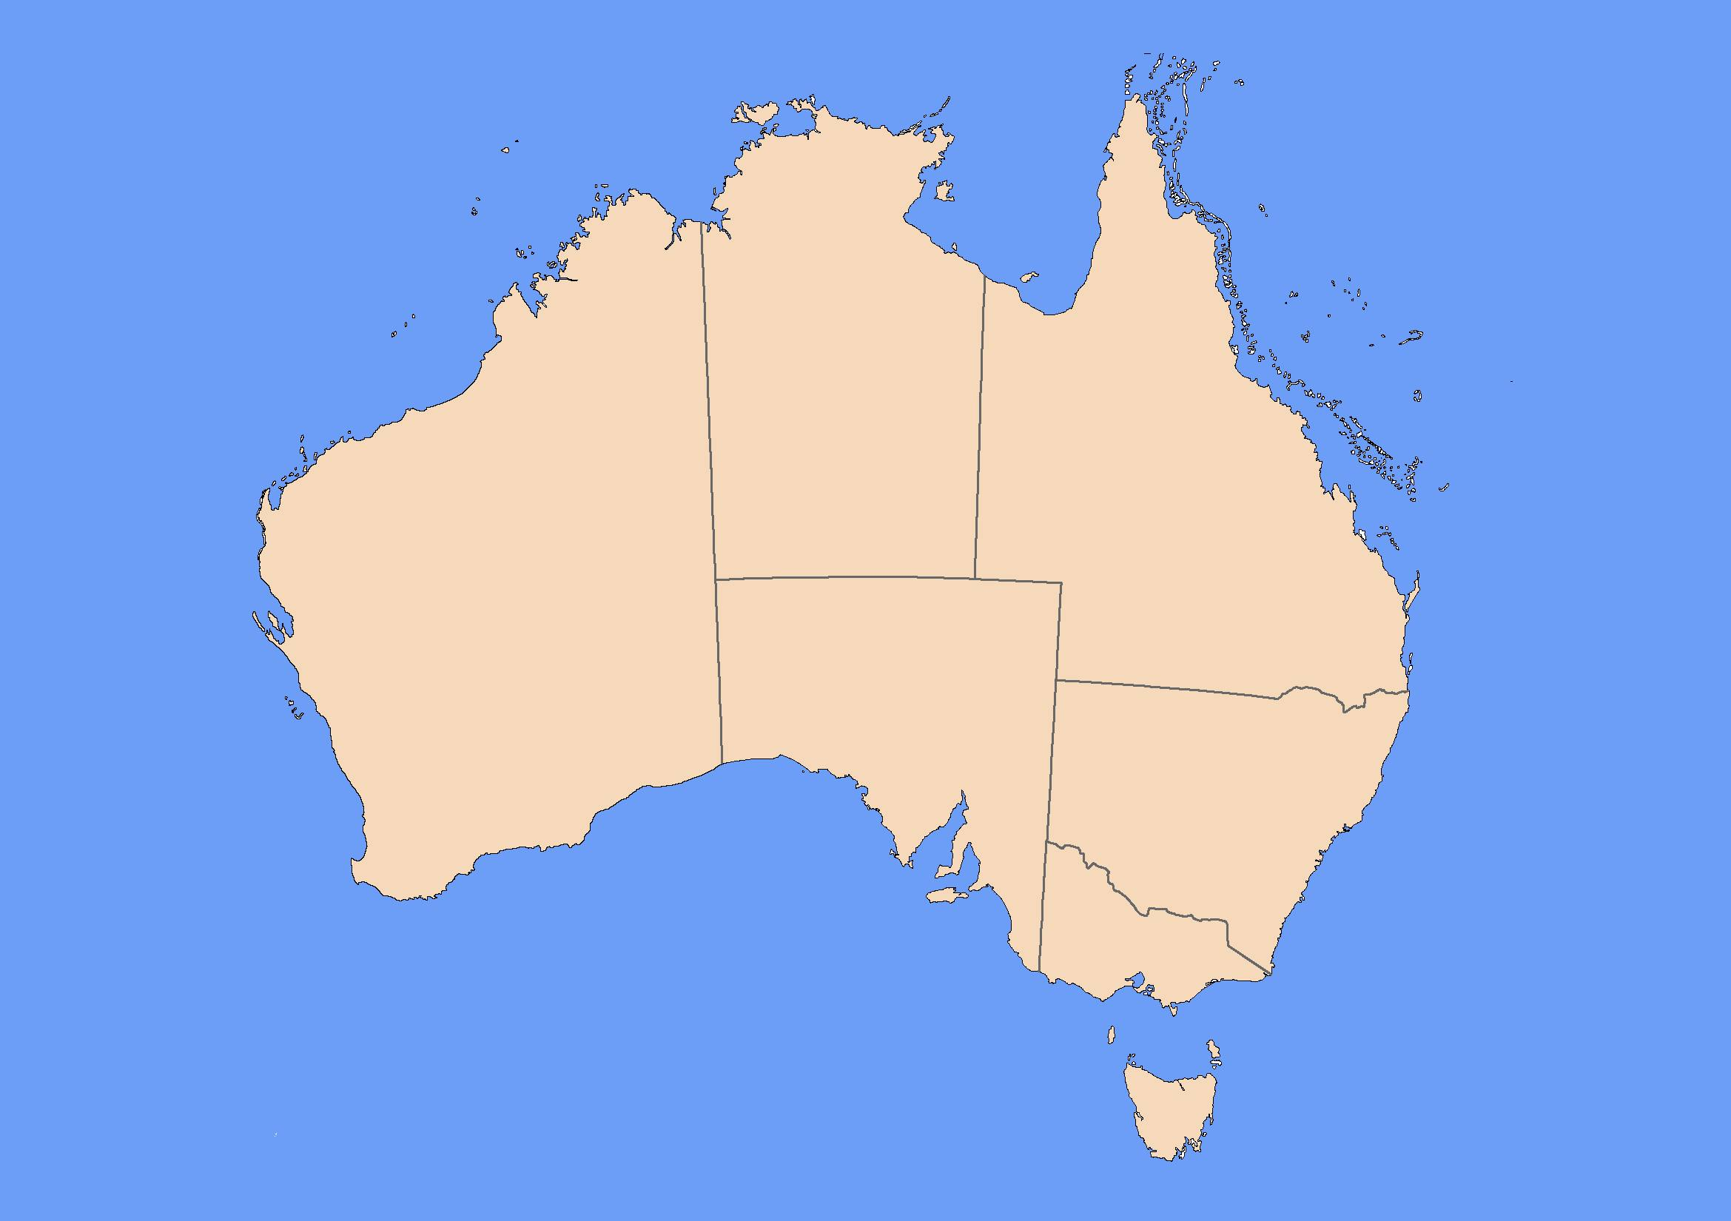
Australia is one of the six
most biodiverse countries in the world.
More than 80% of our mammals,
reptiles and flowering plants are found only on this continent.
Because of habitat destruction, land clearing, feral animals and invasive weeds we have the highest mammal extinction rate in the world.

Slide 3
Queensland is home to
70% of Australia’s native mammals,
70% of our native birds,
over 50% of our native reptiles
and
more than 50% of our native frogs.

Slide 4
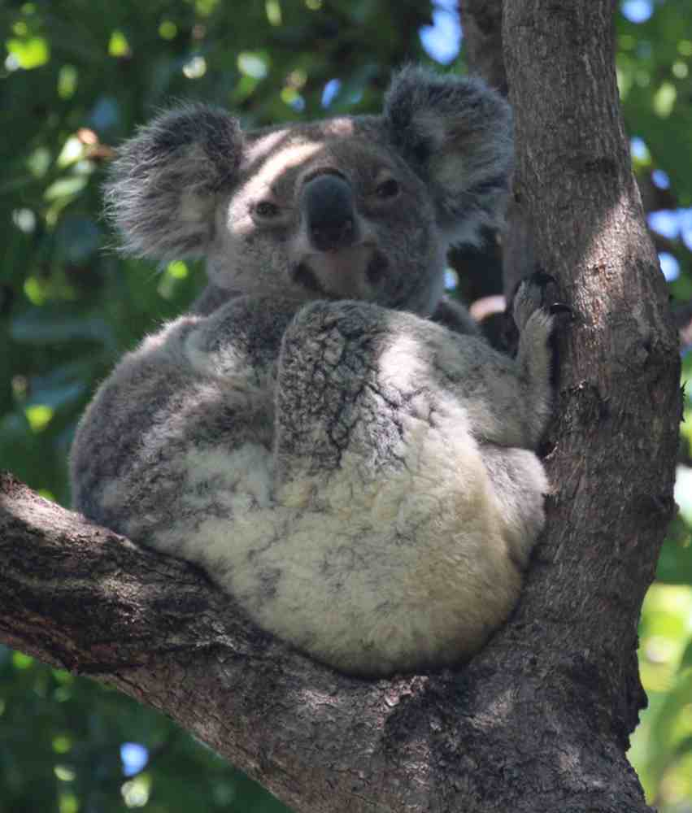
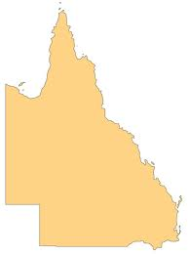
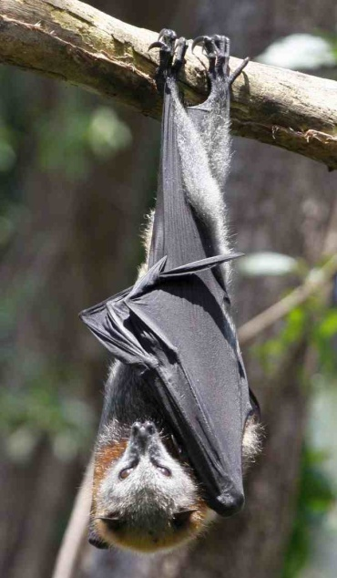
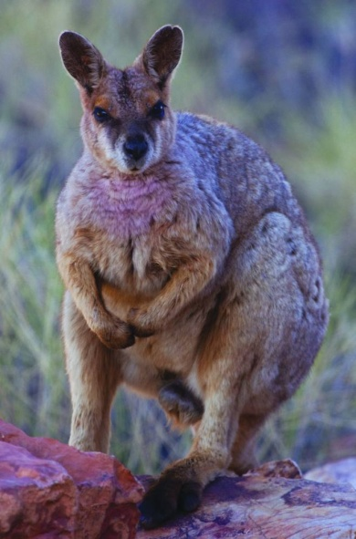
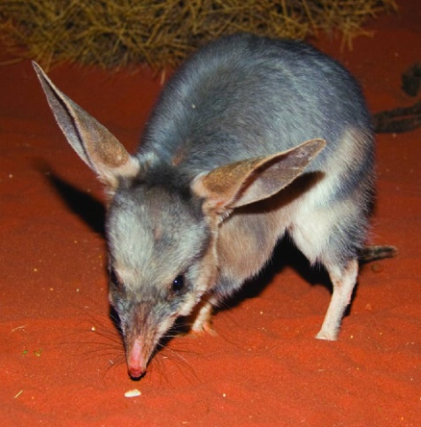
12 of our original
238 mammals are extinct.
45 of our 226 remaining mammals
are threatened.

Slide 5
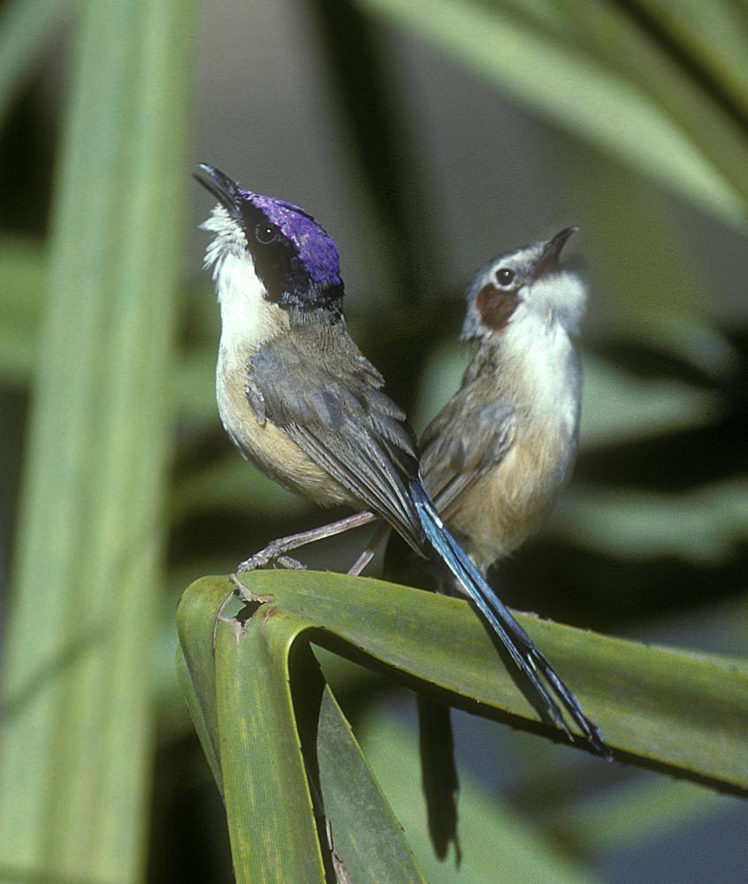
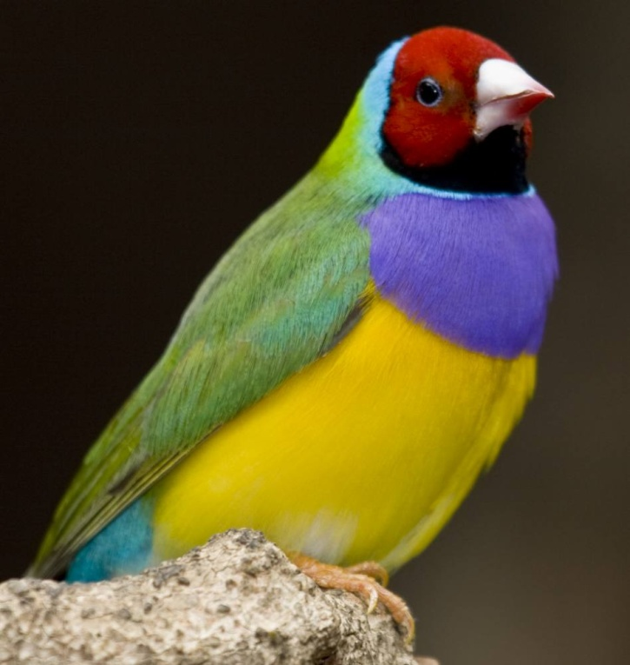
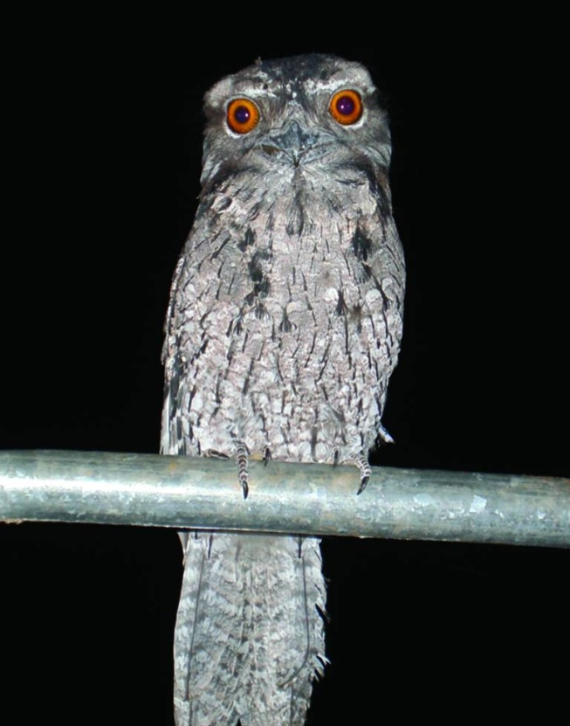
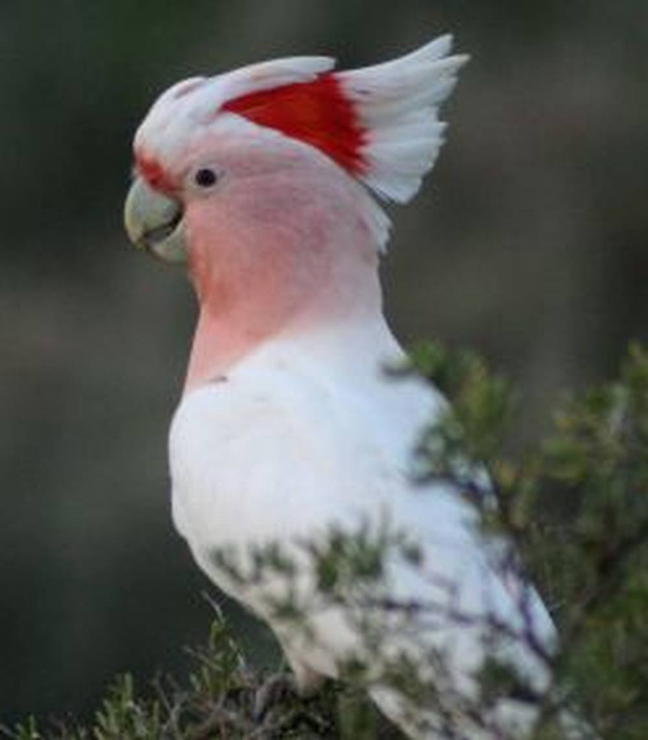
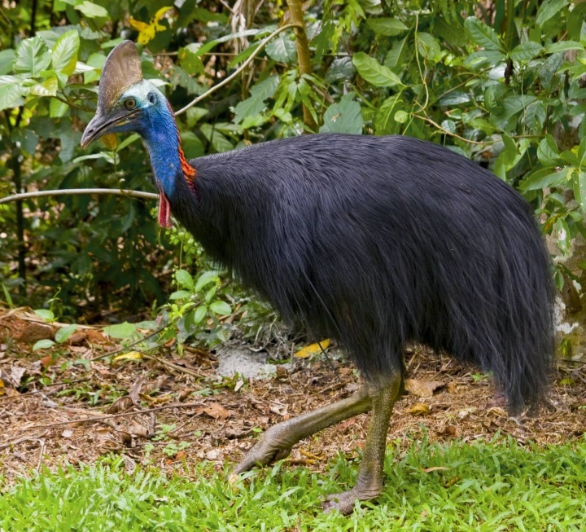
There are 630 species of birds in Queensland
49 are threatened.

Slide 6
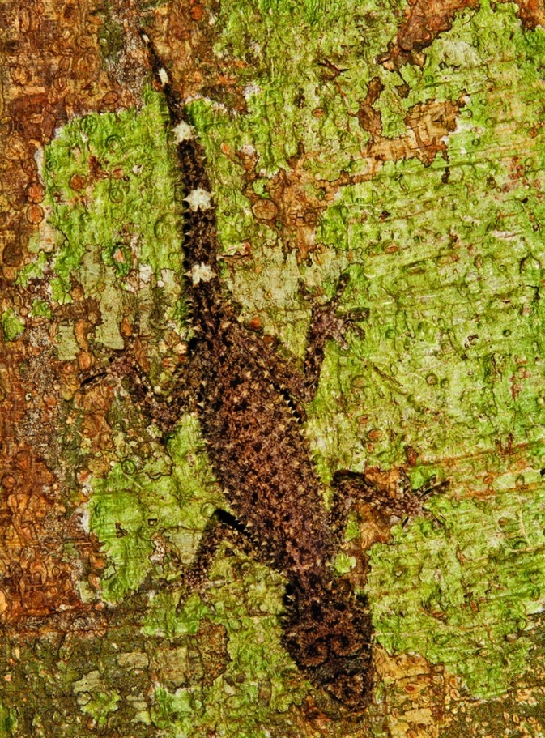
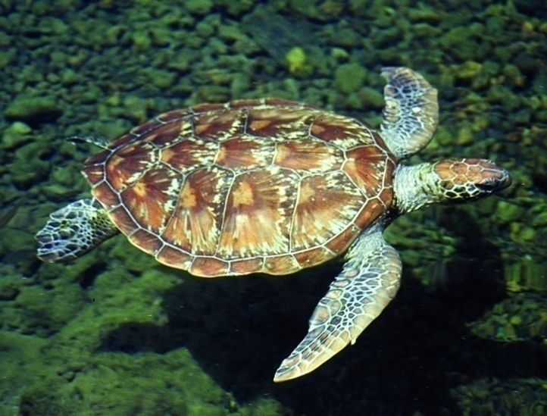
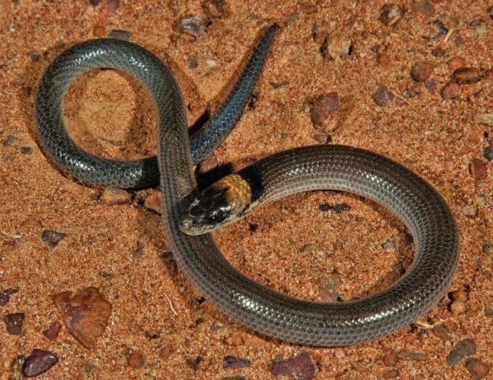
There are 485 native reptile species in Queensland.
36 are threatened.

Slide 7
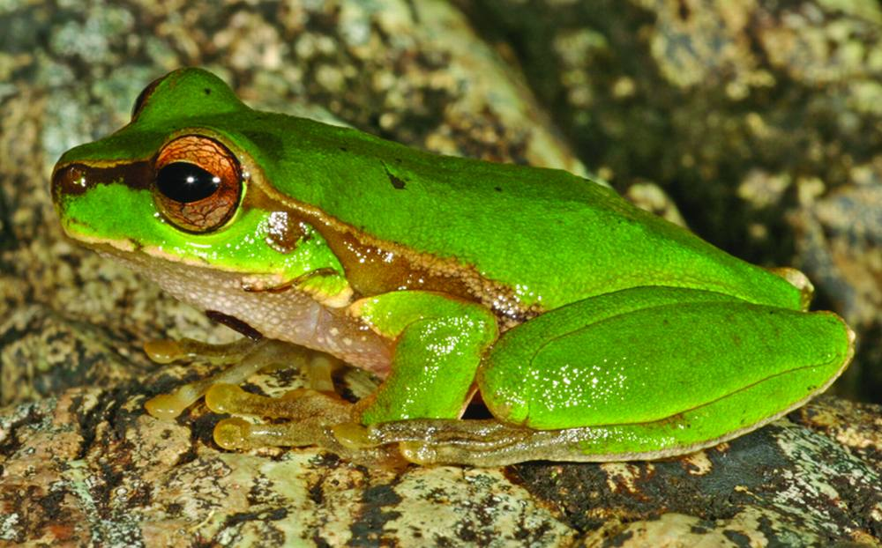
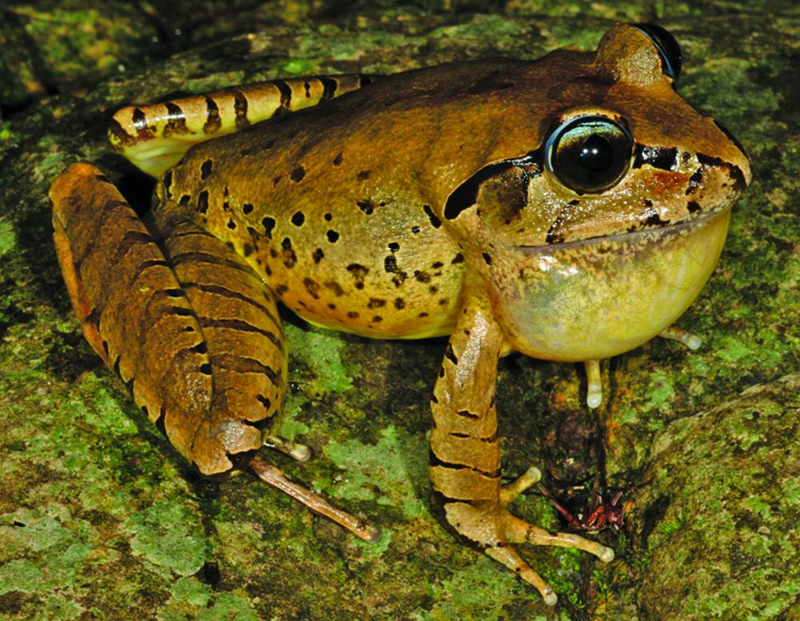
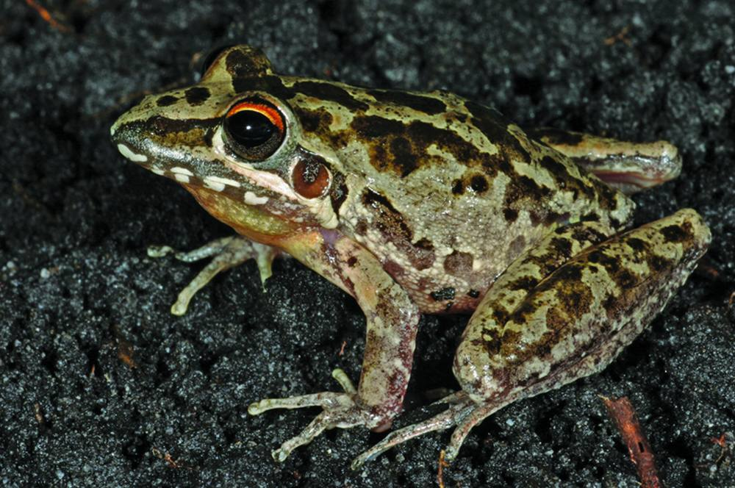
30 are threatened.
127 frog species call Queensland home.

Slide 8
The less charismatic, yet just as ecologically vital threatened animals in Queensland include...

Slide 9
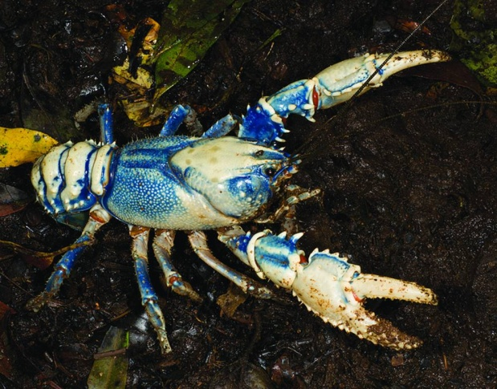
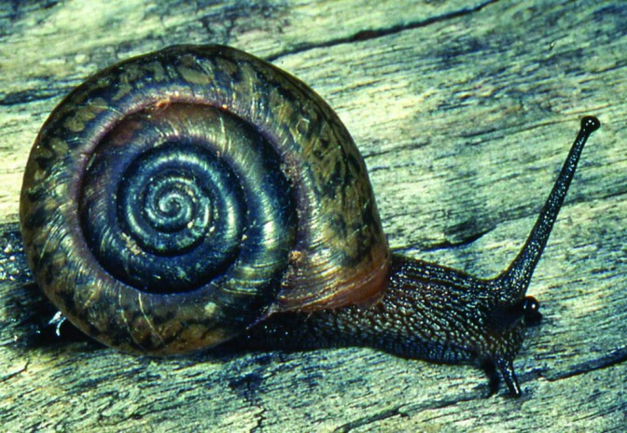
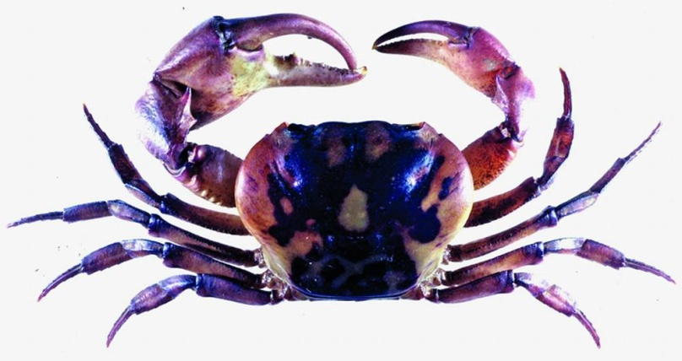
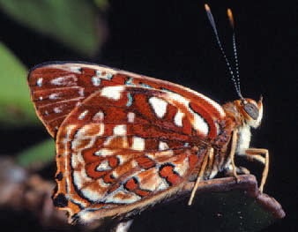
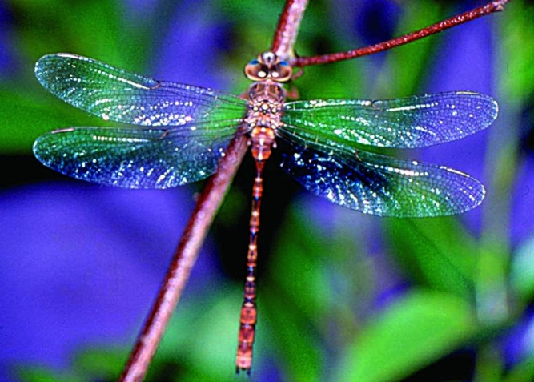
26 invertebrates

Slide 10
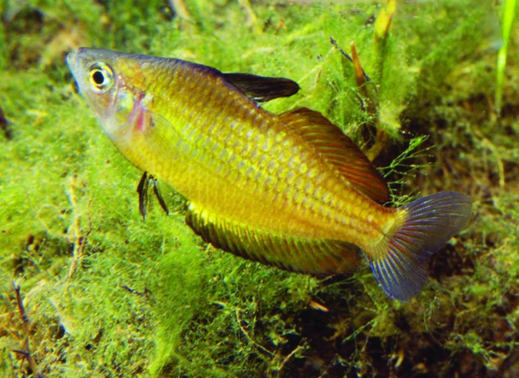
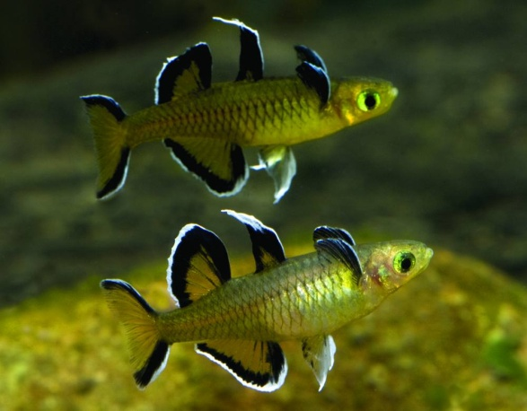
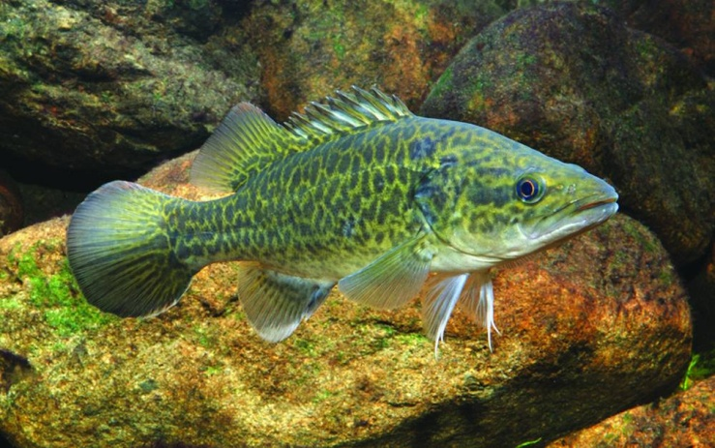
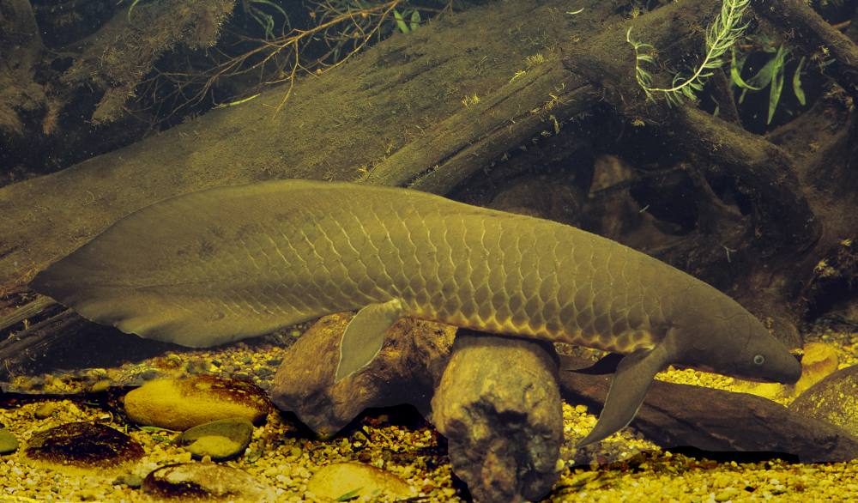
and 11 bony fishes.
including the amazing Lungfish
A ‘living fossil’ which has been around for 200 million years and is the longest surviving vertebrate species on this planet.
Will ours be the last generation to see it in the wild?

Slide 11
Why so many threatened species?
#1 REASON?
Habitat loss due to
land clearing
and
land fragmentation

Slide 12
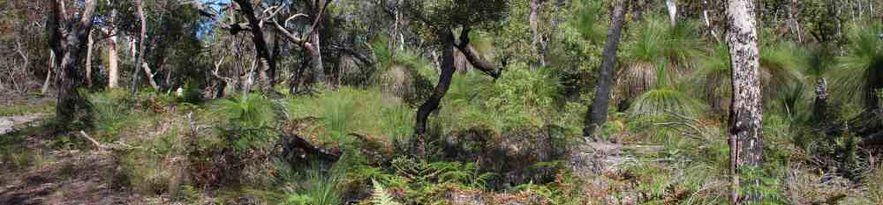
Queensland has the highest biodiversity in Australia.
But the least amount
of protected land.

Slide 13
65% of Queensland is leasehold and the
current government is looking for buyers.
82% of Queensland is under
exploration permits for
coal, oil, gas, metals and/or minerals.
Only 117,717 km², or 6.80%,
of Queensland’s total area, is ‘protected’.

Slide 14
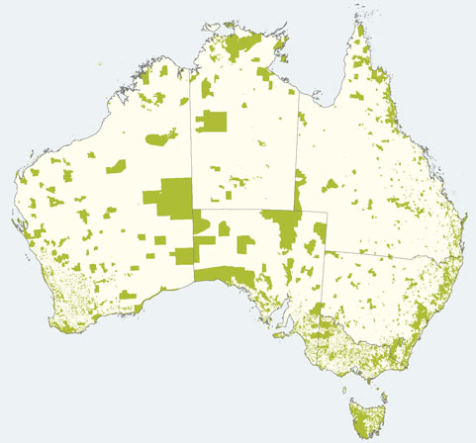
Queensland, Australia’s 2nd largest state, is
1,730,648 km².
Only 115,051 km², or 6.65% is in the National Reserve System.
That’s 11.14% of the NRS’s total area.

Slide 15
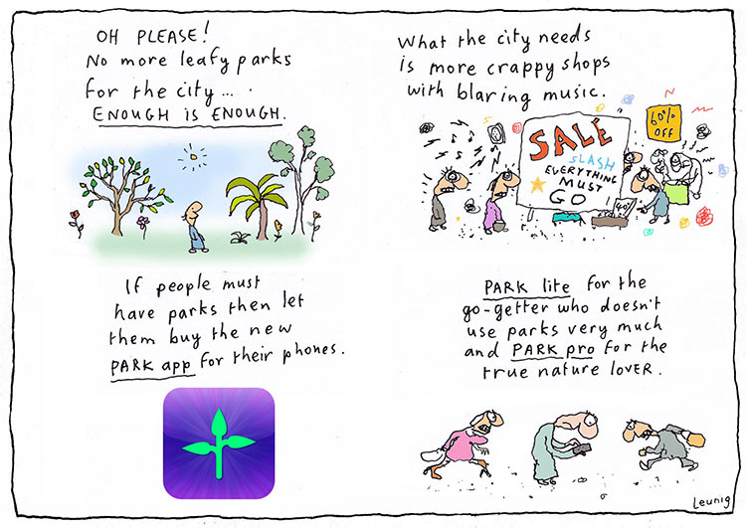
Only 4.8% of Queensland is in National Park.
The national average is 9%.

Slide 16
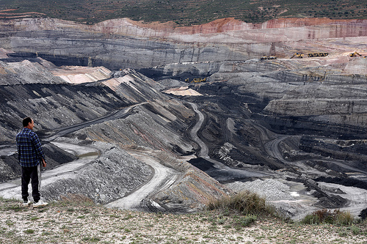
No coal mine has EVER been stopped on environmental grounds in Queensland.

Slide 17
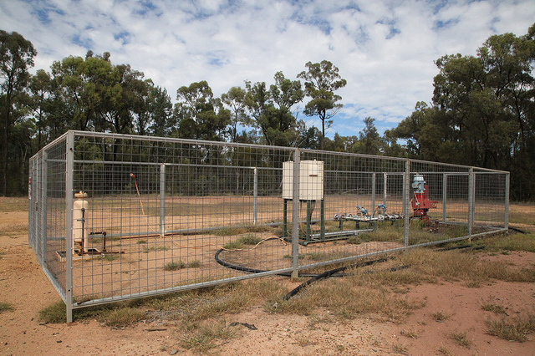
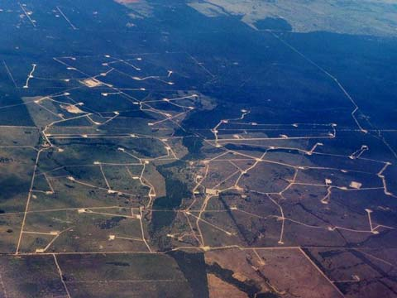
No land clearing limit exists for coal mining or CSG.
1 hectare per CSG well is
currently being cleared.
There are 45,000+ wells
planned for Queensland.
These figures do not include the land
to be cleared for roads, railways and pipelines.

Slide 18
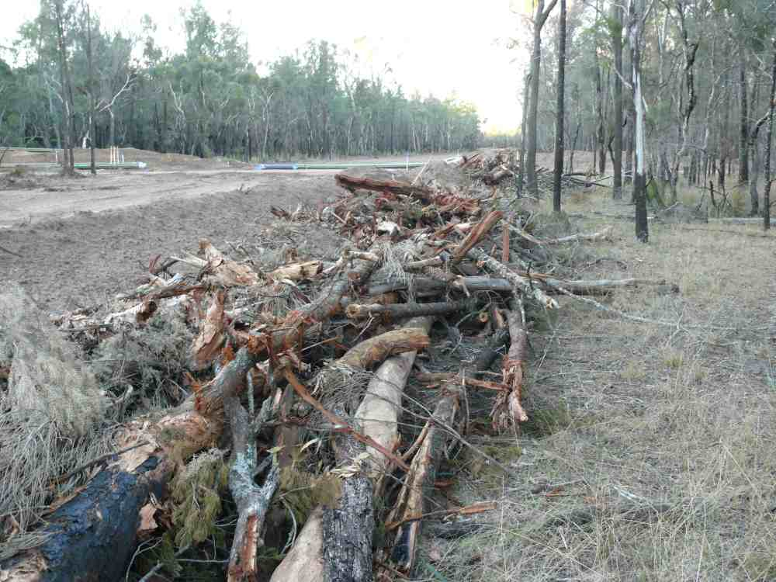
What are the implications of this for every well pad connecting across the landscape?

Slide 19
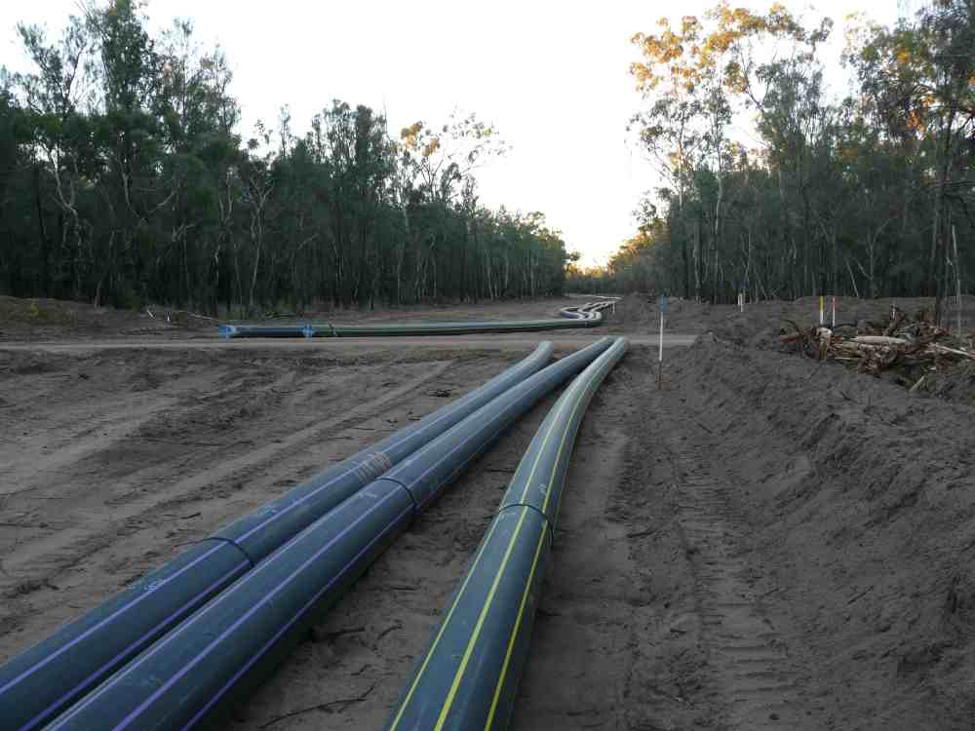
Premier Newman made a pre-election commitment to retain the current level of statutory vegetation protection.
BUT the proposed changes will open up hundreds of thousands of hectares of bushland for clearing.

Slide 20
Why do extractive interests
always trump the environment?

Slide 21
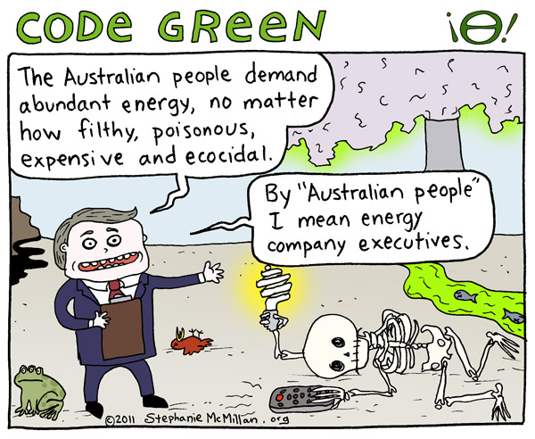

Slide 22
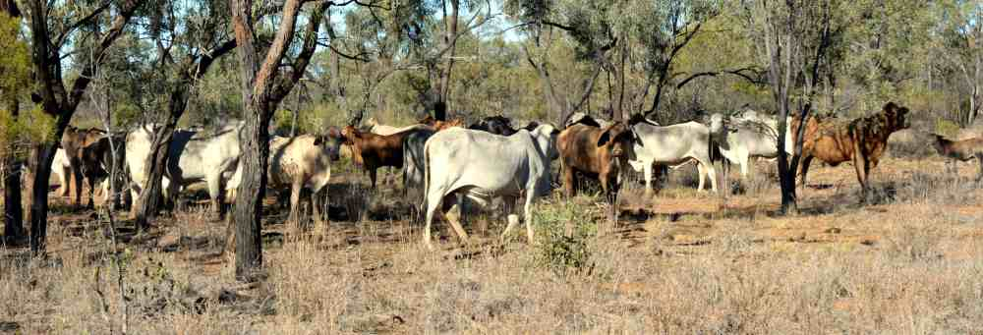
The current Queensland government
has been breaking Nature Conservation Act laws for which we fought long and hard.
It is now attempting to repeal those laws or change them to their advantage.

Slide 23
In a post-election email from the National Parks Minister to the National Parks Association Queensland, he assured NPAQ that there would be no grazing in National Parks.
Today, however there are 440,000 hectares of
National Parks and reserves opened for grazing.
2,000,000 hectares of forest protected under the
Qld Forest Agreement have been released for logging.
Clearing permits can now be issued for 790,000 hectares
of High Conservation Value regrowth.
A total of 4,530,000 hectares of previously protected areas are right now vulnerable to degradation.

Slide 24
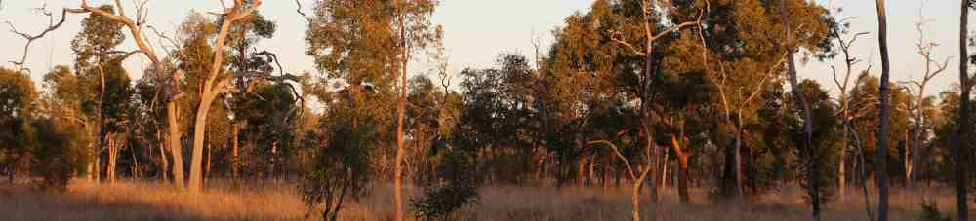
The Protect the Bush Alliance was established in
June 2012 to give a strong voice of reason to
conservation organisations, businesses and individuals concerned with the impacts of mining and other potentially harmful activities in
Areas of High Conservation Value.

Slide 25
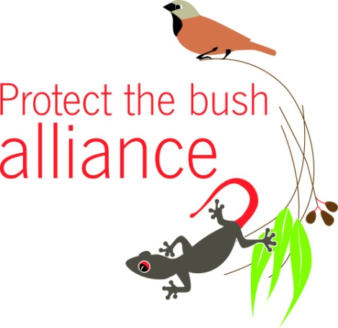
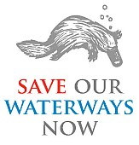
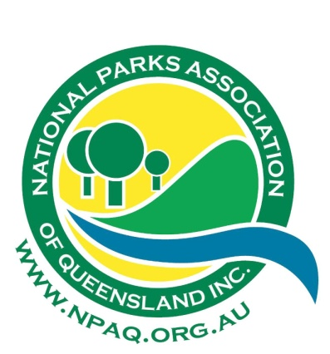
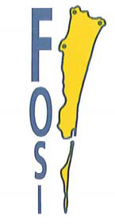


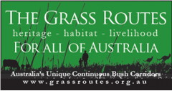
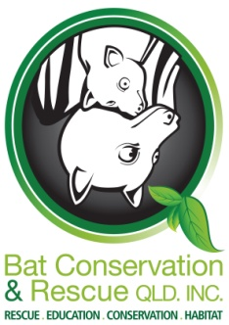

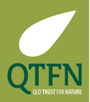

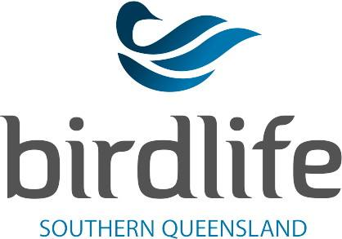
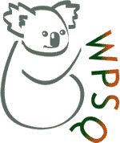

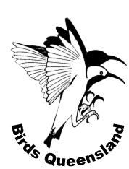

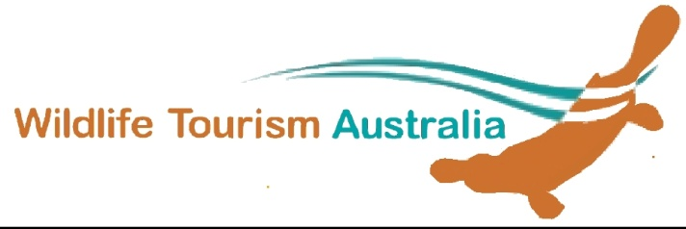
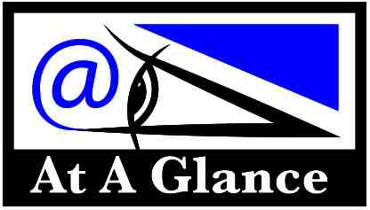


Slide 26


The primary goal of the
Protect the Bush Alliance
is to protect areas of high conservation value
in Queensland from inappropriate activities.

Slide 27

HOW DO WE DO THIS?
Conduct biodiversity surveys in
Areas of High Conservation Value that are at risk.
Lobby to increase the participation of
local NGOs in the Environmental Impact Statement decision making process.
Examine and respond to proposed changes
to environmental legislation.
Lobby to increase the number of
(really) protected areas.
Mount social network campaigns.

Slide 28

SURVEYS
Baseline surveys of Queensland’s High Conservation Value areas are few and far between, however, they are vital for conducting effective land management.
PTBA volunteers donate their time,
expertise and equipment to conduct
flora and fauna surveys.
The purpose of these surveys is to identify
new and/or threatened species and
vegetation communities...
in the hopes of influencing the governments that claim to only make decisions based
on sound science.

Slide 29


Survey criteria
A demonstrated interest by the affected landowner in preserving the conservation values of their property.
Existing protected areas, or other public lands, such as state forests that are under
threat from mining or currently being mined.

Slide 30

We hope that the results of these surveys will:
1) build sound scientific arguments to secure
permanent protection of these areas
2) trigger Federal involvement in
the protection of remnant habitat through
the application of the EPBC Act 1992
3) provide valuable information to landowners
so they can make informed decisions about
the management of remnant habitat.

Slide 31

PTBA also assesses the impacts of inappropriate activities in national parks and
areas of high conservation value.
For example, cattle in Moorrinya National Park.

Slide 32

Approximately 20 hectares were cleared to build this fence at Blackbraes National Park, the role of which is to keep cattle IN the park, at the Queensland taxpayer’s expense…

Slide 33

How can you help?
Join (for free!)
www.ptba.org.au/membership
Like us on Facebook.
Follow us on Twitter: @ProtectTheBush
Contribute your physical or financial
support to our survey work.
Contacts:
Coordinator, Lee K Curtis – coordinator@ptba.org.au
Survey Coordinator, Tanya Pritchard – surveys@ptba.org.au

