Slide 1
Reframing the economy, reframing ourselves: ethical interdependence in a climate changing world
Jenny Cameron, University of Newcastle (and Community Economies Collective)

Slide 2
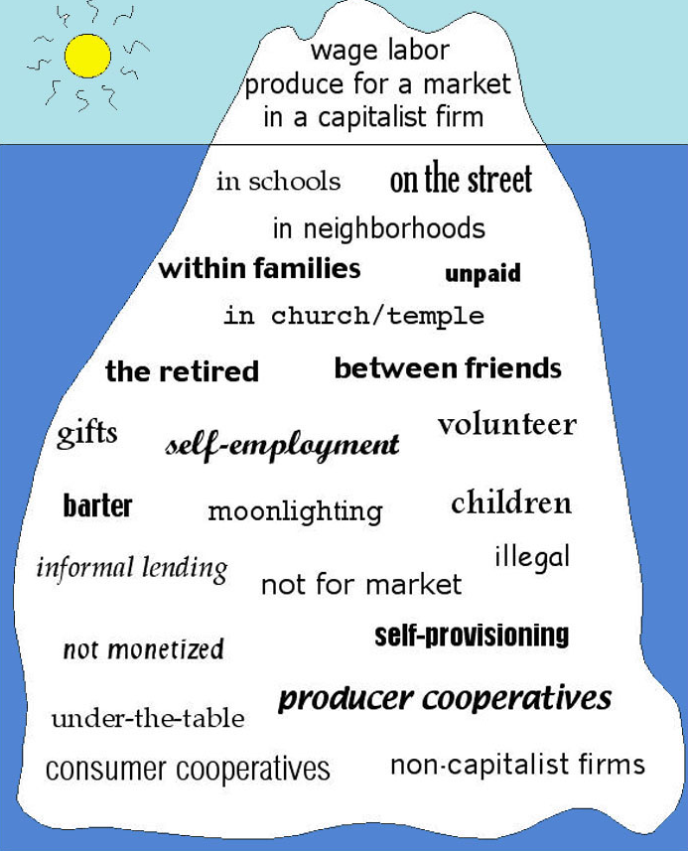

Slide 3
(Ironmonger, 1996)

Slide 4
The lives of these farmers are “undeniably complex in ways that are invisible to mainstream economic analysis.”
(Wright, 2010, 308)

Slide 5
If the economy is diverse, and if we occupy diverse economic identities, then what sorts of actions might we take to create an economy for our times--and the future?

Slide 6
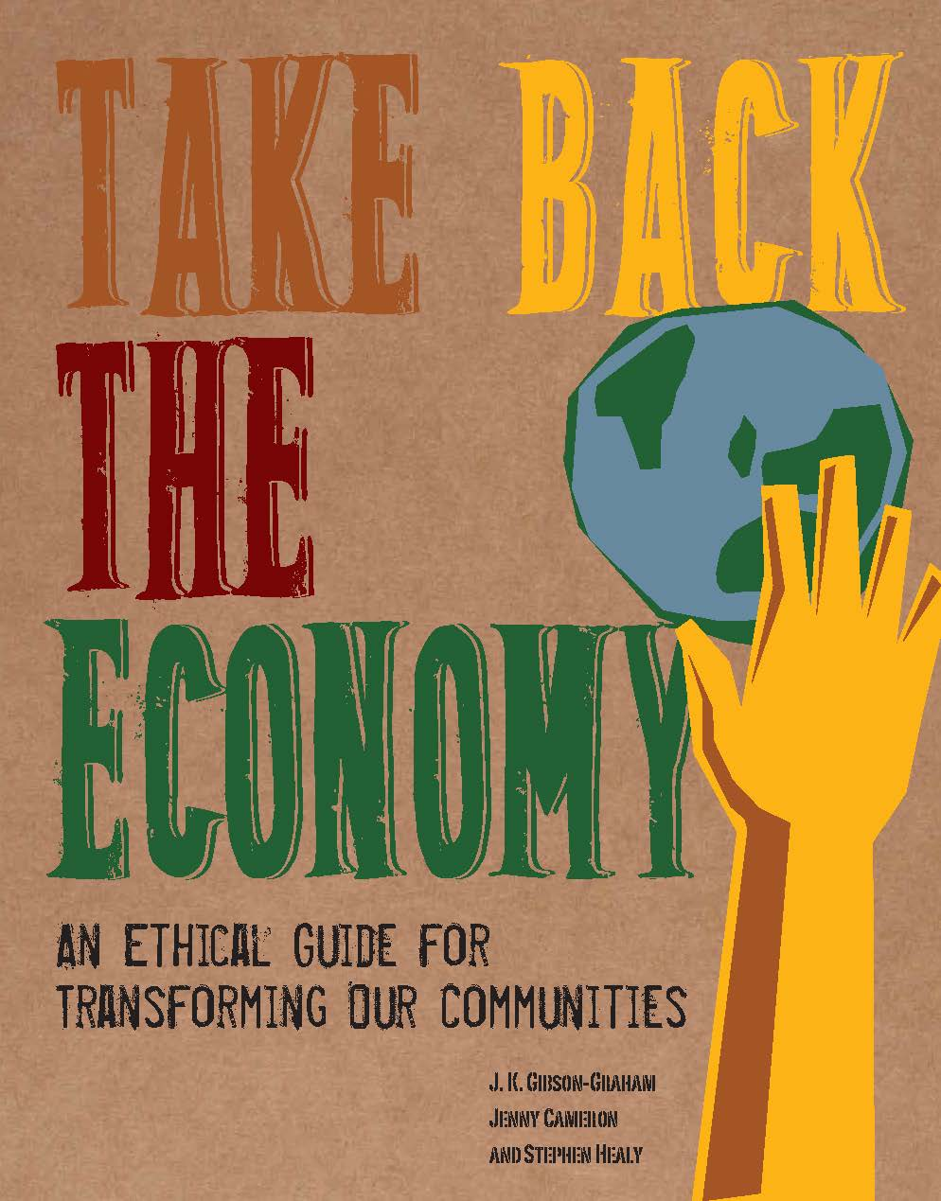

Slide 7
Usual economic priority | Reframed ethical concern
Working for higher wages | Surviving well via a range of labour practices
Running businesses to maximise profit | Distributing surplus to enrich social and environmental health
Paying less for more ‘stuff’ | Encountering others and taking into account their wellbeing
Generating higher returns on property | Commoning all forms of property
Investing for greater private return | Investing for future generations

Slide 8
Usual economic priority | Reframed ethical concern
Working for higher wages | Surviving well via a range of labour practices
Running businesses to maximise profit | Distributing surplus to enrich social and environmental health
Paying less for more ‘stuff’ | Encountering others and taking into account their wellbeing
Generating higher returns on property | Commoning all forms of property
Investing for greater private return | Investing for future generations

Slide 9
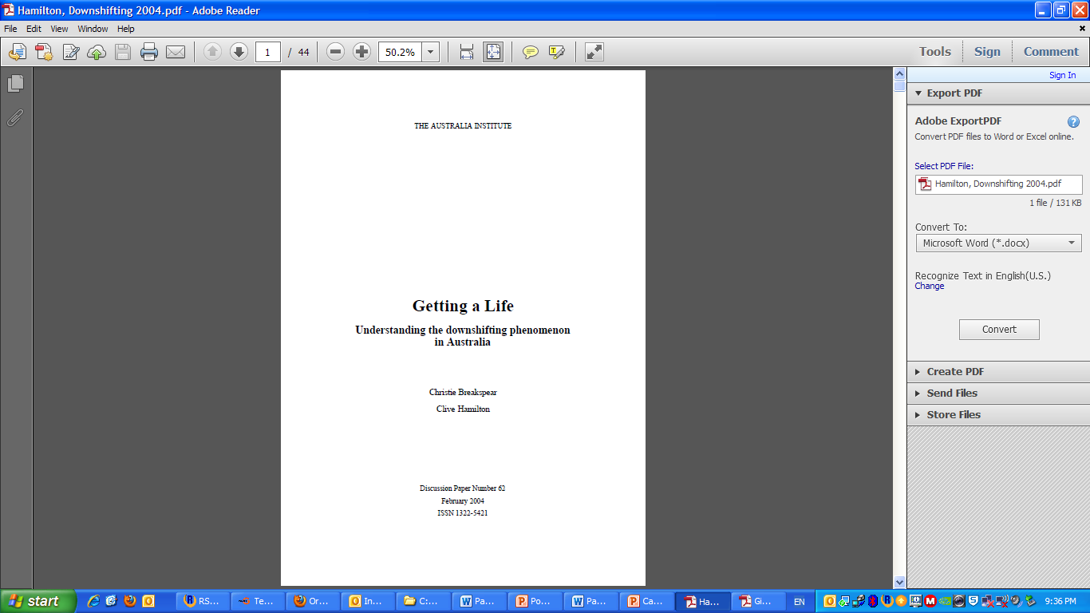
“While their incomes
may have shifted down,
everything else has
shifted up.” (p. 2)

Slide 10
Wellbeing:
Material (resources to meet our basic needs)
Occupational (whether paid or purposeful work)
Social
Community
Physical

Slide 11
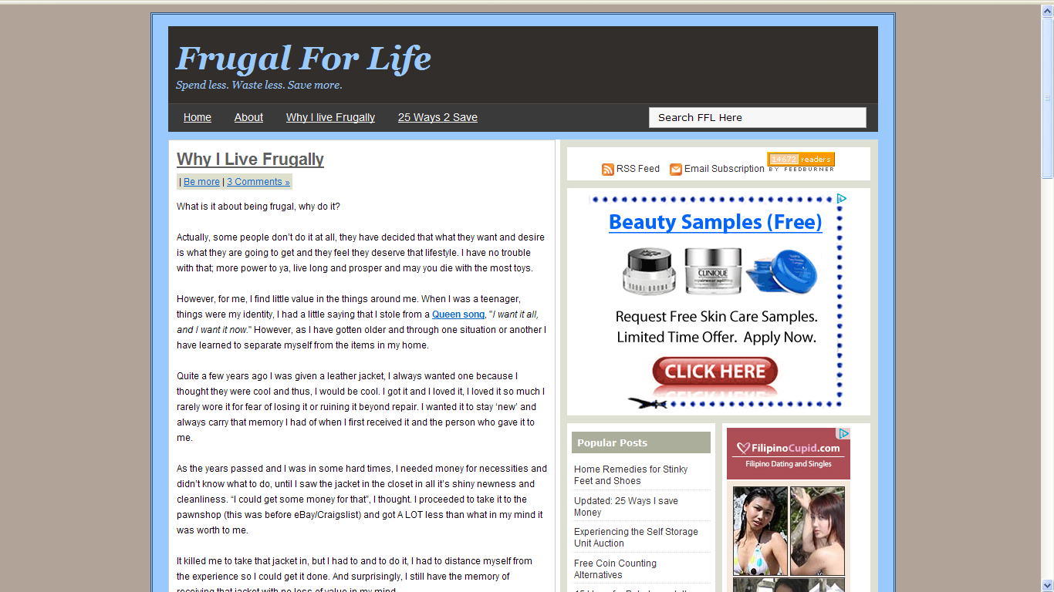
“Less is more in my world: less to worry about, less to find
space for, less to keep up.”
Dawn, Frugal for Life

Slide 12
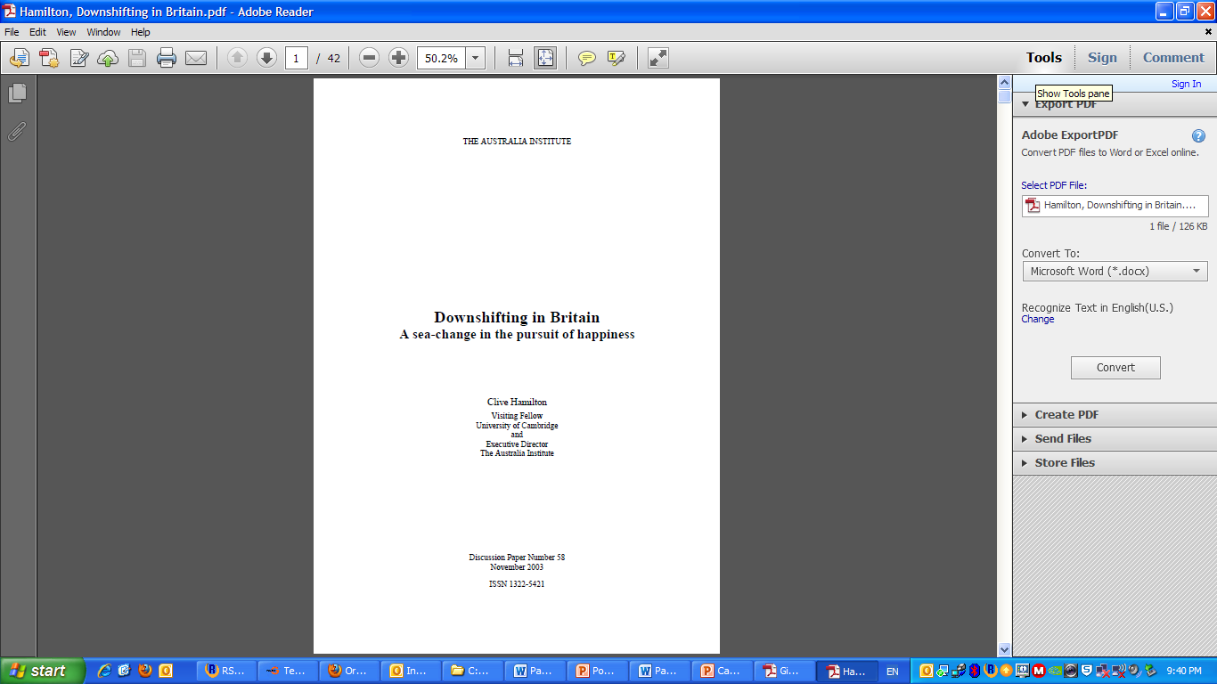
25 per cent of semiskilled
manual workers and apprentices downshifted between 1993 and
2003, as did 27 per cent of executives, managers and professionals (p. 15)

Slide 13

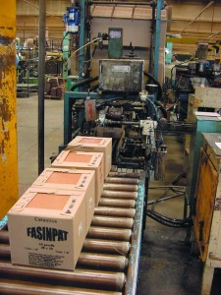
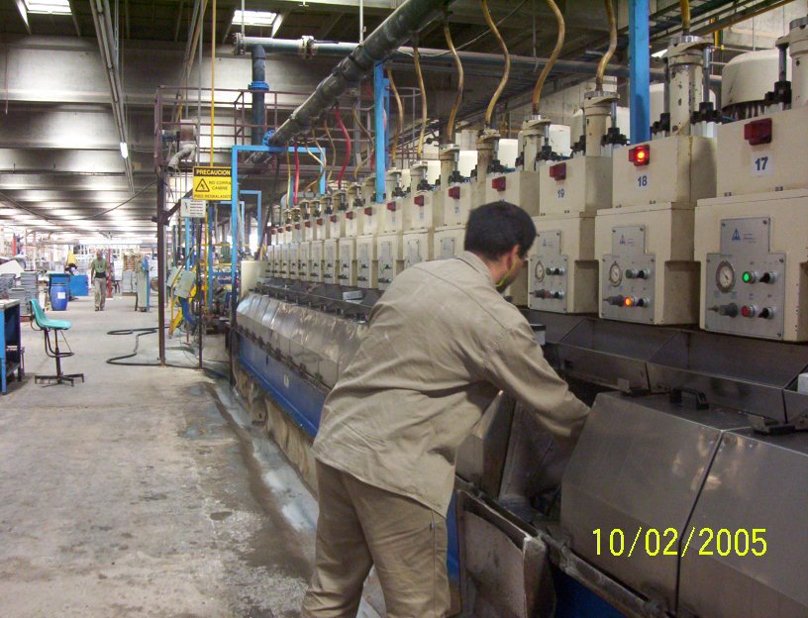

Slide 14
“Now that we’ve increased production, improving quality and production output will become easier. Part of the profits are being put toward creating new jobs,
improving machinery, and buying replacements for the machines. The other part of the profits generated are being put toward society.”
Francisco Murillo, FaSinPat worker

Slide 15
“We always said the factory isn’t ours. We are using it, but it belongs to the community.”
Reinaldo Gimenéz, FaSinPat worker
“The profits shouldn’t go to us . . . but to the community.”
Carlos Acuña, FaSinPat worker

Slide 16
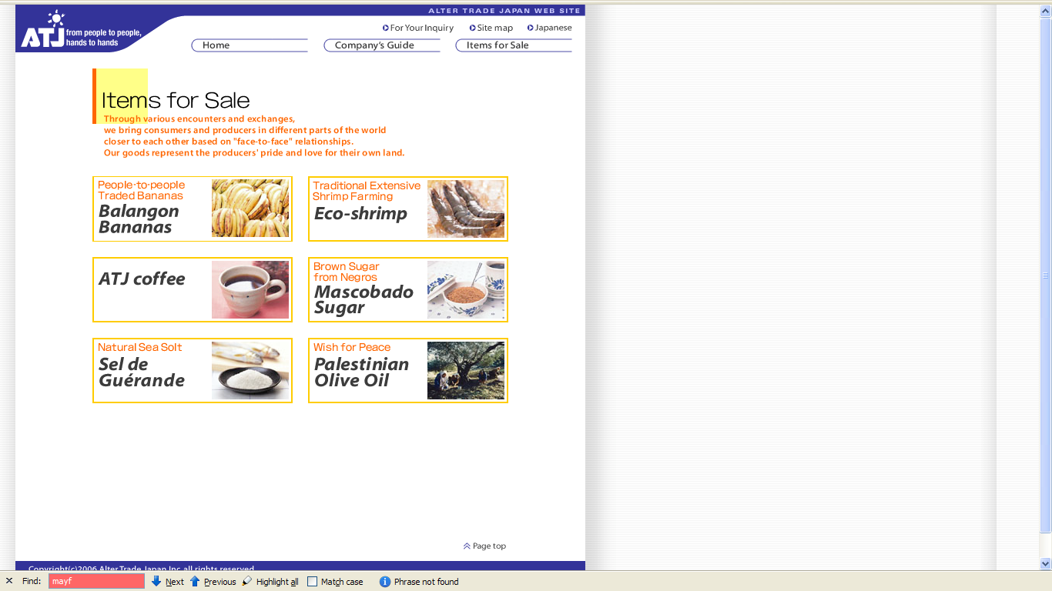

Slide 17
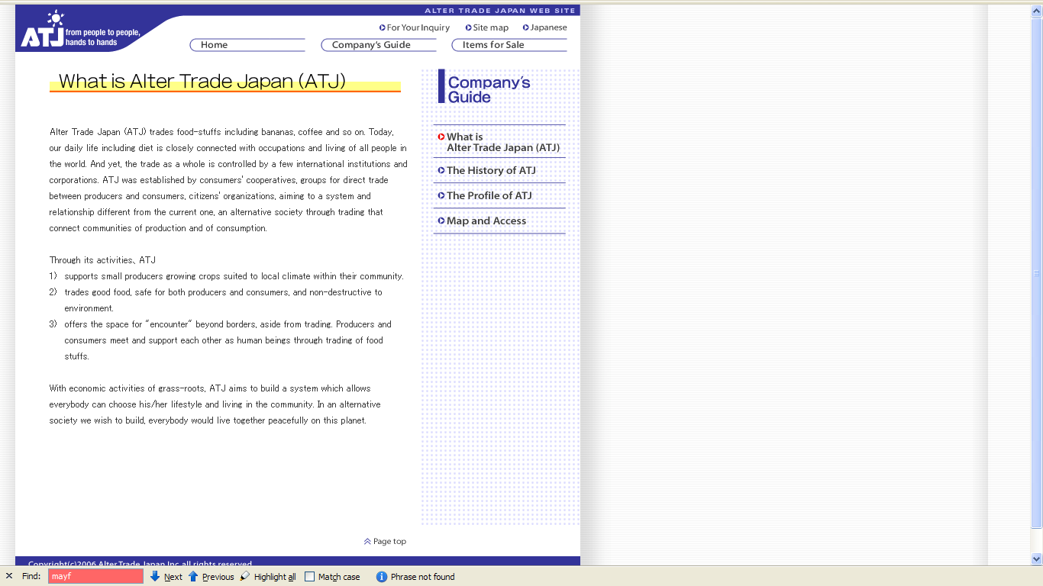

Slide 18
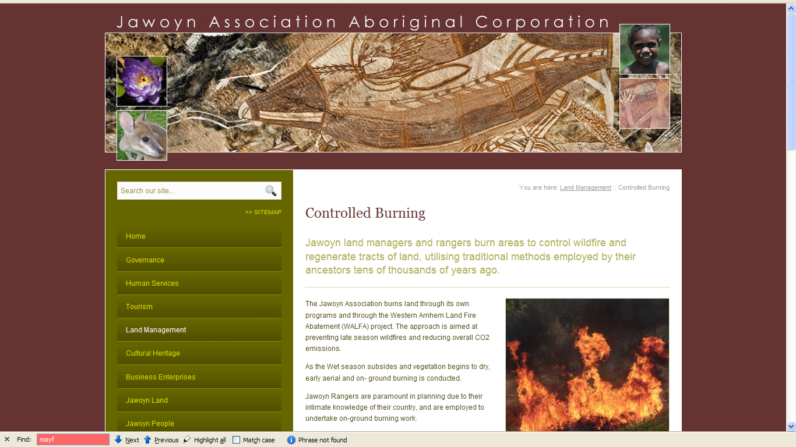

Slide 19
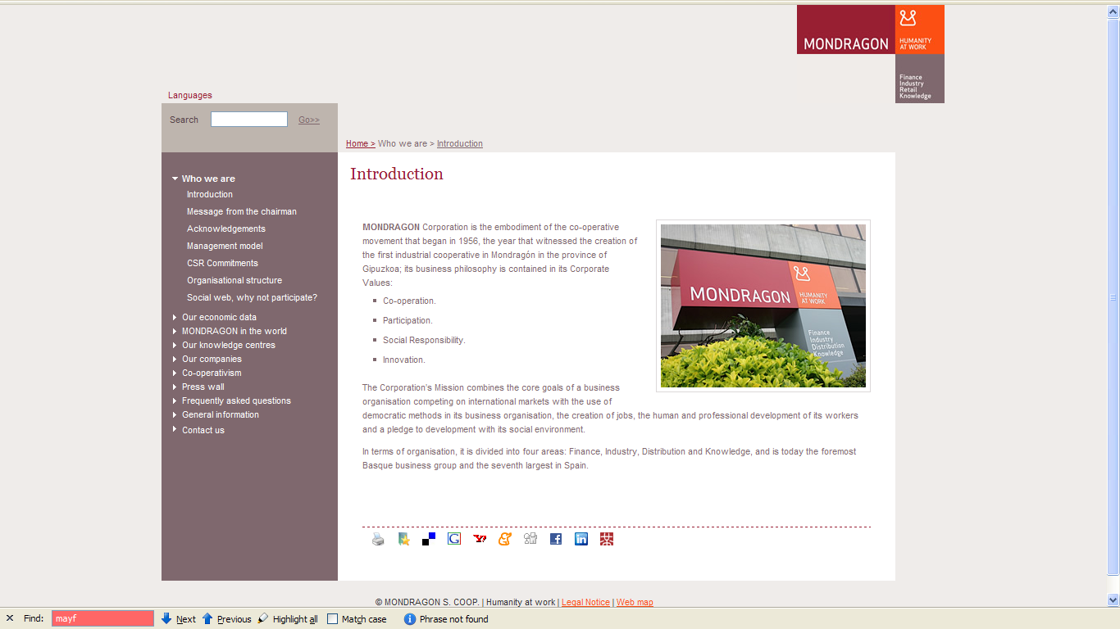

Slide 20
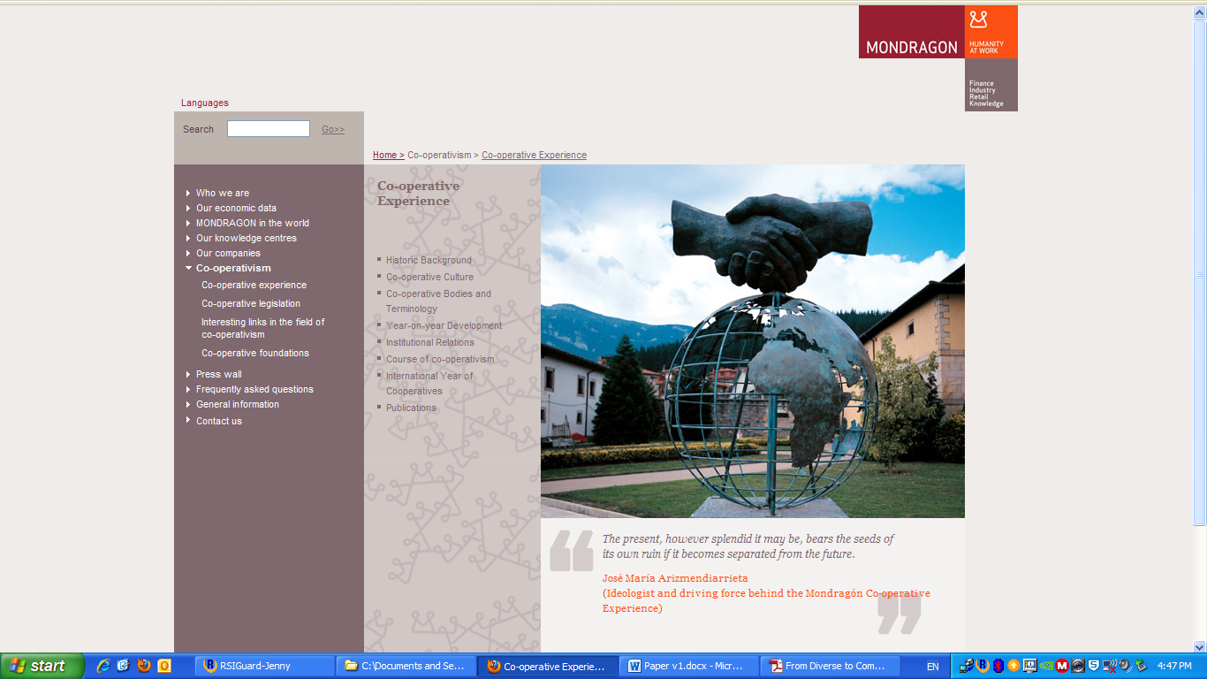

Slide 21
The Brazilian government is required “to expropriate for the purpose of agrarian reform, rural property that is not performing its social function”
(Article 184, Brazilian Constitution)

Slide 22
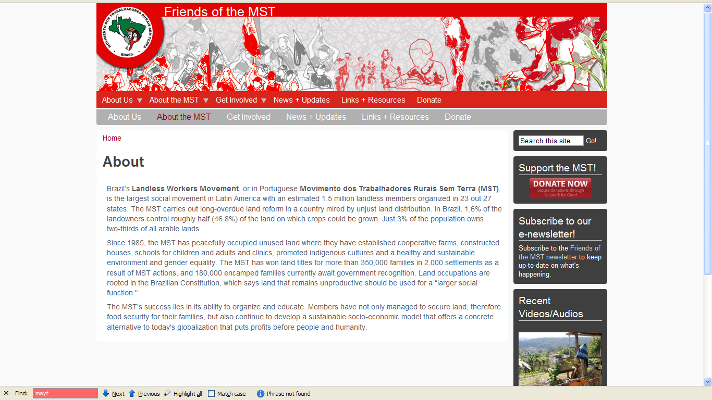

Slide 23
Assemblages are “ad hoc groupings of diverse elements” and “living, throbbing confederations.”
(Jane Bennett, 2010, 23)

Slide 24
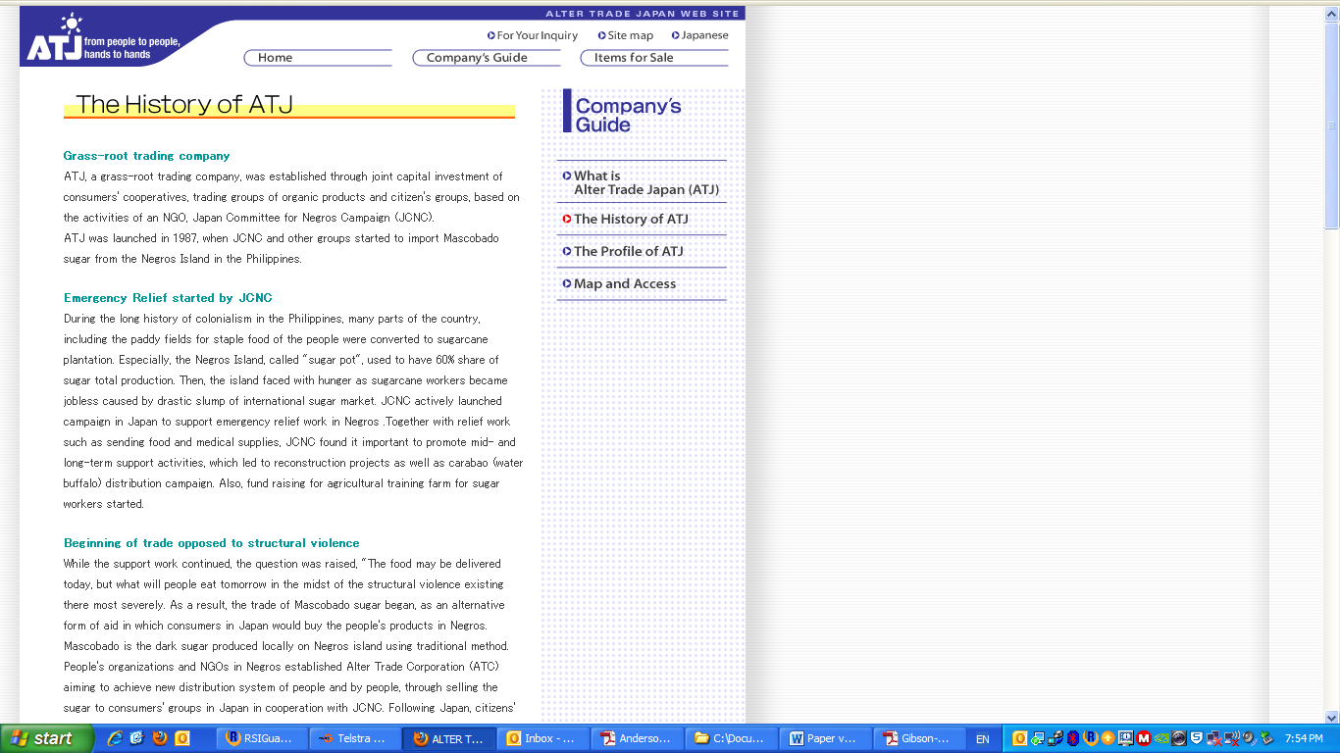
“The food may be delivered today, but what will people eat tomorrow?”

Slide 25
What economic systems do we need
to live within our limits?
Living in times when we might draw on our capacity to be in relation with others
Enacting this capacity through economic assemblages

