Slide 1
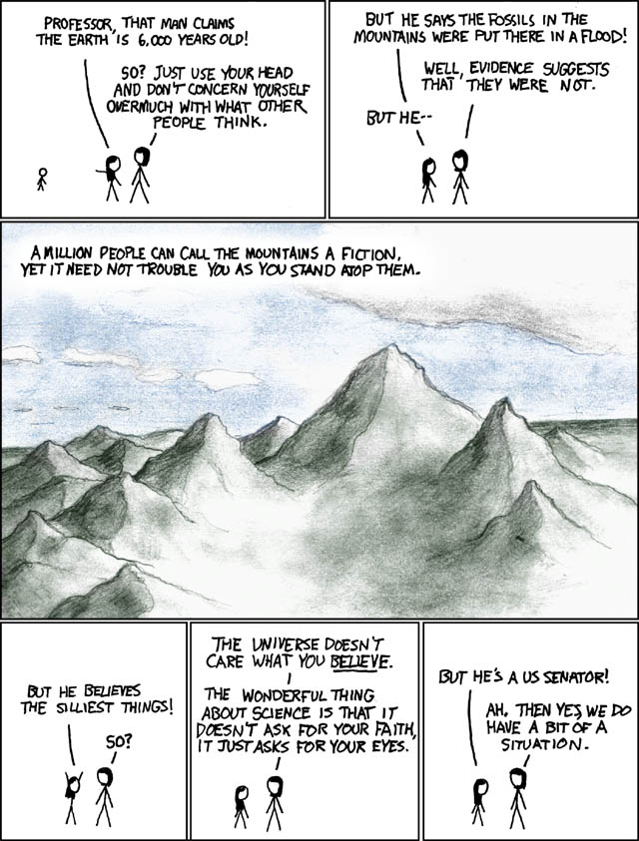

Slide 2
Understanding the role of science in defining ecological limits
Edward Morgan
PhD Candidate
Urban Research Program
Griffith University
As a result of the new control over the environment which scientific knowledge has conferred, a new philosophy is growing up, involving a changed conception of man’s place in the universe – Bertrand Russell, 1952

Slide 3
Science and Nature
We are consuming the planets resources faster than they can be replaced.
We have a human-centred approach to nature.
Scientific knowledge has allowed:
  Access to new resources
  ‘Better’ use of resources
Science has promoted the sense of human mastery over nature.
But science has given us an (incomplete) understanding of nature (and the problem).
Notes:
We know what the problem is: we are unsustainable. This is probably not unique, but has been exacerbated by science (in the form of applications). However, science also gives us understanding of nature and the problems we face. Albeit incomplete understanding.
An Earth Law/jurisprudence approach aims to redefine our relationship with nature – we are a part of it.

Slide 4
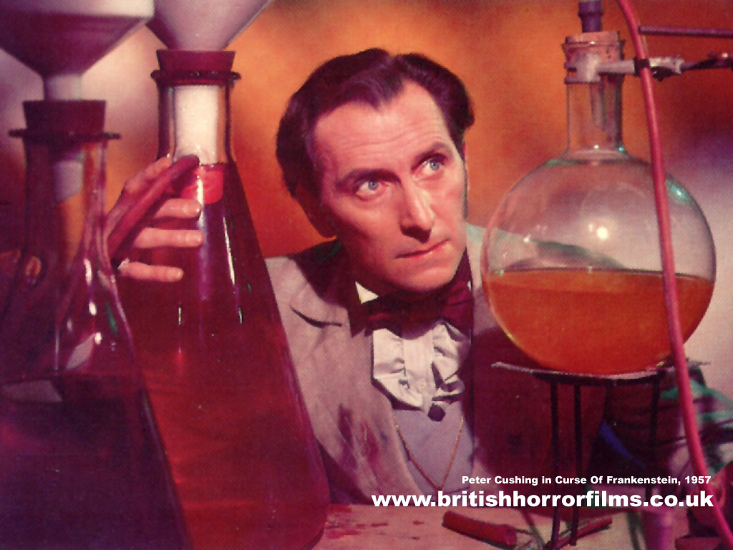
Science and Ecological Limits
The idea of ecological limits is to define when use of nature is causing (too much) harm.
We would like to define some point at which we’ve gone too far or done too much damage.
  E.g. irreversible change, change that limits future use or change that shifts nature to a different state.
Defining these needs knowledge of nature and its processes.
Call in the boffins!
Sadly, it isn’t so simple…

Slide 5
Science and Ecological Limits
Unfortunately:
  Our understanding is incomplete
  Nature is highly variable and complex
  We’ve only got one lab to work in
Defining limits is not a science-only problem.
Social values are fundamental.
But (most of us) want to use science to inform the choice of limts.
(Also, this might imply a human-centred approach to nature.)
Notes:
It is a issue of risk and consequently a social issue. Science can not tell us unequivocally what is right and wrong. E.g. climate change: we know this will have impacts, but whether those impacts are good or bad is a choice for us to make. Or pollution: science can tell us a substance is increasing or decreasing in concentration (with a lot of precision), it can suggest potential impacts of a substance (with less precision), the idea of whether this is good or bad is not a science question.

Slide 6
Science and Policy
The problems of using science in policy are well known
Research into the science-policy interface highlights:
  Communication, uncertainty, unrealistic expectations, scientisation and politicisation
Potential solutions:
  Better communication, ‘better’ science (more relevant, ‘post-normal’, civic), integration, boundary organisations and knowledge brokers
However, no one solution seems to provide the magic bullet.
Notes:
This is where my research comes in. I look at the use of science in policy-making, which is one aspect of a wider issue: the use of science in society. Much of what applies to science-policy interface, applies to science-society interface. Climate change provides a fantastic example where all of these problems and solutions seem to appear.

Slide 7
Using Science
We need to understand:
  What we are using science for
  What science is (and what it isn’t)
  The interaction between science and values
The drink-driving limit provides a good example
  Chemistry can measure the blood-alcohol
  Physiology can tell us the impact of alcohol on coordination
  Choosing/enforcing a limit requires the understanding of both, but also a decision on what is ‘acceptable’
Notes:
Note that chemistry is well-established, quantitative, precise and accurate. Physiology less precise, statistical, more qualitative. Science provides us with some knowledge, but can not tell us what the ‘right’ level is. If we use science solely, then science will end up on trial – Italian Earthquake. Not much science can offer the certainty required. Measurement of blood alcohol is difficult to challenge (except in terms of human error), physiological effect would be easier to challenge.

Slide 8
Science in WRM
Studying the use of science in water resource management (WRM) in South East Queensland
Provides an interesting case study because WRM is divided into:
  Water quality (environmental)
  Water quantity (supply/demand)
Each has taken a very different approach to tackling problems and using science.
Through document analysis, interviews and comparison to theory, I’m trying to understand ‘how and why’ science is used.
Notes:
My research looks at the use of science in one particular area, but the lessons can be applied more widely and have relevance here. Much of the use of science in WRM is about defining ‘limits’ – whether it is allocations, water quality levels, environmental flows etc. The approaches have been different. I’ll run through a few examples of what science was used for and how it was used. These are preliminary results…

Slide 9
Science in WRM
Water quality: a collaborative, governance approach, with science integrated and used in a number of different ways.
  Often the science was cutting-edge ecology: uncertain, complex
Water quantity: a more traditional, command-and-control approach, with science mainly used in a knowledge-supply role (at least until controversy arises).
  The science was usually well-established flow-modelling and engineering: quantitative, ‘certain’
Notes:
Water quality: run by Healthy Waterways, which is essentially and NGO. Started with science to identify and understand problem, led by scientists (among others). Science helped to define problem, then used to help identify best solutions. Trust and credibility were developed over time. However, reliant on collaboration – no legal enforcement. Used ‘external’ science through strong links with researchers. Allowed development of a shared understanding.
Water quantity: Became predominantly state controlled during drought. Science is generally ‘internal’: defined and led by policy problems. Much of it was in-house knowledge of engineering, but ecology grew in importance. Use of knowledge in a traditional sense as opposed to understanding

Slide 10
Water Quality
Water quality monitoring, based on a number of indicators, gives a report card score.
  Required integration to develop a shared understanding of processes to choose indicators
‘Science-led’, but focussed on an agreed goal.
  Needed ecology and ‘frontier’ science
  Process allowed scientific uncertainty to be debated within science community
  But transparent and open about uncertainty with stakeholders
Note: there’s been little improvement more recently.
Notes:
Heavily reliant on ecology – not simple quantitative science, but quantitative measures (indicators needed)
The idea of good water quality was defined scientifically, but because of the integrated nature the science reflects values held by the stakeholders (who probably started with similar values). The process allowed for co-learning: trust was developed.

Slide 11
Water Quantity
‘Top-down’ supply decisions taken during drought
Well-established, policy-led and ‘certain’ science (engineering)
  Uncertainty discussed in-house
Traveston Crossing Dam:
  Ultimately rejected on scientific grounds under existing legislation
  Many arguments over science – politicisation.
Water recycling in Toowoomba:
  Science unable to challenge emotive values.
Notes:
Values determined by society: levels of service expected (although note that water usage did decrease dramatically as a result of demand side strategies).
The science was all policy-relevant, but little room for frontier science (including social science). Engineering dominated – resulting in engineering solution. Traveston and Toowoomba show examples where this approach hit problems. Traveston: the engineering science was questioned; but more importantly ecological science was used to advocate against the dam. There was existing legal framework (EPBC Act) that allowed minister to interfere in normally a State decision (legal protection for nature). Science was major part of no campaign, but the science could not really say whether it was good or bad to build a dam, only tell you what impacts there would/might be – decision was based on whether these impacts were OK. State government ‘ignored’ many of the impacts.
Water recycling: Toowoomba Regional Council invested heavily in a campaign to teach people about the water recycling process and how safe it was – science-led campaign. No campaign focussed on drinking sewage, and was backed by trusted locals. Economics and science couldn’t overcome emotions. Note however that there was no room for co-learning or participatory approach – plebiscite was forced.

Slide 12
Water Quantity
Defining environmental flows has been a challenge.
  Combining quantitative flows with ecological understanding
Process involved determining ‘environmental values’.
  Linked to scientifically measurable indicators
Engineering-dominated but having to deal with less ‘certain’ science (e.g. ecology).
  Initially began using external experts and co-learning but has become increasingly ‘in-house’
Notes:
Water Resource Planning process: more participatory; development of shared values with stakeholders. Use of external scientists in consultation process (TAPs), to help develop indicators. Science has since moved in-house to make it more policy-relevant. Some use of co-learning to establish shared understanding: trust developed over time (once people realised they weren’t going to lose their entitlement). However the science is still complex and uncertain, and much of this is not transparent.

Slide 13
Conclusions
Science can supply understanding to help define limits (but can not simply define limits).
Science is varied, uncertain and developing – a process, not a body of facts.
May need to use science differently depending on what we are using it for and the science we have available.
There may be a need for a participatory, co-learning approach.
  But do we want the science to set boundaries (arbiter role) or be a participant (advocacy role)?
Even where science is well-developed, it may not be able to resolve a conflict.

Slide 14
Conclusions
To use science in socio-ecological problems (e.g. defining ecological limits) we need a process that can:
  Accept different types of science
  Allow for and cope with evolving and changing science (including science being ‘wrong’)
  Deal with conflicts between scientific knowledge and tightly held values
May need:
  Opportunities for co-learning
  Strategies to deal with uncertainty
  A way for science to develop away from politics
  Strategies to cope with politicisation
Notes:
Simply understanding that there are different types of science is a start
A governance/collaborative approach might be needed, but not easy to implement
May be times when science ‘over-rules’ society: Will result in politicisation and controversy which will need to be handled

Slide 15
Conclusions
Governance research provides us with tools for helping develop processes.
  Importance of participation, trust, credibility, legitimacy etc.
Science-policy interface research provides with tools to understand the roles of science and strategies to improve it.
However, we must remember that choosing ecological limits is a value-decision
  We can still put humans on top…
Notes:
There are lots of tools to help us: governance, science-policy literature. We need to start to apply them. My research is looking at choosing the right tools for the job.

Slide 16
Finally…
Scientific knowledge does not have to imply human mastery over nature.
More scientific understanding can help to challenge our human-centred view.
As a result of the new control over the environment which scientific knowledge has conferred, a new philosophy is growing up, involving a changed conception of man’s place in the universe – Bertrand Russell, 1952
As a result of the new understanding of the environment which scientific knowledge can confer, a new philosophy can grow up, involving a changed conception of man’s place in the universe
Thank you for listening
  Any questions?
  ed.morgan@griffith.edu.au
Notes:
In my view: The more you understand the complexity and enormity of nature and the universe, the easier it is to challenge the self-centred approach to the world

