Slide 1
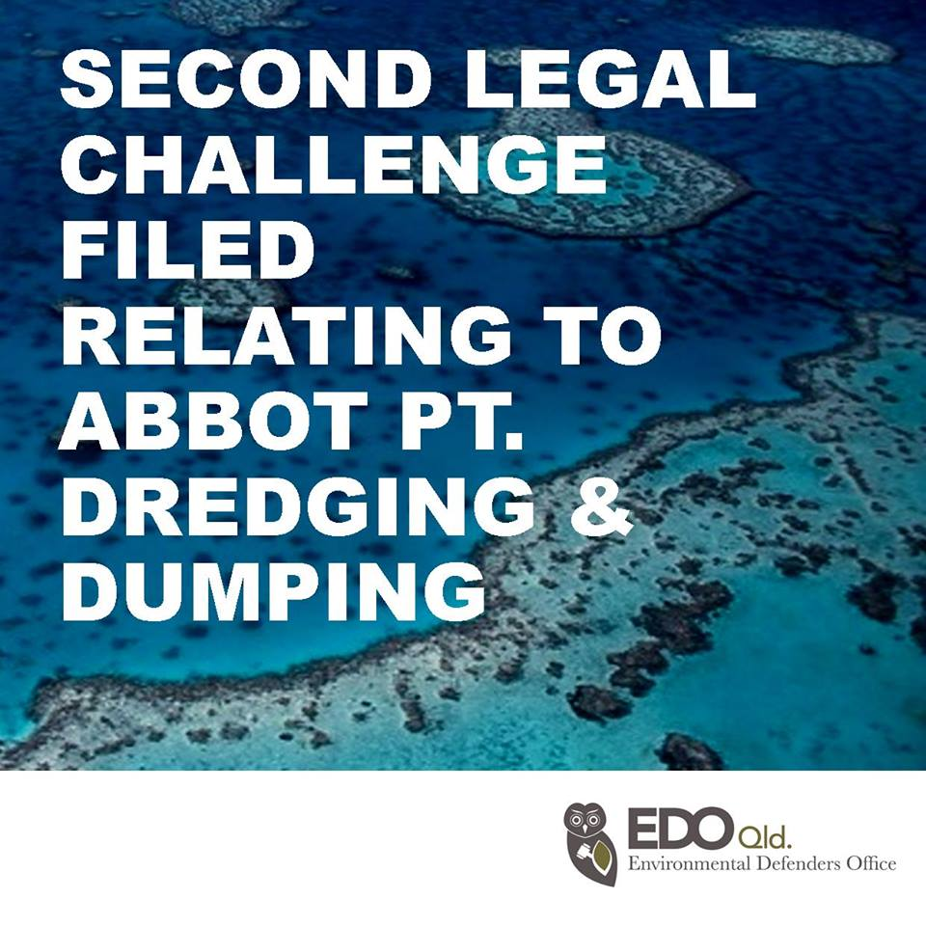

Slide 2
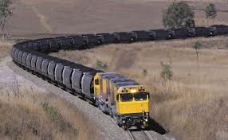
Reforming the planning laws without public consultation Jo Bragg, EDO Qld AELA April 2014
This material is for information purposes and is not legal advice.

Slide 3
What is planning?
Looking at data, considering our values and making decisions about land use and natural resources.
Needs consider medium and long term issues such as biodiversity and impacts of climate change as well as short term issues.
The system needs to be open and accountable to limit influence of vested interests.

Slide 4
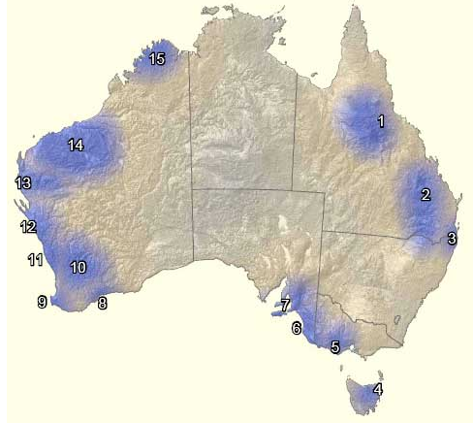
South East QLD
… biodiversity provided little protection.

Slide 5
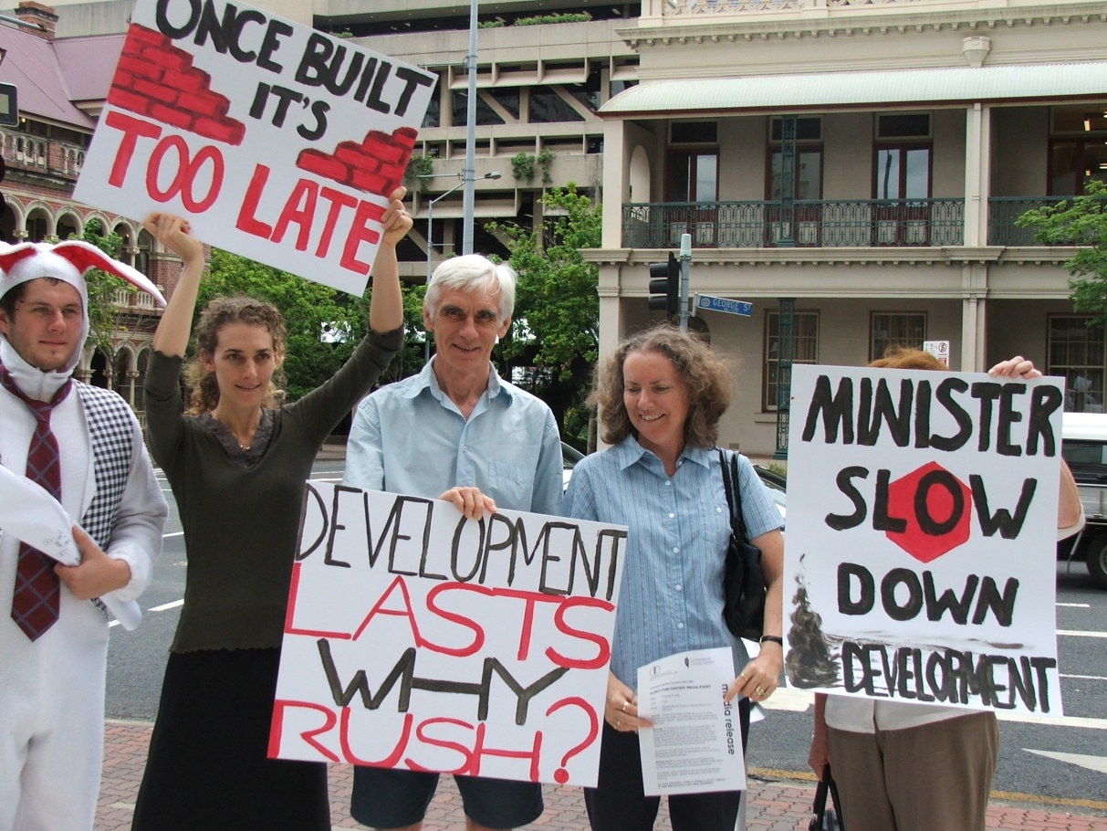

Slide 6
Qld Cabinet Handbook (October 2013)
Section 1.1 Principles of Cabinet:
“consultation is an essential element of the Cabinet process…”
Section 6.1 Community consultation
“Consultation with persons or organisations external to government (including employers, unions, community groups, and special interest groups) should be a routine part of policy development.”

Slide 7
With whom?
Handbook says “with persons or organisations external to government (including employers, unions, community groups, and special interest groups)”
This material is for information purposes and is not legal advice.

Slide 8
Consult when?
Legislation Handbook, section 2.9:
“Well-drafted laws are generally not conceived and drafted within a short period of time. A Bill, particularly a large, complex or controversial Bill, can take a long period to complete.”

Slide 9
Fair Process
Policy development and consultation
Cabinet Approval for Authority to Prepare a Bill (ATP)
Drafting
Consultation
Cabinet Approval for Authority to Introduce a Bill (ATI)
Passage through Parliament and referral to Committee
Assent
Final drafting
Committee hearing
This material is for information purposes and is not legal advice.

Slide 10
No white paper on proposed changes
Proposed change planning legislation so the Sustainable Planning Act 2009 (Qld) becomes the Planning for Queensland’s Development Act.
Proposed change purpose from ecologically sustainability to economic development and prosperity
Radical changes but no public discussion paper.

Slide 11
Objecting to Mines – proposed loss of public rights
Anyone can object to ‘mining leases’ in Queensland (but not exploration)
Usual process to object to the Mining Lease (tenure) and the Environmental Authority at the same time.
This material is for information purposes and is not legal advice.

Slide 12
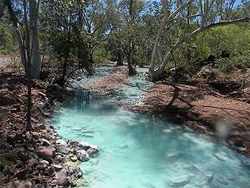
Notes:
Mt Oxide Station from photo by Verdun Spreadborough

Slide 13
Summary of objection process
Application for Mining Lease and Environmental Authority
Objections made to Mining Lease and/or Environmental Authority
Land Court Hearing
Land Court makes recommendation to Minister/EHP
This material is for information purposes and is not legal advice.

Slide 14
Proposed reduced rights to object to new mines
Third party or public interest appeal rights are under threat, submissions due 28 March 2014
Everyone, every group needs the right to have a say as mines affect the whole community-there is no evidence of vexatious claims
Proposed that only affected landholders and local governments can object to tenure
90% of mines will not even be notified under the changes
*http://mines.industry.qld.gov.au/mining/modernising-qld-resource-acts-program.htm
This material is for information purposes and is not legal advice.

Slide 17
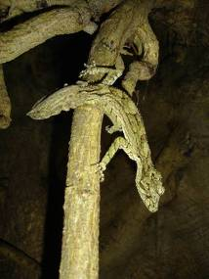
Any questions? www.edo.org.au/edoqld https://www.facebook.com/EDO.Qld
This material is for information purposes and is not legal advice.

