Slide 1
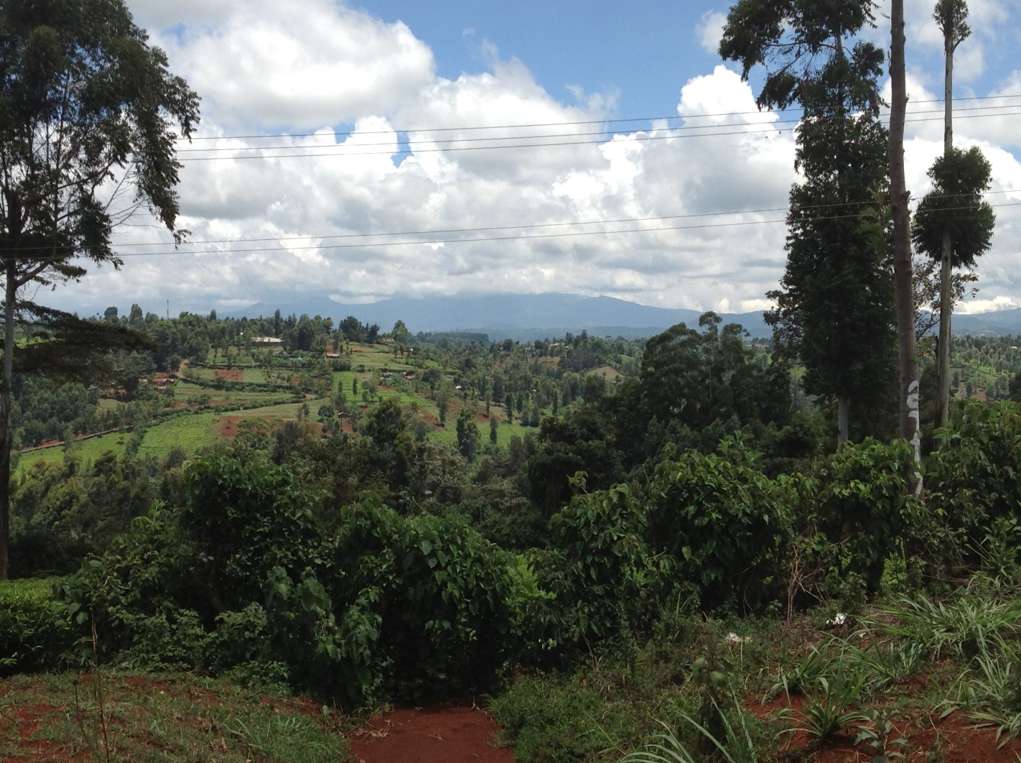
Climate Justice and Forest Conservation: The REDD+ Scheme
Environmental Justice Symposium
Dr Rowena Maguire
Faculty of Law
QUT

Slide 2
What is REDD+
Reduced Emissions from Deforestation and Degradation: (COP 16 – Cancun Agreement)
    Reducing emissions from deforestation;
    Reducing emissions from forest degradation,
    Conservation of forest carbon stocks
    Sustainable management of forests
    Enhancement of forest carbon stocks
An introduction to REDD – the REDD desk
http://theredddesk.org/resources/an-introduction-redd

Slide 3
Re-cap
Aim of REDD+ is reduce emissions from deforestation and land degradation in developing countries.
  Initiative is already providing financial incentives to states to alter existing forest practices (demonstration activities).
  REDD+ has generated unprecedented levels of finance at the international level for improved forest governance and management.
  REDD+ is seeking to deliver on carbon, ecological and social objectives.

Slide 4
Justice Concerns : REDD+
There are three key justice issues raised by state and non-state actors (NGOs):
  Potential for Indigenous and Local Forest Dweller rights to be overlooked during REDD+ investment;
  Concern that market-based REDD+ mechanism will not deliver benefits to local forest stakeholders nor ensure solid emission reductions (corruption);
  Urgent need for a legally binding “safeguard policy” to ensure that social and environmental criteria fulfilled and to prevent any unintended consequences from REDD+ investment.

Slide 5
Climate Justice Network and REDD+
REDD+ should not be a market based mechanism
  Market mechanisms merely shift the burden of emission reduction from developed to developing countries – wealthy corporations can continue to pollute.
  Existing market-based emission reduction schemes have not resulted in the expected emission reduction levels.
  The impermanence of forest carbon sequestration means that forest carbon stocks will increase carbon in the atmosphere now and in the future.
  Carbon trading will not finance the types of forest protection activities that are most needed (address the drivers of deforestation – institutional reform, law enforcement, alternative livelihood income.

Slide 6
Third World Network and REDD+
Developing countries perceive themselves as being asked to manage their resources for the benefit of western interest
  “The poor are not asking for charity. When the rich chopped down their own forests, built their own poison-belching factories and scoured the world for cheap resources the poor said nothing… Now the rich regulate the development of the poor countries. And yet any suggestion that the rich compensate the poor adequately is regarded as outrageous”
  Controversy: over compensation that will be paid as a result of REDD+ investment.

Slide 7
Indigenous Networks and REDD+
REDD+ seen as C02lonialism of forests – “No Rights, no REDD”
UN Special Rapporteur – considered rights of forest dwelling indigenous communities
  Lack of formal tenure recognition of customary ownership rights
  Existing practice of granting timber concession rights to large forestry corporations on indigenous lands
  UNDRIP – must obtain “Free, Prior and Informed Consent (FPIC) of indigenous groups before dealing with land under their control.
    Existing UNFCCC (COP) only requires “full and effective participation”

Slide 8
Eviction of Indigenous Forest Group
Kenya Forest Service (KFS) has forcibly evicted the Sengwer Indigenous People from ancestral forest lands (burning of homes and food stores) in contravention of injunction issued March 2013.
Kenya government accused of taking colonial approach to forest conservation – evicting those who have protected their forests for centuries.
KFS – seeking to improve forest management to attract REDD+ funds.
2784 people offered 400 000 KES ($5000)
  Some of the beneficiaries Sengwer People
  Some IDP’s – landslide victims (more likely to accept compensation)

Slide 9
Summary
REDD+ while “good in intent” – may result in unintended consequences.
Compensation available under REDD+ must get to the local level and to those who change practices.
Needs to be stronger safeguards in any future legally binding instrument to protect community interests.
Large amount of finance needed for REDD+ - look at system based on non market and market based sources.
REDD+ must comply with existing human rights and UNDRIP law.

Slide 10
Full Copy of Paper
Rowena Maguire, “Designing REDD+ to be Just: Considerations for a Legally Binding Instrument” 4 (1) Asian Journal of International Law, 169
  http://journals.cambridge.org/abstract_S2044251313000325
  http://eprints.qut.edu.au/66432/

Slide 11
Upcoming Climate Justice Event
When People Have to Move: Climate Change Related Displacement and Pre-Emptive Migration Pathways in the Australia-Pacific Region
  Friday 23 May 2014
  P Block, QUT Gardens Point Campus
  Attendance is free but places limited: copy of flyer available here.

