Slide 1
Global Trends in ‘Food vs FueL’ and the Uneven Distribution of harms
Dr Carol Richards, QUT and AFSA

Slide 2
Introduction
Fossil Fuels vs Biofuels – part of the shift to alternative energy
Land grabs for ‘biomass’ markets
Finance driven – land as an asset class
Environmental Justice - On the ground impacts
A few thoughts on fossil fuel divestment

Slide 3
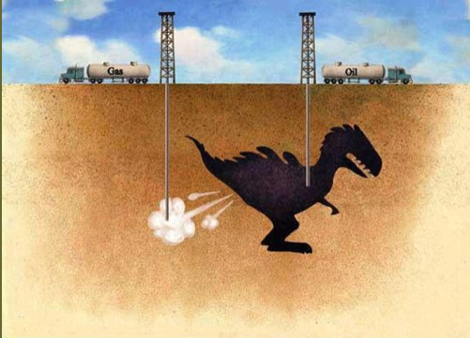
From Fossil Fuels to BioFuels
FOSSIL FUELS
Impact of fossil fuels (oil, coal, gas) on environment well documented
Carbon dioxide, methane, nitrous oxide emissions contribute to climate change
Land degradation/species disruption or loss
Air, land and water pollution (oil spills, etc).
(sources, Union of concerned scientists; IPCC)

Slide 4
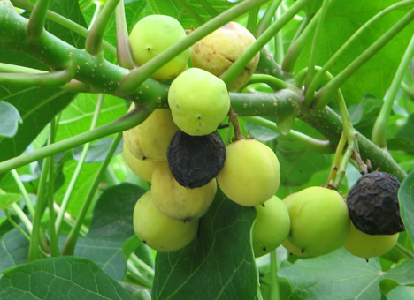
From Fossil Fuels to BioFuels
BIOFUELS
Plant based ‘feedstock’ for fuels
Looks good at face value, renewable, ‘green’, responds to peak oil and climate change
Downsides:
‘Peak oil’ has helped ‘fuel’ a global land rush, driven by finance capital
Land is acquired in developing countries, particularly in Africa and Asia
Foreign land acquisition (via lease or purchase) has been criticised due to accumulation by dispossession (including forced evictions in developing countries)
Food security issues
Planting can involve deforestation(eg Palm Oil) and fossil fuel based inputs (fertilisers)
Biofuel ‘feedstocks’ are not all equal (can be food (corn, wheat, sugar cane for bioethanol); waste; or fuel crops (Jatropha)
Biofuel production is linked to food price spikes
Neoliberal capitalism….

Slide 5
finance capital Lens: “Biomass Market”
Not simply farmers ‘choosing’ to grow biofuels to respond to new market demands
Rather…
Global land rush is driven by finance capital. Land is considered a new ‘asset class’ (extension of the commodification of food)
Problematic due to global asymmetries of power – in environmental justice terms, undermines right to food, water, land of affected communities

Slide 6
Why Land? The ‘Perfect Storm’
The sub-prime mortgage meltdown and ensuing global financial crisis of 2007 led investors to search for new and safer markets
Growing global population and projections of higher demands for food/fuel;
Peak oil and the search for alternatives such as plant-based biofuels;
Global Food Security – identified/perceived need for increased food production
Biofuel targets (EU, US, Aus) The Netherlands Environment Assessment Agency estimates that 20–30 million hectares will be required for the EU to meet its target, with 60% of supplies imported
Land is considered “gold with yield” in investor terms- it is a ‘fixed’ asset (with flexible production) finite and likely to increase in value as demand for food and natural resources increases

Slide 7
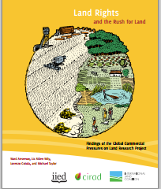
Land acquired for ‘BIOMASS’ Production
Biomass industry (forestry for carbon trading/biofuels/energy/bioplastics), has been estimated by the World Economic Forum to be capable of generating $300 billion by 2020
Between 2000 and 2011, large-scale land deals accounted for 203 million hectares of land (International Land Coalition, 2012)
Friends of the Earth has documented that 5 million hectares of land, an area the size of Denmark, was acquired or biofuels across 11 African countries (at Oct 2012)*
Other studies have estimated worldwide land grabs for biofuels at 37 million hectares (ILC, 2012)
*http://www.foeeurope.org/sites/default/files/agrofuels_food_prices_hunger_briefing_october2012.pdf

Slide 8
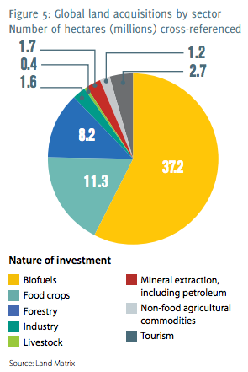
Source:
Anseeuw, W., L. Alden Wily, L. Cotula, and M. Taylor. 2012. “Land Rights and the Rush for Land: Findings of the Global Commercial Pressures on Land Research Project”. ILC, Rome
http://www.landcoalition.org/sites/default/files/publication/1205/ILC%20GSR%20report_ENG.pdf

Slide 9
Land Users of the 37 million Hectares?
Difficult to collect data on local level impacts
Still, much evidence of dminished local livelihoods
For example, Investment for Development (!) via Development Finance Institutions
DEG (Germany), FMO (Netherlands) and Swedfund (Sweden) invested in Addax Bioenergy Sierra Leone Ltd – sugar plantation for biofuels. 50 year lease of land effects 13,000 people – growing fuel on land that was growing staple foods. Criticised for failing to deliver on promises to promote local economic development

Slide 10
Land Users of the 37 million Hectares?
Ghana, Pru District:
20 commercial plantation companies, three-quarters of which are majority foreign-owned, 1.184 million ha of land for biofuel feedstock
Decline of 71% in terms of standards of living for affected households
In one village, 18 households lost 61% of land, many households became landless, or only had access to rocky/waterlogged land.
Schoneveld , G. C., L. A. German, and E. Nutakor. 2011. Land-based investments for rural development? A grounded analysis of the local impacts of biofuel feedstock plantations in Ghana. Ecology and Society 16(4): 10.
http://dx.doi.org/10.5751/ES-04424-160410

Slide 11
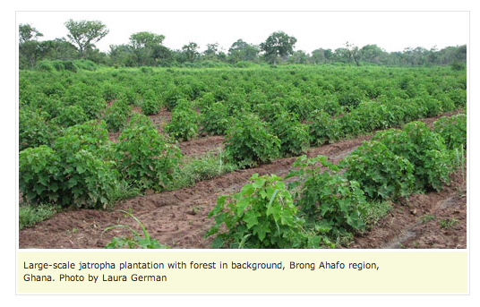

Slide 12
Conclusions
Biofuels might solve some problems, create new ones, especially via finance capital
Global land deals lack transparency, monitoring or independent oversight
Terms of acquisition often do not favour the local population - the ‘losers’ in the transaction are the world’s poor
Exacerbates North/South inequalities, diminishes local access to basics of food, water, shelter
In developed countries like Australia, US – feel good factor for 10% ethanol – in developing countries rights to land, food and water are diminished
Where will capital from fossil fuel divestment end up? We need to look beyond divestment…

