Slide 1
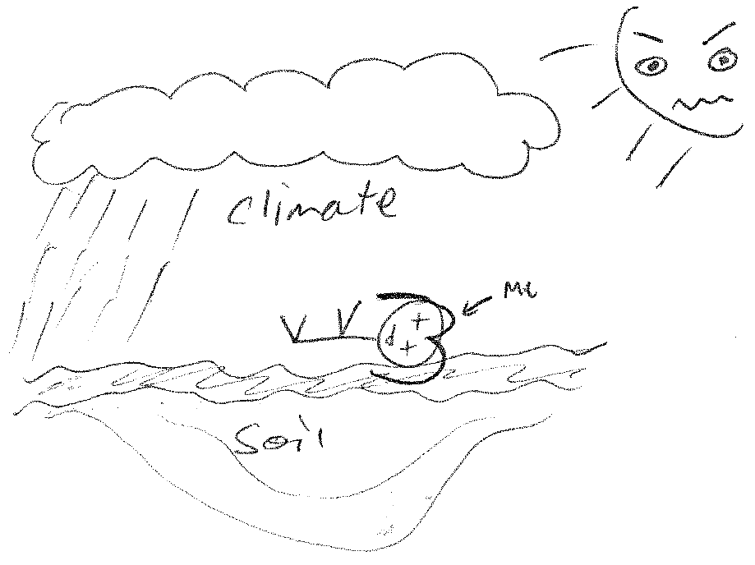
the politics of climate justice: working within and between the mainstream
Wendy Steele and Hartmut Fuenfgeld
RMIT, April 2014

Slide 2
Throughout the 21st century, climate-change impacts are projected to slow down economic growth, make poverty reduction more difficult, further erode food security, and prolong existing and create new poverty traps, the latter particularly in urban areas and emerging hotspots of hunger
IPCC 2014
“What is to be done and who the hell is going to do it?”
Harvey and Wachsmuth 2012

Slide 3
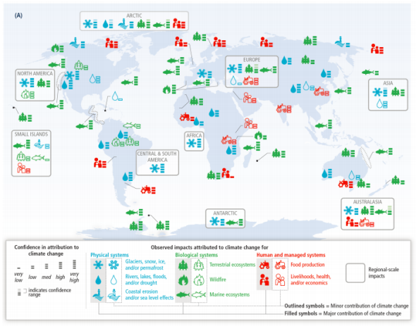

Slide 4
the world of wounds
We are told we must accept ‘the world of wounds’
…to live with the disappearance of coral reefs and glaciers, rainforests, of rivers and wetlands and species which, like people, will be unable to adapt
“As the scale of the loss to which we must adjust becomes clearer, grief and anger are sometimes overwhelming. You find yourself, lashing out……”
Community wounds – ecological, social, economic
Monbiot 2014

Slide 5
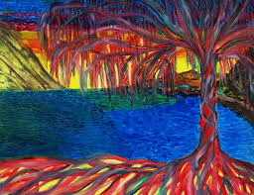
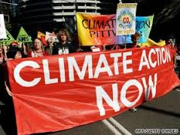
Justice and equity issues arise in the climate change context because of the
high prospects for impacts on already vulnerable people and communities
….our responses to the climate crisis can hurt people
Friends of the Earth 2010

Slide 6
5 principles of climate justice:
1. the responsibility is not equally distributed
2. will not affect all people equally
3. vulnerability is determined by political-economic processes that benefit some more than others
4. climate change will compound under development because of the processes of disadvantage embedded within the political-economic status quo
5. climate change policies may themselves create unfair outcomes by exacerbating, maintaining or ignoring existing and/ or future inequalities
Barnett 2006

Slide 7
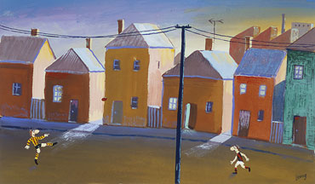
advance Australia fair?
Australia is a recognized IPCC global climate change hotspot
High urban concentration of population in the five largest cities
one of the world’s driest continents
“….yet climate justice remains a chronically underdeveloped area of Australian thinking”
Garnaut, 2009

Slide 8
‘landscapes of despair’ Dear & Wolch 1987
Issues of [climate] justice - policy, planning and disciplinary silence and underwritten by economic marginalization and political invisibility
growth over sustainability
shareholders/stakeholders rather than citizens
velocity over quality
economic efficiency over equity
Steele & Gleeson 2010
Notes:
Since the 1980s Australian cities have experienced waves of micro-economic reform that have given enhanced status and influence to private interests in urban public policy and services. The outcome has been an increasing emphasis on:

Slide 9
feral capitalism
If we accept that anthropogenic climate change is real then we must also recognize that its impacts are likely to be felt unevenly…….
The economy, as both mode of seeing and means of organizing society has no ethical platform, singular logic or essential form
Capitalism exists parasitically, drawing momentum and sustenance from the earth and others as opportunity arises and provides
the central mechanisms within capitalism fail in two key ways:
[i] in the provision of public infrastructure; and
[ii] in the management of the market and development outcomes
Both of these failings in turn call for planning interventions which often exacerbate the very issues they sets out to resolve.

Slide 10
spaces of hope
shift justice away from state of paralysis, and instead focus on the progressive activities of existing communities.
Particularly the diverse experiments already taking place that challenge dominant capitalist modes of production
4 ethical coordinates:
1. commons - how a commons is produced and sustained
2. consumption - whether and how products and surplus are to be consumed
3. necessity - what is necessary to personal, social and ecological survival
4. surplus - how surplus is appropriated from and distributed to humans and non-humans
Gibson-Graham & Roelvink 2010

Slide 11
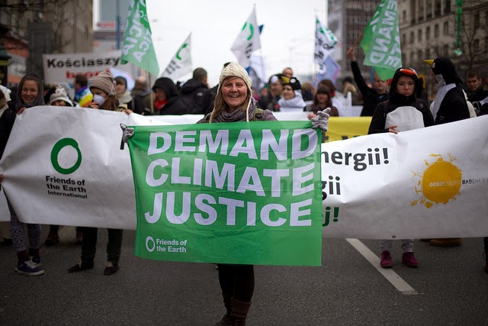
grassroots action
convening of “Climate Camps” near coal mines and power stations
the formation of climate summits
peoples’ policies on climate change; and
the youth climate coalitions and
local climate action groups

Slide 12
community-based initiatives
community gardening to combat growing food insecurity and preserve agro-biodiversity
blocking coal trains from delivering their payload to coal-fired power stations as a form of protest and intervention
working in solidarity with indigenous groups to effect social and environmental change building networks with traditionally marginalised groups
farmers joining with city-folk to try to block coal-seam gas projects
local schools, community groups, environmental organisations and tertiary institutions joining to map out transitions to a low carbon economy

Slide 13
The seeds of change creatively confronting the climate crisis
What these community actions, both global and local, suggest is:
that there is already active work underway
central are processes of social learning and interconnection
we need to hear the stories and practices of world citizenry
we must enlarge the boundaries of dialogue and action:
..so that demands for equity are no longer marginalized – this is the first step towards reversing the current tendency that excludes issues of [climate] justice in the pursuit of economic growth and market development
adapted from Fainstein 2006

Slide 14
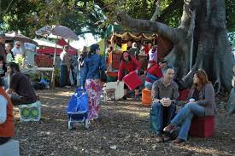
creative food practices in West End
A small volunteer co-operative offer - for free - local food tours of the West End area highlighting the fruits, herbs and other delicious edibles that are available (depending on the season) throughout the suburb.
·A West End activist collective has taken steps to go around and harvest ripened fruit from local trees (avocados, oranges, mangoes, passionfruit, bananas etc.) - making them freely available to all - rather than seeing the fruit rot on the tree or the ground.
Individual activists regularly engage in ‘dumpster diving’ to retrieve some of the vast quantities of food that is thrown out on a daily basis by large companies in compliance with health and other regulations – but to all intensive purposes are still edible and able to be used in creative ways.
Guerrilla plantings occur on sidewalks as a way of reclaiming public space for fruit, vegetables, flowers and other food producing and community purposes.

Slide 15
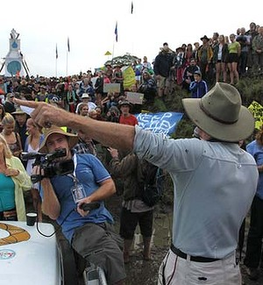
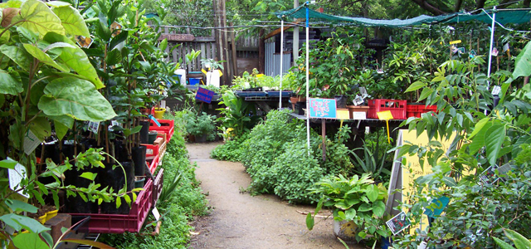
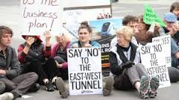
“What is to be done and
who the hell is going to do it?”
Harvey and Wachsmuth 2012

