Slide 1


What is environmental law?

Slide 2
Why we love green tape
Environmental laws are an essential element in achieving ecologically sustainable outcomes. These laws:
  Set minimum standards
  Require impacts to be assessed (rigour, independence)
  Establish offences for inappropriate activities (enforcement)
  Address market failures
  Allow the community to be informed about, and participate in, decisions that affect their lives
  (transparency, accountability, better decisions)
Notes:
Rather than being seen as ‘green tape’ or a burden on business, environmental laws are an essential element of a healthy society. Environmental laws not only protect our fragile ecosystems, they also protect our health, our communities, our economy, and future generations. The efficacy of an environmental assessment and approval system should not be judged solely on its ability to meet processing timeframes or attain ‘satisfactory’ development approval rates. More fundamental is the system’s ability to produce ecologically sustainable outcomes.

Slide 3
Tasmanian legislation
Environmental Management and Pollution Control Act 1994 | Land Use Planning and Approvals Act 1993
State Policies and Projects Act 1993 | Resource Management and Planning Appeal Tribunal Act 1993
Tasmanian Planning Commissions Act 1997 | Mineral Resources Development Act 1995
Primary Industry Activities Protection Act 1995 | Agricultural and Veterinary Chemicals (Control of Use) Act 1995
Forest Practices Act 1985 | Forestry Act 1920
Major Infrastructure Development Approvals Act 1999 | Historic Cultural Heritage Act 1995
Living Marine Resources Management Act 1995 | Marine Farming Planning Act 1995
Threatened Species Protection Act 1995 | Water Management Act 1999
Natural Resource Management Act 2002 | Nature Conservation Act 2002
National Parks and Reserves Management Act 2002 | Crown Lands Act 1976
Local Government Act 1993 | Urban Drainage Act 2013
Water and Sewerage Industry Act 2009 | Regional Forest Agreement (Land Classification) Act 1998
Public Land (Administration & Forests) Act 1991 | Gas Act 2000
Weed Management Act 1999 | Climate Change (State Actions) Act 2007

Slide 4
Objectives of the RMPS
to promote the sustainable development of natural and physical resources and the maintenance of ecological processes and genetic diversity; and
to provide for the fair, orderly and sustainable use and development of air, land and water; and
to encourage public involvement in resource management and planning; and
to facilitate economic development in accordance with the objectives; and
to promote the sharing of responsibility for resource management and planning between the different spheres of Government, the community and industry in the State
Sustainable development means managing the use, development and protection of natural and physical resources in a way, or at a rate, which enables people and communities to provide for their social, economic and cultural well-being and for their health and safety while –
sustaining the potential of natural and physical resources to meet the reasonably foreseeable needs of future generations; and
safeguarding the life-supporting capacity of air, water, soil and ecosystems; and
avoiding, remedying or mitigating any adverse effects of activities on the environment.

Slide 5
Where it all falls down
‘Resource management’ focus
Exemptions for major industries
Implementing ESD
Lack of integration
Standardisations vs lowest common denominator
Lack of strategic outlook – assessments on a case-by-case basis
Enforcement
Restrictions on standing

Slide 6
What about the animals?
Biodiversity conservation
Threatened species
  Listing approach focusses on individual species
  “Kill or take”
  Habitat protection
  Resource priorities
Landscape planning / reserve management
Offsetting

Slide 7
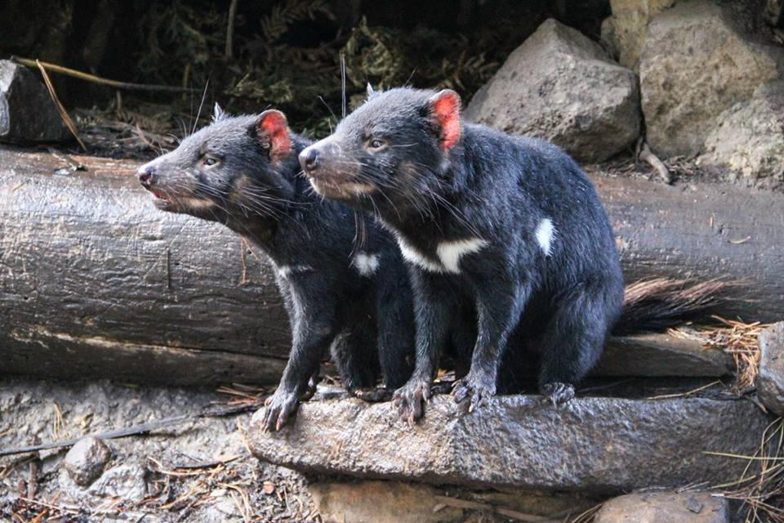

Examples
Mining in the Tarkine
  Lack of strategic planning
  “Acceptable losses”
  Ex-situ offsets
The Supertrawler
  Limited heads of power
  By-catch of listed species

