Slide 1
Protecting our evolutionary companions through environmental law
Jemilah Hallinan
Outreach Director
Notes:
Jemilah Hallinan – solicitor at EDO NSW
Community legal centre specialising in public interest environmental law

Slide 2

Environmental law
International, national, State and local
Over 40 Acts
  Climate change and energy
  Coastal, marine and fisheries
  Farming and private land management
  Forestry and clearing of native veg
  Mining and CSG
  Native plants and animals
  Planning, development and heritage
  Pollution
  Protected areas and public land management
  Water management
Notes:
Environmental law is a massive body of law
Several international conventions – World Heritage Convention, Ramsar Convention etc
States retain primary responsibility for the environment under the Constitution.
Federal Gov can make laws where it has entered into an international agreement. Our main international obligations are enacted through a key piece of Federal law called the Environment Protection and Biodiversity Conservation Act
Huge amount of State law – dealing with a wide variety of issues
At the local level, waste management, local development etc.

Slide 3
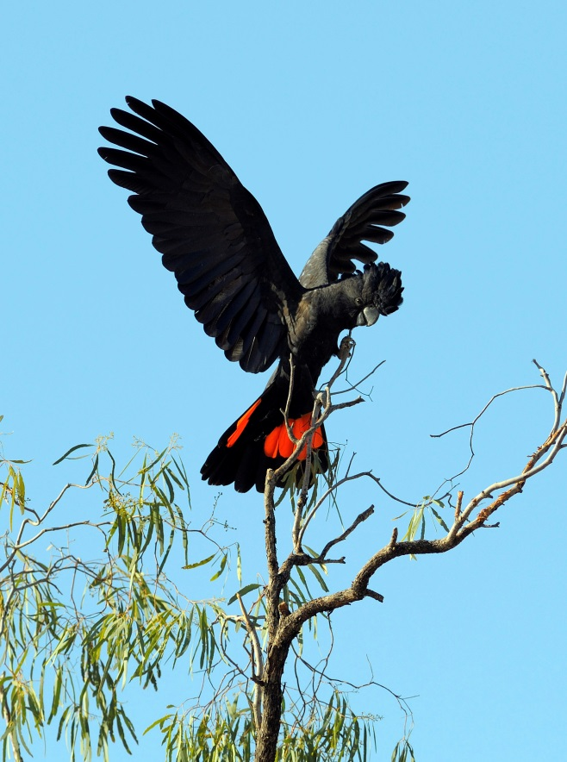
Environmental laws that protect animals
Threatened Species
  Threatened Species Conservation Act 1995 (NSW)
  Fisheries Management Act 1994 (NSW)
  EPBC Act 1999 (Cth)
Native Species
  National Parks and Wildlife Act 1974 (NSW)
Migratory Species
  EPBC Act 1999 (Cth)
Notes:
Environmental law protects animals in three key ways:
Protections for threatened species
Protections for native species
Protections for migratory species
A bit all over the place
Threatened Species Conservation Act
The TSCA provides procedural basis for listing terrestrial threatened species as either:
Vulnerable – facing a high risk of extinction in the medium term future
Endangered – facing a very high risk of extinction in the near future
Critically endangered – facing an extremely high risk of extinction in the immediate future
Presumed extinct – not recorded in its known or expected habitat within a determined time frame
A species can be listed as an entire species, as a population or as part of an ecological community.
A species is either on the list or it isn’t. only listed species are covered by the Act. A Scientific Committee determines whether a species should be listed and how it is listed.
It also provides for the identification of critical habitat, the listing of key threatening processes and the preparation of recovery plans and threat abatement plans.
The Fisheries Management Act
Does the same thing but for marine and aquatic species, including marine mammals.
The Scientific Committee cannot list species, but only make recommendations to the Minister. More political process.
National Parks and Wildlife Act
Protects all native animals.
The Act lists non-native species as specifically unprotected – including : bears, lions, dogs, moles, hedgehogs, cloven hoofed animals, horses,
donkeys, apes, monkeys, elephants, hares, rabbits and Indian Palm Squirrels.
The Act establishes a range of offences relating to harming or interfering with native animals -
It is an offence to harm protected fauna. This includes harm by using a substance (e.g. poison), an animal (e.g. a hunting dog), or a gun, net or trap.
The maximum penalty is $11,000 or 6 months imprisonment, or both.
It is an offence to buy, sell or possess protected fauna.
The maximum penalty is $11,000 or 6 months imprisonment or both.
However, the Act sets out a large range of defences (rescuing an injured animal) and provides for the licencing of activities that would otherwise be illegal (being a skin dealer, being an emu breeder, exhibiting protected animals).
Confusingly, this Act also contains the offences that relate to threatened species
EPBC Act
Only applies to species that are listed as threatened under that Act. Also applies to listed migratory species.
It protects these species by requiring all actions that are likely to significantly affect the species to be referred to the Environment Minister for assessment and approval. This is in addition to the State assessment process.
However, Federal Gov is looking to hand it’s powers back to the States and enter assessment and approval bilateral agreements.

Slide 4
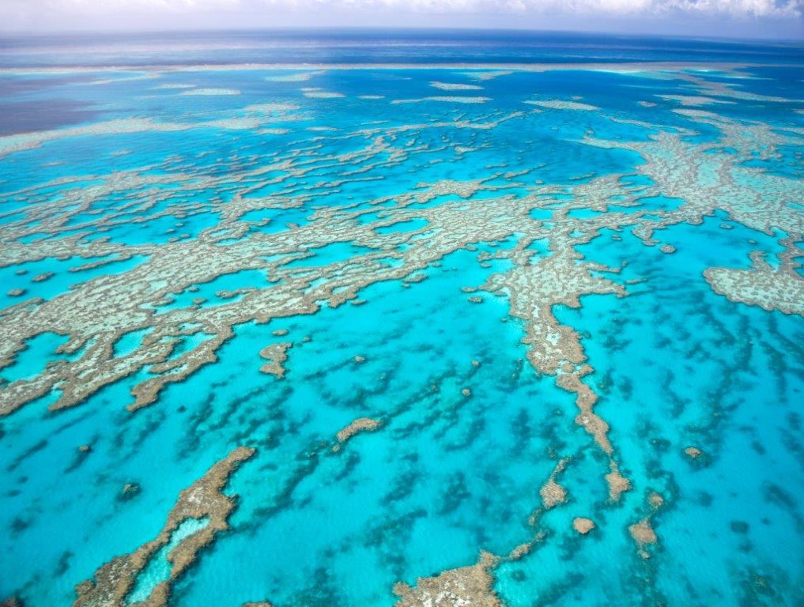
Environmental laws that protect habitat
Native Vegetation laws
  Native Vegetation Act 2003 (NSW)
Forestry laws
  Forestry Act 1919 (NSW)
Protected areas laws
  National Parks and Wildlife Act 1974 (NSW)
  Wilderness Act 1987 (NSW)
  Marine Parks Act 1997 (NSW)
  EPBC Act 1999 (Cth)
Notes:
There are many laws that protect the habitat of animals, and by extension, the animals themselves.
Native Veg laws
Require approval before native vegetation can be cleared in most circumstances
Applications to clear are assessed by applying a Biometric tool which is a scientific methodology that allows decision-makers to determine whether a proposal to clear will meet legal standard to maintain or improve biodiversity values.
The landholder can only clear vegetation if appropriate offsets can be found.
Forestry laws
Forestry approvals authorise the harming or killing of threatened species but there are limited provisions designed to protect threatened fauna.
E.G – Under current forestry approvals there is a requirement to conduct pre-logging surveys to locate and avoid threatened species (200m boundaries)
Protected areas
There is a suite of protected areas established under a range of laws.
National Parks, State Conservation Areas, Nature Reserves, Wilderness Areas, Marine Parks and World Heritage Areas.
Rules restrict activities that can take place in these areas and create offences for harming fauna within the area

Slide 5
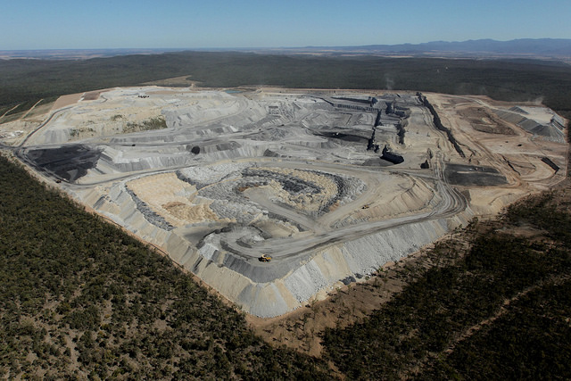
The role of planning law
Development is a key threat to fauna
Planning laws interact with Environmental laws to ensure development takes account of fauna
E.g. if a development is likely to have a significant impact on a listed threatened species, a Species Impact Study must be prepared
Notes:
Planning law triggers the operation of many environmental laws.
However, for developments categorised as State significant developments, the trigger is often switched off. So the developments that are likely to have the most impact, don’t trigger the environmental laws designed to protect threatened species.

Slide 6
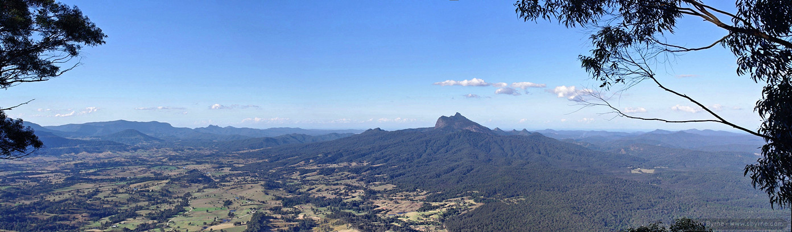
Underlying principles and trends
Focus on procedure, not outcomes
Scientific methodologies
  Biobanking
  Biocertification
  Biometric tool
Move towards landscape approach
Move towards offsets
Notes:
Focus on procedure, not outcomes
TSC Act focuses on process for listing species but does not appear to have an end game in mind. No legal requirement for the species to recover.
Developments likely to impact on threatened species require a Species Impact Statement, but development can still be approved even where the study shows there will be a devastating impact. There is no restriction on decision-making.
There is no prohibition on making a species extinct, so long as the correct procedure is followed.
Scientific methodologies
Many decision-making processes under environmental law are now constrained by scientific methodologies.
These tools allow data to be entered and deliver a result. Biobanking tool indicates which types and the number of biobanking credits that a piece of land will generate.
Move towards a landscape approach
Efforts to protect individual species are time and money intensive and are not working. There is a recognition that not all species can be saved, especially in light of climate change. The focus is shifting to a landscape approach where the habitat is conserved as much as possible.
In planning, biocertification is used to avoid the need for Species Impact Statements. Biocertification looks at a landscape and identifies areas of high biodiversity value. It sets out measures to improve or maintain this biodiversity. The expectation is that everywhere not set aside for conservation will be fit for development and the need for site based assessments is removed.
There is a move to more landscape assessments in forestry – to avoid the need for pre-logging surveys for threatened species.
Move towards offsets
The ideal approach is avoid, mitigate then offset.
However, offsets are becoming increasingly popular.
Offsetting seeks to make up for damage done to biodiversity values in one location by preserving the same biodiversity values in another location. The test is that the offset must maintain or improve overall biodiversity values.
Biobanking, Biocertification and the biometric tool are all offset based mechanisms.
Gradual weakening of offset requirements. Weakening the like for like requirement. Legal mechanisms for offsetting also need to be strengthened in light of the Bulga case.
Proposal that if no offset available – pay money

Slide 7
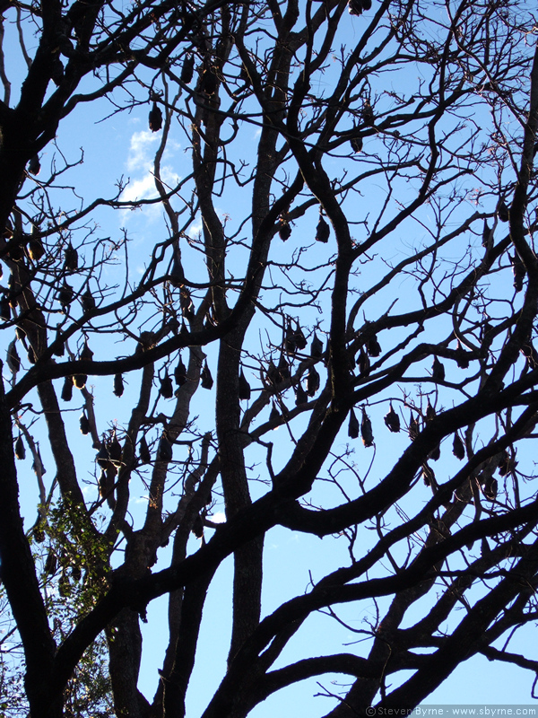
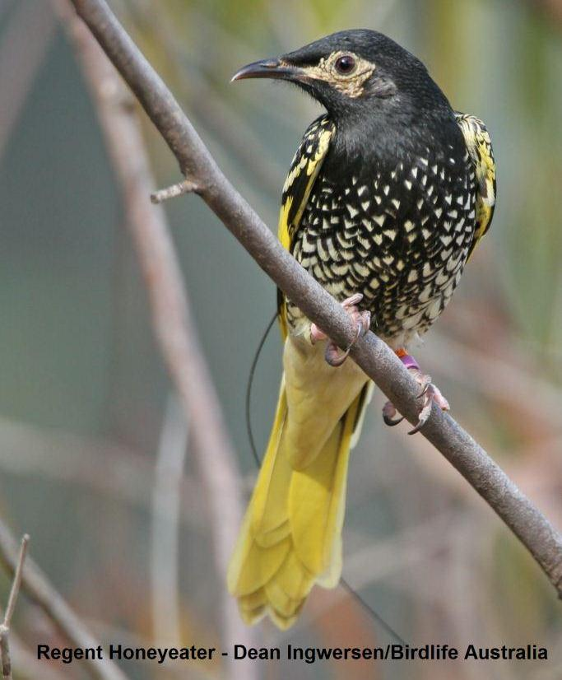
Case studies – The Botanic Gardens Bats and the Tumblebee Regent Honey Eater
Notes:
Bats
Grey headed flying foxes roost in the Sydney botanic gardens. They are listed as endangered under the EPBC Act
Causing damage to trees. Botanic Gardens sought permission to disperse the bats. The Federal Environment Minister granted approval.
The BG population represented 8.5% of the total population. Loss of roosting habitat was identified in the National Recovery Plan as a high priority threat to the species.
EDO represented Bat Advocacy NSW in challenging the Minister’s decision on a number of technical points including that the Minister failed to have regard to the fact that the Botanic Gardens was critical habitat and the adverse impacts of the approval given the duration of 17 years.
The Court rejected all the grounds. The Minister had satisfied the procedural requirements of the EPBC Act. Therefore, the decision was valid, even though it was likely to have a significant impact on an endangered species.
Honey eater
A Hunter Valley community group is seeking to protect the critically endangered Regent Honeyeater (pictured) by taking legal action against Cessnock Council’s approval of a steel fabrication facility on land which includes potential habitat for the rare bird.
Council approved the facility on land containing one of the few remaining viable breeding sites for the Regent Honeyeater in Australia, supporting about 10 per cent of the national (and therefore global) population of between 350 to 400 birds
.
The Regent Honeyeater is critically endangered
Friends of Tumblebee claim that the proposed development is likely to significantly affect the Regent Honeyeater, and therefore the development application should have been accompanied by a Species Impact Statement (SIS).
The purpose of an SIS is to provide the Council with detailed information about how the proposed development would affect the critically endangered Regent Honeyeater, and to assist the Council in deciding whether or not to approve the development.
If successful, the Council will have to require a SIS before approving the development, but can still approve the development.

Slide 8
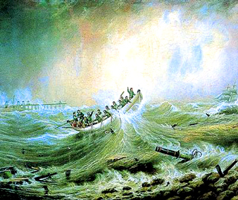
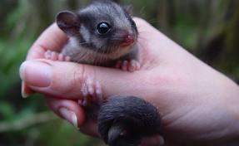
The future
Private conservation to complement public reserve system
Climate change will test our laws
Need to discuss our approach
Legal framework does provide a wide variety of tools – task is to get the mix right and then apply them
Notes:
Conservation on Private Land will become more important
State Gov has wanted to open up national parks to more commercial activities
Federal Gov hostile to new national and marine parks
Federal Gov wants to allow logging in national parks
Federal Gov wants to remove areas from World Heritage
Many species may not be able to adapt to climate change and our laws will be tested. Strong view that it will no longer be possible to save everything as it is where it is. May be necessary to condemn some species to extinction because it would be too resource intensive to save them.

