Slide 1
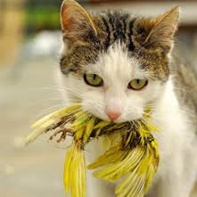
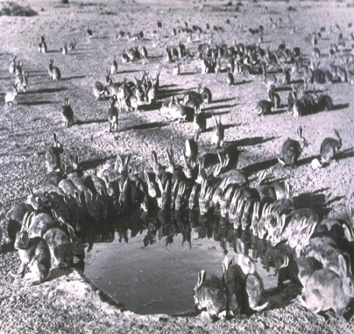
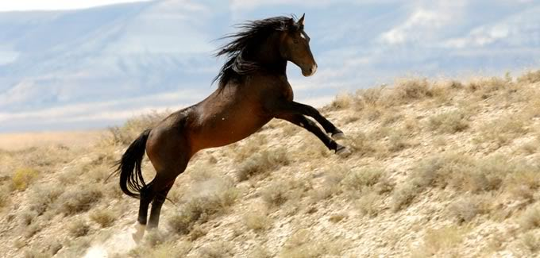
INVASIVE ANIMALS: KILLING FOR THE GREATER GOOD OR short-sighted EXPEDIENCY?

Slide 2
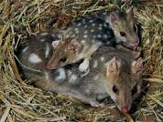
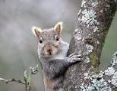
a tale of two species
http://www.abc.net.au/news/2014-04-26/western-quoll-returns-to-flinders-ranges-after-a-century/5412284
http://planet.uwc.ac.za/NISL/Invasives/Refs/BertolinoandGenovesi.pdf

Slide 3
Difficulties in regulating invasive species
How do we protect biodiversity from invasive species?.
Ethical considerations of how we weigh competing interests of individual species as against other species, habitats and ecosystems
Practical considerations of how we weigh competing interests of individual species against human land use and land management
Should society’s obligations be limited by notions of welfare or is it valid to consider the life of individual animals?

Slide 4
1. What is an invasive animal?
2. And what are Australia’s ethical and legal responsibilities?
3. Regulatory responses in Australia
4. Evaluation

Slide 5
1. What is an invasive animal
Biodiversity Convention - species that threaten ecosystems, habitats or other species.
Model Codes of Practice for the Humane Control of…….(camels, cats, donkeys etc)
  native or introduced, wild or feral, non-human species of animal that is currently troublesome locally, or over a wide area, to one or more persons, either by being a health hazard, a general nuisance, or by destroying food, fibre, or natural resources (Koehler, 1964).

Slide 6
In NSW and also at the Federal level, the impacts of invasive species are listed as a threatening process under environmental legislation.
For example, under the NSW Threatened Species Conservation Act 1995
http://www.environment.nsw.gov.au/threatenedspecies/KeyThreateningProcessesByDoctype.htm
And at the Federal level, under the Environment Protection and Biodiversity Conservation act 1999
http://www.environment.gov.au/cgi-bin/sprat/public/publicgetkeythreats.pl

Slide 7
 | Camels | Cats | Donkeys | Goats | Horses | Pigs | Foxes | Rabbits | Wild Dogs | Macro
Env Impact |  |  |  |  |  | Not known – |  |  |  | Conflict with land uses
Damage to vegetation | X |  |  | X | X | X |  | X
Contribute to erosion |  |  | X (possibly) | X | X |  |  | X
Trampling | X |  |  |  |  | X
Foul Waterholes | X |  |  | X | X
Suppression of recruitment in some plant species | X
Competition with native animals for food, water and shelter | X |  |  | X | X |  |  | X
Potentially be involved in the spread of diseases | X | X |  | X known to carry foot rot | X | X | X |  | X
Predation on native animals |  | X |  |  |  |  | X
Threaten success of recovery programs for endangered species. |  | X |  |  |  |  | X
Habitat destruction |  |  | X (possibly) | X | X
Spread weeds |  |  |  | X | X |  | X
Economic Impact
Competing with livestock for food/water | X |  | X | X | X | X |  | X Not well quatnified
Damage to Infrastructure | X |  |  |  | X | X | X
Collision with vehicles | X
Spread disease to livestock |  |  |  | X known to carry foot rot | X equine influenza, African horse sickness and tick fever | X foot and mouth |  |  | X
Prey on newborn lambs/ cattle and livestock |  |  |  |  |  | X lambs | X lambs |  | X
Eat crops/reduce their yields |  |  |  |  |  | X | X
Social/ Cultural Impact
Damage sites culturally important to Aboriginal people | X
Destroy Bush Tucker | X
Reduce people’s enjoyment of natural areas | X
Create dangerous driving conditions | X
Cause a general nuisance in residential areas | X
Other features | Tourism Woody Weed Control Harvesting for income |  |  |  |  | Hunted | Could control rabbits |  | Have become a functional part of ecosystems

Slide 8
Anca Vlasopolous of Department of English, Wayne State University and she had this to say:
What seems to be missing…is the awareness that very little of non-human life on our small planet can escape human impingement…and that management is the only way for many species to survive. The pseudo-Darwinian concept--survival of the fittest--in terms of specific populations competing for the same resources in the same territory can no longer be seen as natural. Human interference in destroying and fragmenting habitat, introducing exotic species, and polluting remaining habitat has been so pervasive as to require the present-day management of even the vast ocean environments.

Slide 9
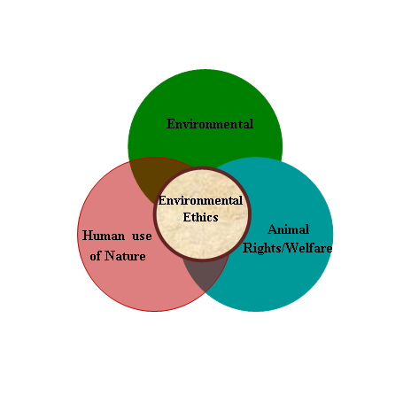
2. ethical and legal responsibilities
A discipline that studies the moral relationship of human beings and their environment including the intrinsic value and moral status of non-human components such as animals.

Slide 10
Article 8(h) of the Biodiversity Convention:
parties should prevent the introduction of, control or eradicate …
Supplemented by the Guiding Principles for the Prevention, Introduction and Mitigation of Impacts of Alien Species that Threaten Ecosystems, Habitats or Species.
Principle 2 refers to a three-stage hierarchical approach starting with preventing entry
of the species.
Otherwise, the preferred response is often to eradicate as soon as possible (principle 13).
In the event that eradication is not feasible or resources are not available for its eradication, containment (principle 14) and long-term control measures (principle 15) should be implemented..
Principle 1 of the Guiding Principles indicates that the precautionary approach should also be applied when considering eradication, containment and control measures.

Slide 11
Does eradicate equate with culling?
What is the impact of the precautionary approach?
Werner Scholtz, ‘Animal Culling: A Sustainable Approach or Anthropocentric Atrocity?
“quick-fix for the inadequate management and planning of authorities”
The Oxford dictionary defines eradicate as : Destroy completely; put an end to

Slide 12
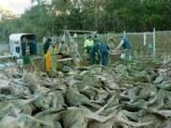
Animal Liberation v Conservator of Flora and Fauna (Administrative Review)
Tribunal Accepted this expert evidence:
The precautionary approach required under the criteria requires a reduction of kangaroo density that is clearly sufficient not merely to a level that would be sustainable, but to a level that enables repair of damage from previous overgrazing. The culling of 7000 kangaroos in 2009 would be a first step but further reduction would be desirable to meet this criterion.

Slide 13
3. Australian regulatory responses
Model Code of Practice for the Humane Control of feral camels
Model Code of Practice for the Humane Control of feral cats
Model Code of Practice for the Humane Control of feral donkeys
Model Code of Practice for the Humane Control of feral goats
Model Code of Practice for the Humane Control of feral horses
Model Code of Practice for the Humane Control of feral pigs
Model Code of Practice for the Humane Control of foxes
Model Code of Practice for the Humane Control of rabbits
Model Code of Practice for the Humane Control of wild dogs
Kangaroo Management Plans + (National Code of Practice for the Humane Shooting of Kangaroos and Wallabies)

Slide 14
Code (Humane) | Summary of Most -Used Control Methods
Control of feral camels | Aerial shooting and ground shooting, mustering and trapping at water.
Control of feral cats | Shooting, trapping, lethal baiting and exclusion fencing. The currently available methods of control are generally expensive, labour intensive, require continuing management effort and can be effective only in limited areas.
Control of feral donkeys | Aerial culling whereby donkeys are shot from helicopters with high-powered rifles.
Control of feral goats | The most commonly used feral goat control techniques are mustering, trapping at water, aerial shooting, ground shooting and exclusion fencing.
Control of feral horses | Trapping at water, mustering, aerial shooting and ground shooting. Other measures such as exclusion fencing, fertility control and immobilisation followed by
Control of feral pigs | Lethal baiting; however not all poisons are equally humane. Depending on the poison used, target animals can experience pain and suffering, sometimes for an extended period, before death.
Control of foxes | Lethal baiting, shooting, trapping, den fumigation, and exclusion fencing. Lethal baiting is considered to be the most effective method of fox control currently available; however not all poisons are equally humane. Depending on the poison used, target animals can experience pain and suffering, sometimes for an extended period, before death.
Control of rabbits | Lethal baiting, warren fumigation and destruction, shooting, trapping, exclusion fencing and biological control with RHDV and myxomatosis.
Control of wild dogs | Lethal baiting, shooting, trapping and exclusion fencing. Other measures such as the use of guard animals have been promoted in recent years but not yet fully evaluated in Australia.
Kangaroo and Wallaby Management Plans eg | South Australian Kangaroo Management Plan 2013-2017 Draft. Queensland Wildlife Trade Management Plan for Export Commercially Harvested Macropods 2013–17. Need to comply with National Code of Practice for the Humane Shooting of Kangaroos and Wallabies The purpose of the testing is to ensure that each person is capable of shooting with sufficient accuracy to meet the animal welfare standards set out in this Code. Prior to competency testing shooters should have received training in both shooting kangaroos and the euthanasia of pouch young.

Slide 15
4. Evaluation of regime
A textual analysis of the nine Model Codes
The work of Hervé Corvellec and Asa Boholm on EIA. They apply what they call a “New-Rhetorical Analysis” to the EIS. Their research includes condlusions that:
EIA functions as a rhetorical locus for both risk production and risk neutralisation; …..
The material in an EIA is presented in a way that facilitates it becoming “an integrated part of reality’.

Slide 16
Code (Humane) | Summary of Most Used Control Methods
Control of feral camels | Fertility control is seen by some as a preferred method of broad-scale feral camel control as it offers a potential humane and target specific alternative to lethal methods. However, delivery of hormones or vaccines that have a transient contraceptive effect are difficult to administer to large numbers of free-roaming camels and there is no long-acting or permanent method of fertility control presently available; therefore repeated administration would be required. Consequently, its application is not currently feasible for most Australian conditions where feral camel numbers are high and their domain extensive.
Control of feral cats | .Shooting can be a humane method of destroying feral cats when it is carried out by experienced, skilled and responsible shooters; the animal can be clearly seen and is within range; and the correct firearm, ammunition and shot placement is used.
Control of feral donkeys | The use of exclusion fencing is generally regarded as a humane, non-lethal alternative to lethal control methods. However, fencing of large areas is expensive to construct and maintain and is difficult in rugged terrain…. [but can concentrate donkeys at other points where they] can die of thirst. Therefore regular inspections are necessary so that any lingering donkeys can be shot or allowed to drink. With this method, a low-charge dart containing a tranquiliser is injected to immobilise approachable donkeys, which are then euthanased with an injection of barbiturate. Although this method is seen as more humane than most other lethal methods, it is very costly, labour intensive, requires veterinary supervision and is therefore unsuitable for broadscale control.
Control of feral goats | The use of exclusion fencing is generally regarded as a humane, non-lethal alternative to lethal control methods. However, fencing of large areas is expensive to construct and maintain and is eventually breached by feral goats. Fences can be of limited use in feral goat control by restricting access to sensitive areas.
Control of feral horses | With this method, a low-charge dart containing a tranquiliser is injected to immobilise horses, which are then euthanased with an injection of barbiturate. Although this method is seen as more humane than most other lethal methods, it is very costly, labour intensive, requires veterinary supervision and is therefore unsuitable for broadscale control.
Control of feral pigs | Shooting can be a humane method of destroying feral pigs when it is carried out by experienced, skilled and responsible shooters; the animal can be clearly seen and is within range; and the correct firearm, ammunition and shot placement is used.
Control of foxes | Fertility control is seen as a preferred method of broadscale fox control as it offers a potential humane and target specific alternative to lethal methods. However, no effective fertility control agents are currently available for broadscale use against foxes in Australia.
Control of rabbits | The use of exclusion fencing is generally regarded as a humane, non-lethal alternative to lethal control methods. However, the high costs of establishing and maintaining rabbit-proof enclosures, limits their use to the protection of valuable pasture, crops and conservation areas.
Control of wild dogs | Other measures such as the use of guard animals have been promoted in recent years but not yet fully evaluated in Australia.
Kangaroo and Wallaby Management Plans eg | South Australian Kangaroo Management Plan 2013-2017 Draft. Queensland Wildlife Trade Management Plan for Export Commercially Harvested Macropods 2013–17. Control = shooting.

Slide 17
In an analogous way the Codes become a locus for identification of impacts of invasive animals as well as welfare considerations connected with their eradication. Welfare concerns are not so much neutralised as rationalised
Killing thus becomes an integrated part of reality – So that by invoking the risk that invasive species pose, it means that the species must be killed lest management goals remain unfulfilled.

Slide 18
TWO CATEGORIES OF PROBLEMS:
The regime may not be working as effectively as it should be
It discounts humanity’s relationship with nature

Slide 19
Penny Olsen, (1998)
more research is need to determine whether lethal control methods are effective in the long-term. Culling can result in re-bound increases in populations.
Pigs and lamb losses

Slide 20
Zeng and Gerritsen (2013) question the effectiveness of commercial harvesting and culling as a regulatory tool for controlling camel populations.
Even where came densities are high, or otherwise more available for harvesting, it would take an increase in commercial harvesting in the order of 30% per annum until 2022 to reduce camels to a level that regulators consider acceptable. This is not a feasible mechanism.

Slide 21
It entrenches culling as a first point regulatory response.
As we continue to kill, it becomes more entrenched and more acceptable. From killing for the greater good it becomes acceptable as an industry or commercial undertaking. In this case what should the rules be?
As we become accustomed to culling/ shooting we stop asking the hard questions concerning the bigger picture of our relationship to nature

Slide 22
Sandro Bertolino and Piero Genovesi, ‘Spread and Attempted Eradication of the Grey Squirrel (Sciurus carolinensis) in Italy and Consequences for the Red Squirrel’, (2003) 109 Biological Conservation 351.
Hervé Corvellec and Asa Boholm, ‘The Risk/no-risk Rhetoric of Environmental Impact Assessments (EIA): the Case of Offshore Wind Farms in Sweden’, (2008) 13 (7) Local Environment 627.
Penny Olsen, Australia’s Pest Animals, New Solutions to Old Problems, Bureau of Rural Sciences (1998), 31, 41 and 53.
Bexxiang Zeng and Rolf Gerritsen, ‘Inadequate Contribution of Commerical Harvest to the management of Feral Camels in Australia’, (2013) 56 (8) Journal of Environmental Planning and Management, 1212.
Animal Liberation v Conservator of Flora and Fauna (Administrative Review) [2009] ACAT 17
Spagnesi and Genovesi v The Republic of Italy Court of Appeal of Turin - IV - July 4, 2000 judgment n.4009 (copy on file with author

