Slide 1

Protecting our evolutionary companions - do our laws measure up?
Michelle Maloney, National Convenor
Australian Earth Laws Alliance
convenor@earthlaws.org.au

Slide 2



Today’s seminar
Overview and intentions
Presentations
  Earth jurisprudence
  Environmental Law
  Animal law
Discussion
Next steps?

Slide 3
My presentation
Questions – our relationship with non-human animals, and the role of law
Overview of Earth jurisprudence
Questions – differences and intersections between these areas of law
  Why do these differences exist?
  Is there a better way to regulate human relationships with animals? (or not?)
  Trends and issues for discussion

Slide 4
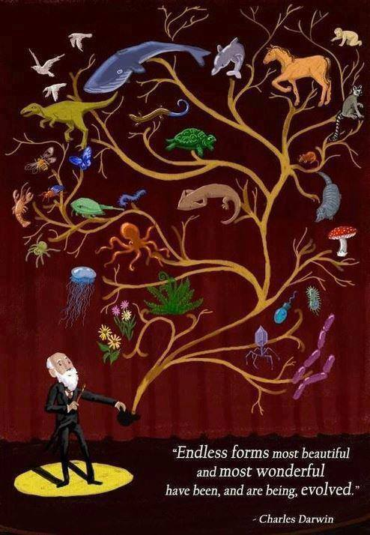

Slide 5
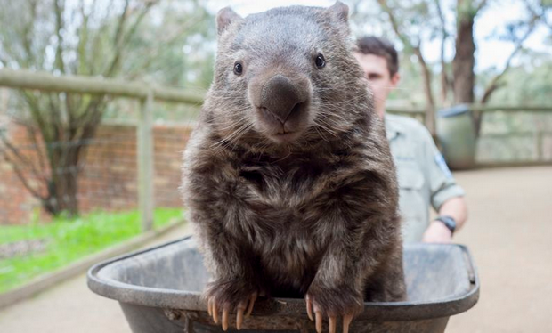
Patrick the Wombat
Legal relationship? Native animal; in animal reserve;
unable to be returned to the wild

Slide 6

Raz the Wonderdog
Legal relationship? Companion animal
Legal personhood in Switzerland

Slide 7
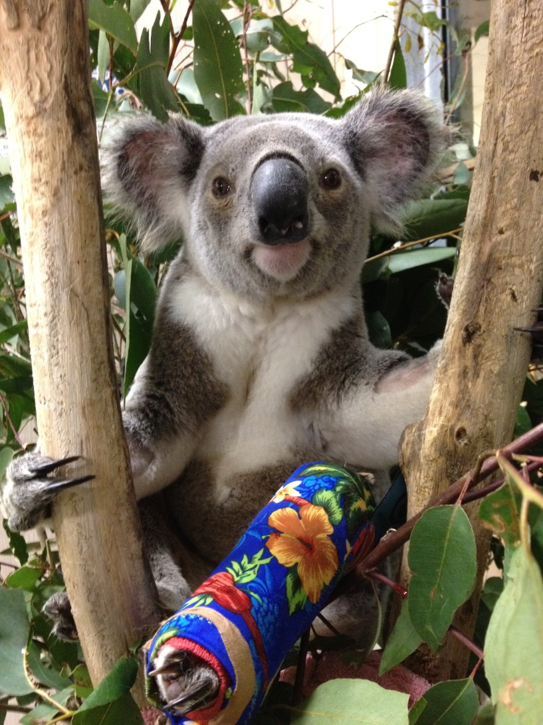
Carrie the Koala
Legal relationship? Native animal; rescued from the wild; to be returned to the wild (euthanasia?)

Slide 8
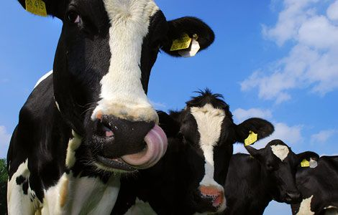
Katrina the Cow
Legal relationship? Farm/stock animal

Slide 9
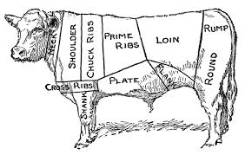

Slide 10
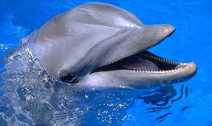
Donald the Dolphin
Legal relationship? Wild animal; oceans;
Captured and ‘on show’

Slide 11
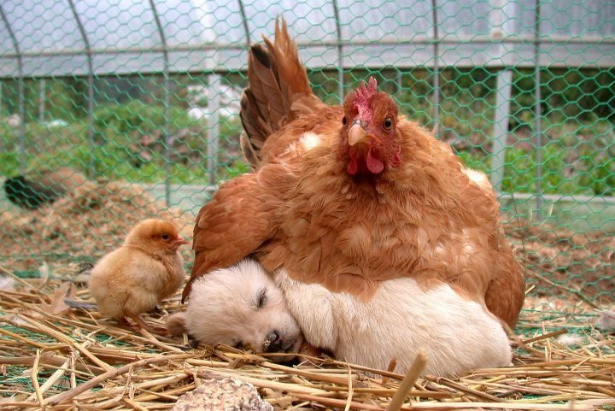
Henny Penny
Legal relationship? Farm animal, pet

Slide 12
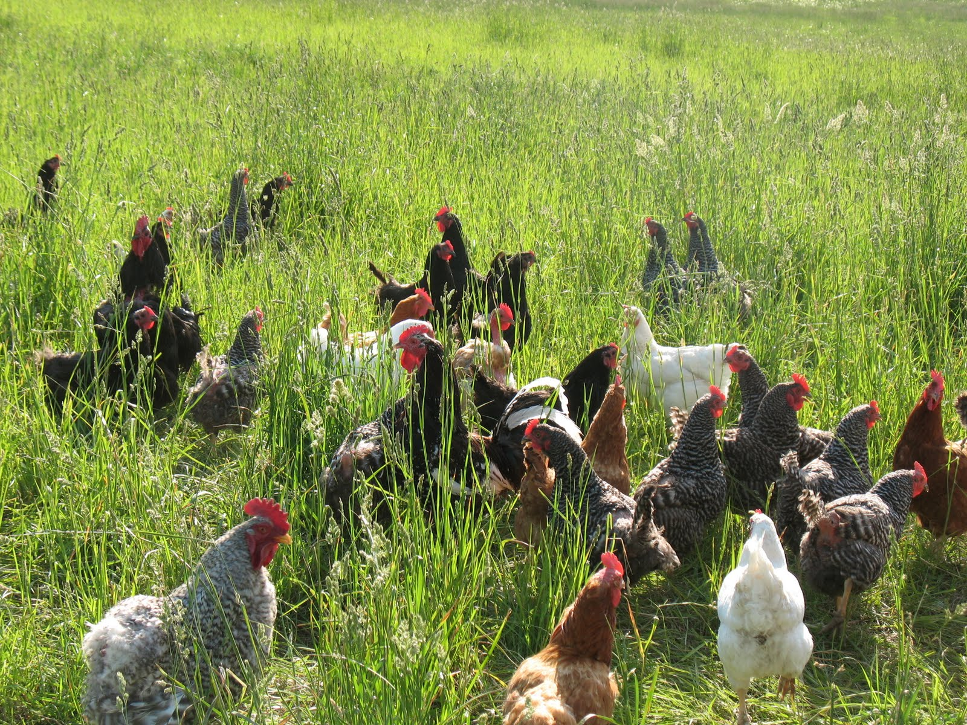

Slide 13
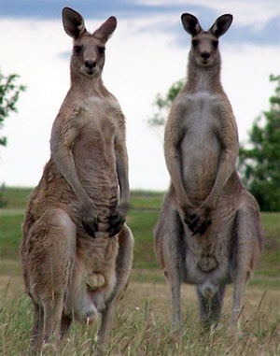
Robert and Ralph the Roos
Legal relationship?
Native animal;
in the wild; hunted,
eaten - “pet food”

Slide 14
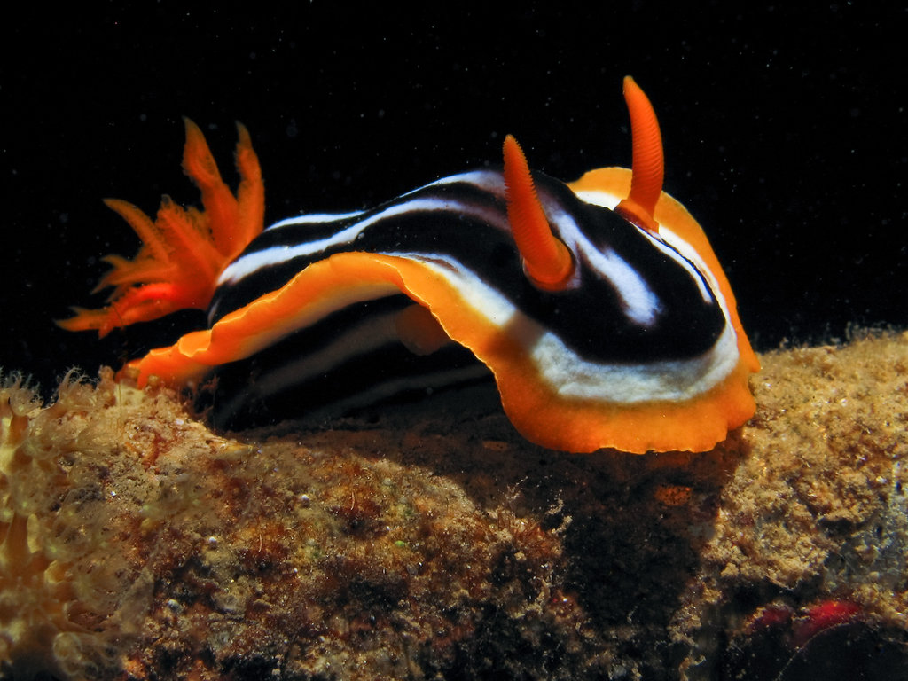
Sybil the Sea Slug
Legal relationship? Wild animal, oceans
(Mostly ignored)

Slide 15
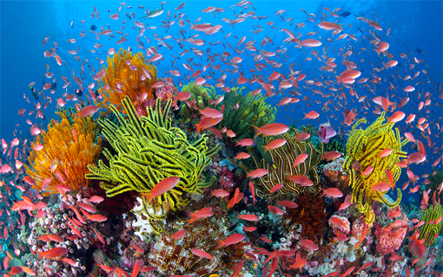
What about the Great Barrier Reef?
Legal relationship? Legal rights?

Slide 16
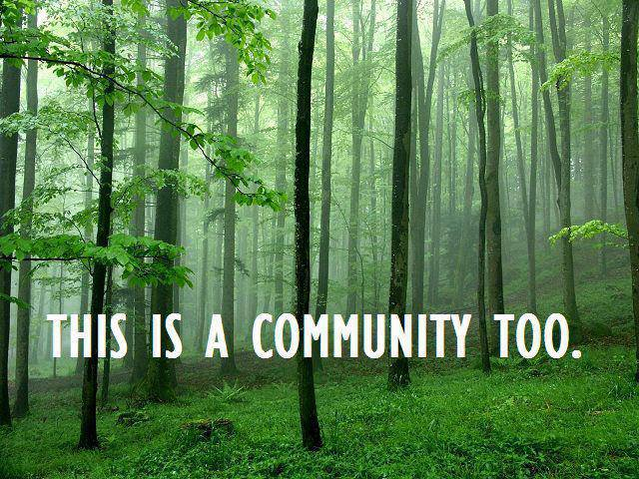

Slide 17
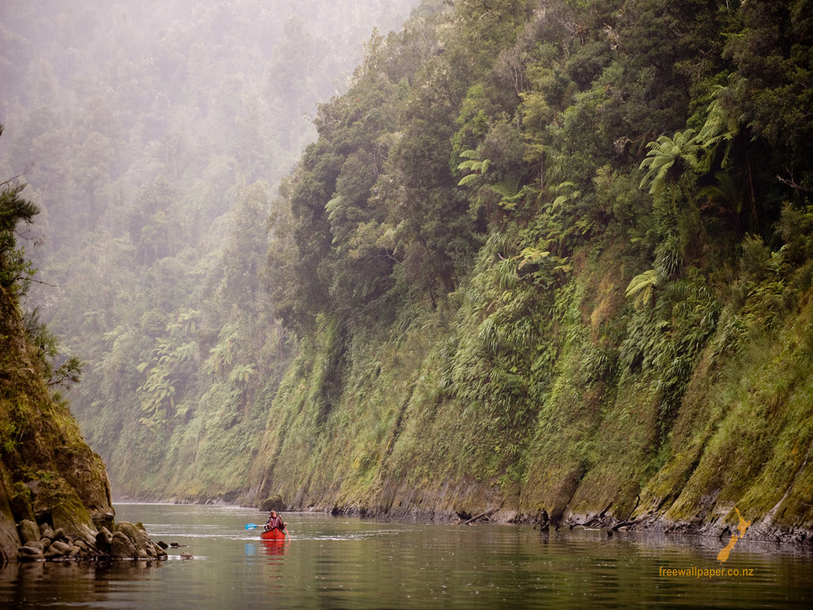
Whanganui River – New Zealand
Legal relationship? River has legal personhood

Slide 18
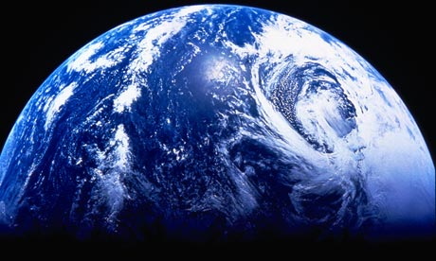

Slide 19
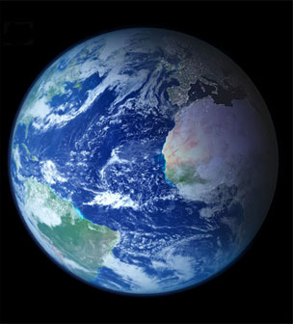
Ecological crisis
In 2005, a report compiled by over 2000 scientists from ninety-five countries concluded that:
60% of global ecosystem services were "being degraded or used unsustainably" including fresh water, fisheries, air and water purification and the regulation of natural hazards and pests.
(Millennium Ecosystem Assessment, 2005)

Slide 20
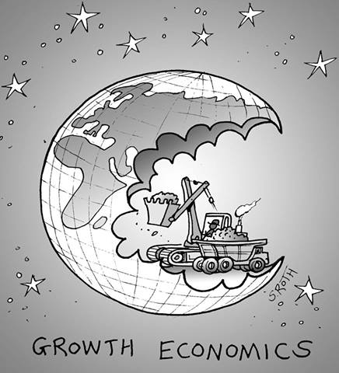
Consuming the Earth
We’re now using 1.5 earths
By 2030 we’ll need 2 earths
For the global population to live like North Americans, we’d need 4 planets
  Global Footprint Network (2013)
“Humanity has used more resources since 1950 than in all of previous human history”
  Alan Durning ‘How Much is Enough? The consumer society and the future of the earth’ (1992)

Slide 21

Human responses
Current ecological crisis is pushing humanity to search for new ideas, different ways of thinking, better ways of caring for our planet
  Science, politics, engineering and design, economics, philosophy, ethics, spirituality,
  law and governance

Slide 22
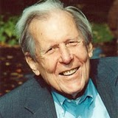
The work of Thomas Berry (1914-2009)
Coined the term ‘Earth Jurisprudence’
Deep ecology, earth philosophy
  Began his career as Catholic priest
  Cultural historian, eco-theologian/ cosmologist
  Earth scholar
His Legacy
  Has inspired hundreds of thousands of people
  Catalyst for movements around eco-spirituality
  Latter years, examined root problems of western governance and called for rights of nature
Thomas Berry

Slide 23
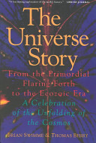
The Universe Story (1994)
Berry’s book with mathematical cosmologist Brian Swimme - ‘The Universe Story’ - proposed that a deep understanding of the history and functioning of the evolving universe is a necessary inspiration and guide for humanity

Slide 24
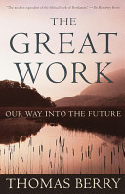
The Great Work: Our Way into the Future (1999)
Critique of the underpinning structures of the western industrialised world
Anthropocentrism is an attitude that is shared (and assumed) by all four of the fundamental establishments that control human affairs:
Law and Government
Economics - neoliberal growth economics; power of corporations
Universities – perpetuate current system, lack of critical thinking
Religion - Perpetuate human dominion and alienation from nature.

Slide 25
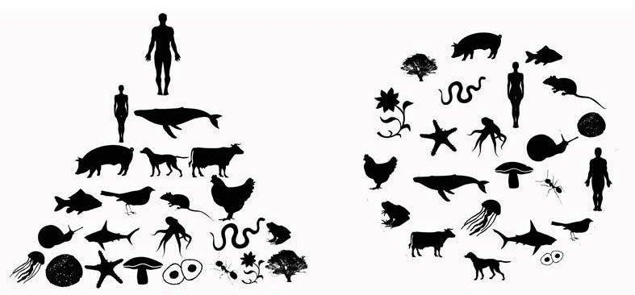
Berry called for us to shift all our governance systems to be ecocentric, and to nurture the Earth community
Human centred
Earth centred

Slide 26
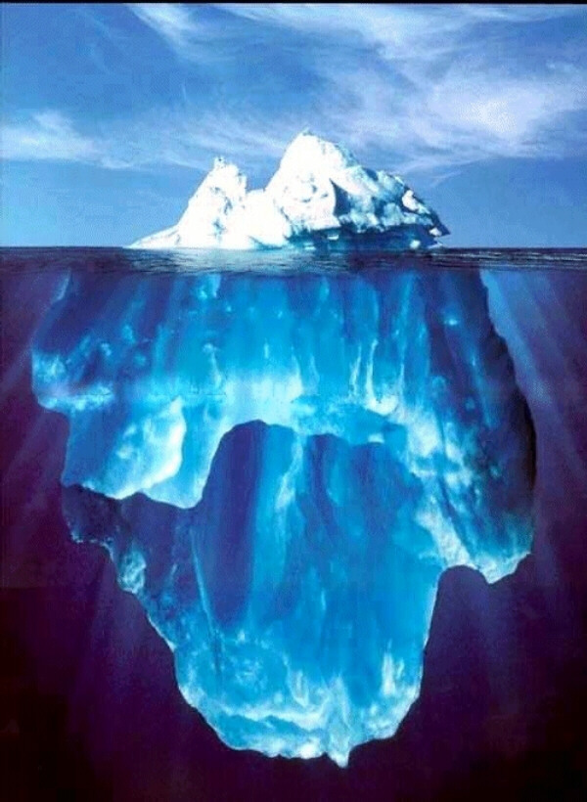
Economic –
Consumer capitalism
(Corporatism)
Legal, Political &
Institutional
Social/cultural
(consumer culture)
Earth laws
looks at
“what lies
beneath” and
argues for
systemic
change
Beliefs, Ideology -
anthropocentrism +
pro growth

Slide 27
Earth jurisprudence
Berry called for a new, earth centric governance system for humanity
‘Earth jurisprudence’ - emerging theory/philosophy of law and human governance that is based on the idea that humans are only one part of a wider community (the Earth community) and the welfare of each member of this community is dependent on the welfare of the earth as a whole
Doesn’t exclude humans – just asks us to
re-examine our privileged position on earth

Slide 28
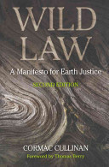
‘Wild Law: A Manifesto for Earth Justice’ – Cormac Cullinan (2002)
Response to Berry’s work
Direct call to the legal profession to embrace Earth Jurisprudence and earth-centredness
(not just about ‘the wild’ or wilderness)

Slide 29
Our evolutionary companions
[T]oday, legally speaking, it is not possible to murder an animal . . . no matter what the magnitude of the slaughter is or what degree of brutality, depravity or cruelty is involved. At worst one might fall foul of animal cruelty laws (which are probably mainly intended to protect human sensibilities) . . .
(Cullinan 2011: 70-1)

Slide 30
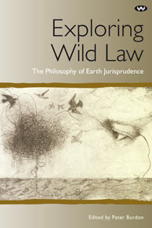

Slide 31
How does Earth jurisprudence differ from existing environmental law?
Environmental law has made great gains (eg air, water, protected areas) and has held off many destructive developments
But despite the proliferation of environmental laws globally during 20th Century, the natural world continues to deteriorate
→ Earth Jurisprudence argues environmental law just mitigates around the edges of the problem
→ permits destruction of the natural world
→ Anthropocentrism + pro-growth economics = pro development legal framework

Slide 32
Elements of Earth Jurisprudence
Current western legal system
Earth Jurisprudence
Human laws are the highest authority
Nature is a commodity for human use – property, other law reflects this
Rights for humans & corporations, but not natural world
Pro-growth ideology
Western legal systems often reject cultural diversity (eg frequent exclusion of indigenous knowledge and lore)
‘Great Law’ - laws of the natural world ‘higher’ than human laws
‘Earth Community’ - community of interdependent subjects
Rights of nature (challenges power of corporations)
Living within ecological limits
Encourages diversity in human governance – cultural pluralism, indigenous knowledge, ‘real’ democracy

Slide 33
Rights of Nature – global trends
Rights of Nature provisions
  USA – CELDF’s work since 2001 – dozens local ordinances, first ‘county’ laws introduced last month
  Ecuador 2008 – Constitution (successful case – Vilcabamba River)
  Bolivia 2010 – Act for Rights of Mother Earth
  2010 Universal Declaration of the Rights of Mother Earth
    30,000 people from 100 countries
New Zealand – rights granted to natural systems under Treaty of Waitangi processes (Maori negotiations with Government) – eg Whanganui River granted legal personhood rights + Urewara forest ecosystem
Also worth noting –
  Legal recognition of non-human animals
  Eg 2002 – Swiss Constitution recognises companion animals as living beings with legal status, not just objects (Antoine Goetschel’s trip to Australia earlier this year)
  2013 – India recognised legal rights of dolphins/cetaceans
  Growing recognition of rights for non-human earthlings

Slide 34
Universal Declaration of the Rights of Mother Earth
Article 1. Mother Earth
(1) Mother Earth is a living being.
(2) Mother Earth is a unique, indivisible, self-regulating community of interrelated beings that sustains, contains and reproduces all beings.
(3) Each being is defined by its relationships as an integral part of Mother Earth.
(4) The inherent rights of Mother Earth are inalienable in that they arise from the same source as existence.
(5) Mother Earth and all beings are entitled to all the inherent rights recognized in this Declaration without distinction of any kind, such as may be made between organic and inorganic beings, species, origin, use to human beings, or any other status.
(6) Just as human beings have human rights, all other beings also have rights which are specific to their species or kind and appropriate for their role and function within the communities within which they exist.
(7) The rights of each being are limited by the rights of other beings and any conflict between their rights must be resolved in a way that maintains the integrity, balance and health of Mother Earth.
http://pwccc.wordpress.com/programa/

Slide 35
Steven White “Wild law and animal law: some commonalities and differences”
Animal law – prevention of cruelty laws since colonial settlement; emergence as a strong field since1990s
Earth Jurisprudence – 21st Century
Core areas of examination
  Both critique current law for allowing exploitation of animals
  Both include rights based discourse – shift from objects to subjects
  Wild law doesn’t differentiate species by sentience or other ‘categories’ - everything has a place in the Earth community
  Reforming property doctrine – wild law calls for radical transformation

Slide 36
More questions
What would an earth centred legal system look like?
  Earth first – ecological integrity
What would it permit and prevent in society?
  Eg factory farming does not fit within a vision of Earth jurisprudence; small scale, sustainable organic farms can. But is this enough?
How would we frame legal recognition and protection of animals?
How do we get there from here?
  Reminder: civil society movements – votes for women; abolition of slavery

Slide 37
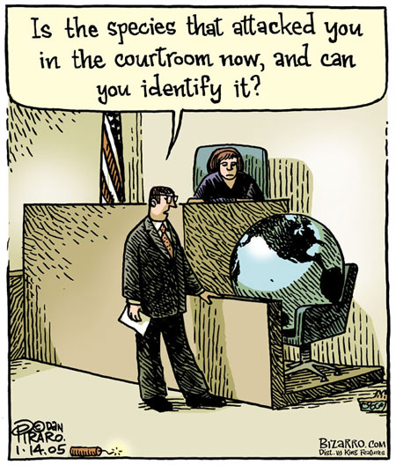

Slide 38
Issues for discussion
Why do our laws treat different animals differently?
Are our laws adequate?
In light of current political trends – retreat of the state, regression of environmental laws (and civil rights) –
  What can we do to ensure the protection and just treatment of our evolutionary companions?
  How do we handle increasing responsibilities being pushed back onto civil society?

