Slide 1
Organisational Costs of Conflict
Individual distress
mental &physical illness
absenteeism ESPECIALLY WHEN WORK IS INVOLVED
general dissatisfaction
Broken relationships
decreased productivity,
declining trust and morale
increased disharmony and disputation
Strained organisational resources
case management
difficulties with recruitment/membership
reduced retention.
TIME SPENT IN DISPUTATION
based on www.dpcd.vic.gov.au/communitysector
Notes:
Costs are not just monetary:
• Loss of productivity
• Loss of focus
• Draining of emotional energy
• Stress
• Strained or terminated relationships
• Loss of productivity
• Lower morale
• Damaged reputation
• More time spent on the conflict
• More money and other resources spent on the conflict

Slide 2
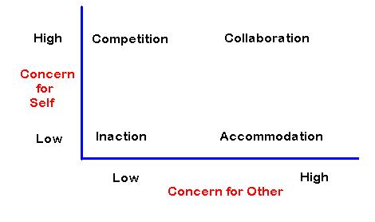
Conflict Styles

Slide 3
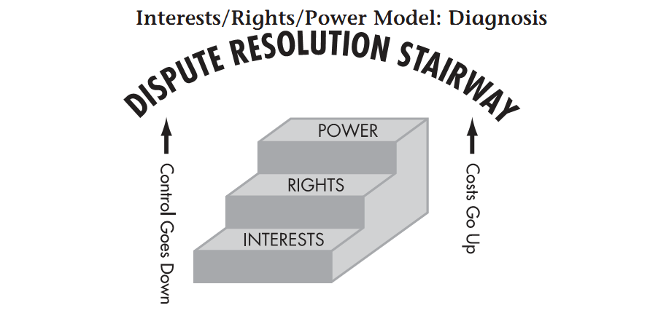
Furlong The Conflict Resolution Toolbox 2005
Notes:
Approaches to Conflict
1. Power based approaches use power to handle the problem.
I'm the boss. We do it my way. You do the dishes.
Can also use threats, manipulation, physical force, intimidation, strikes,
acts of disobedience
2. Rights-based approaches appeal to a general standard and apply it to a
particular case.
Our policy says the interns do the dishes.
May be explicit in laws, policy manuals, contracts, religious moral codes,
or may be implicit in given contexts.
3. Interest-based approaches ask the question “what needs or underlying
interests are you trying to address by taking a certain position?”
You'd rather to do the dishes, I'd rather take out the garbage.
Involves identifying underlying needs of the particular individuals in the
conflict to generate new ways of meeting as many needs as possible.
Interest based approaches require good listening skills. Good listening require a
certain amount of self-reflection and skills we can all learn and practice.

Slide 4
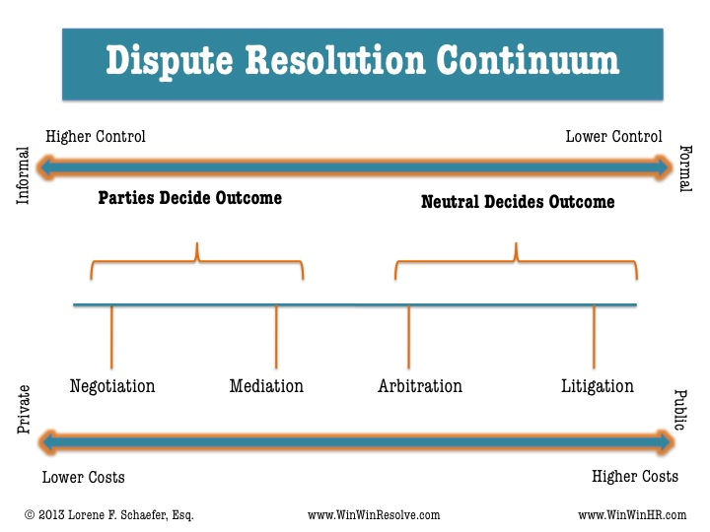

Slide 5
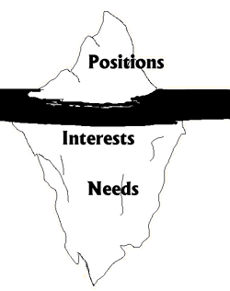

Slide 6
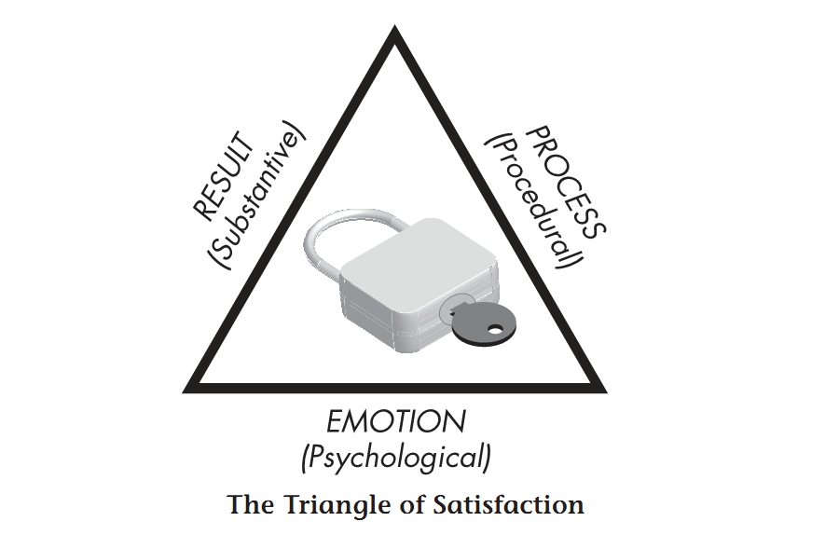
Furlong The Conflict Resolution Toolbox 2005

Slide 7
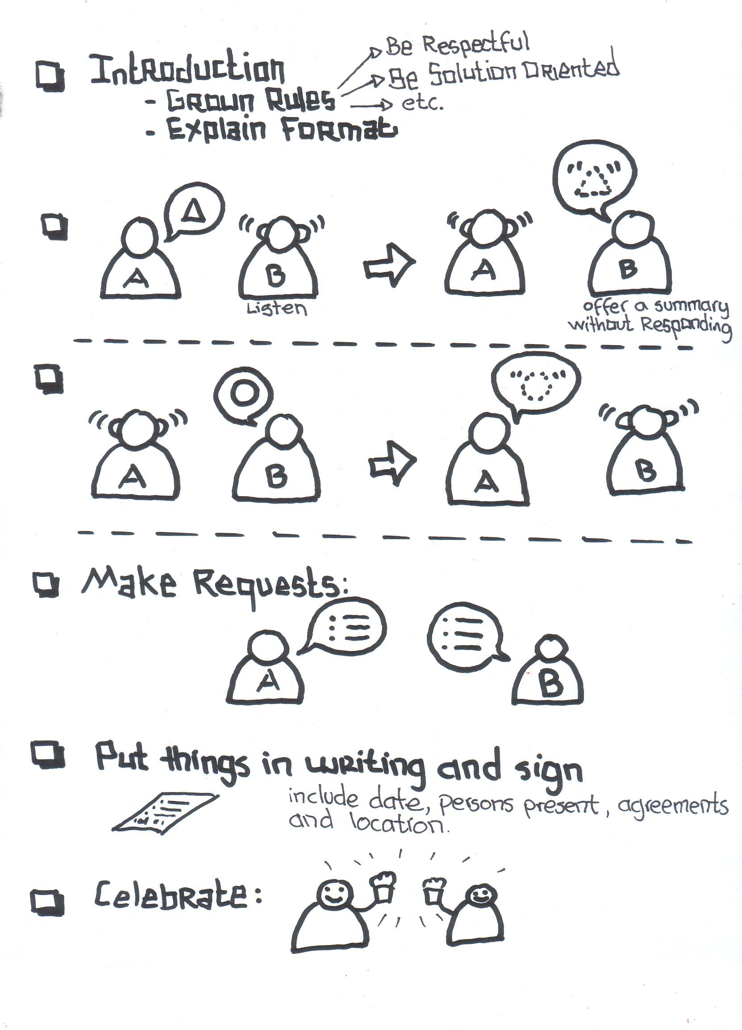
A STRUCTURED CONVERSATION
LA Eco Village https://laecovillage.wordpress.com/2011/08/08/outline-of-the-mediation-process/

Slide 8
Definition of Mediation
‘Mediation’ is a process in which parties to a dispute with the assistance of a neutral third party (‘the Mediator’) identify the disputed issues, develop options, consider alternatives and endeavour to reach an agreement.
The mediator has no advisory or other determinative role in regard to the content of the dispute or the outcome of its resolution, but may advise on or determine the process of mediation whereby resolution is attempted.

Slide 9
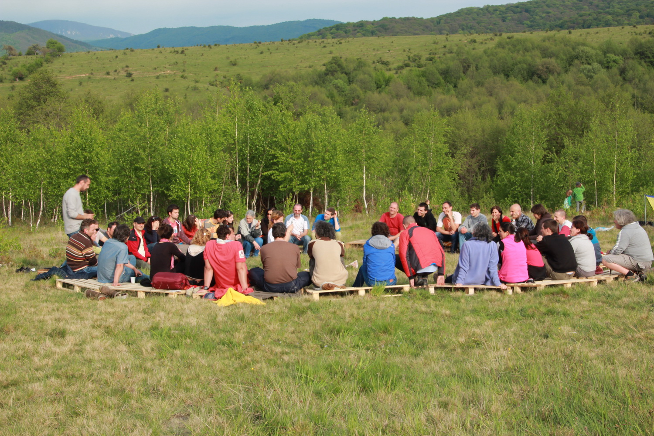
FACILITATION PROCESS
http://permaculturecollege.eu/summer-school/281/
Notes:
multi party,
planning,
Information
Conflict

Slide 10
A facilitator is:
“One who contributes structure and process to interactions so groups are able to function effectively and make high-quality decisions. A helper and enabler whose goal is to support others as they achieve exceptional performance.”
- Ingrid Bens

Slide 11
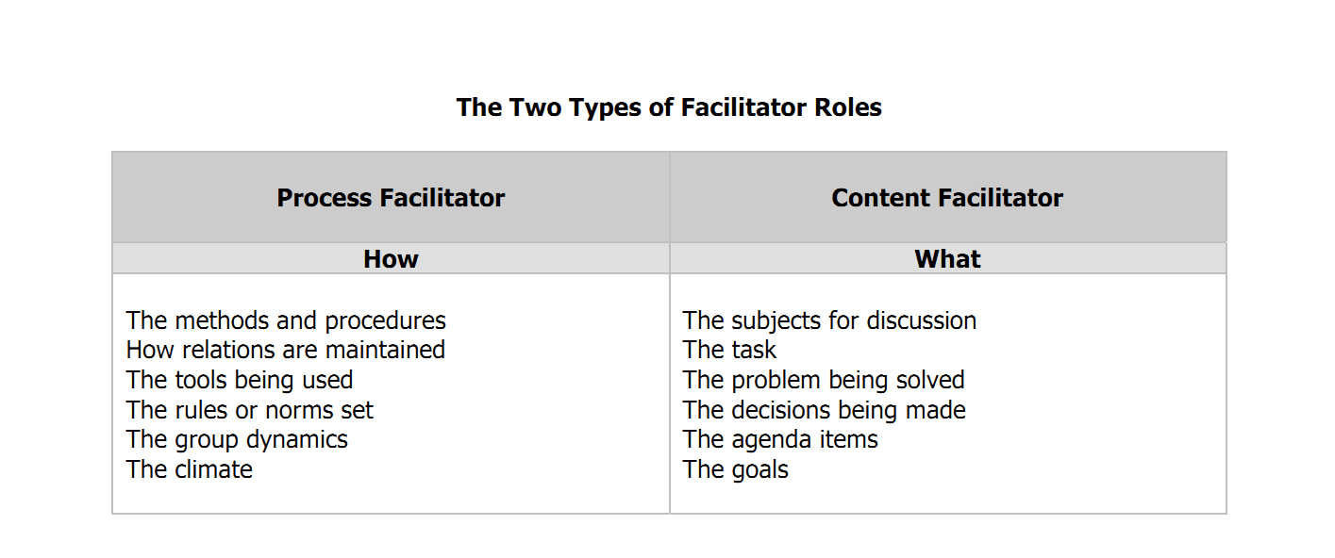
The Role of the Facilitator
http://www.virginia.edu/processsimplification/resources/Facilitator.pdf

Slide 12
Developing a ‘resolution culture’
Formal,
adversarial,
judgement,
blame,
punitive,
defensive,
draconian,
combative,
divisive,
sanction,
argument,
win-lose.
Informal,
safe,
talk,
listen,
empathy,
dialogue,
resolve,
non adversarial, collaborative,
openness,
values,
consensus,
win-win.

Slide 13
Imbedding Conflict Competence
Skill development
committee/board/management
membership and other stakeholders
Commitment to continuing skills development
allocation of resources
creating opportunities for application of skills
Structure and Processes reflecting
constituent documents
practices and procedures
expectations

Slide 14
Dispute Resolution Procedure in Constitution/Rules
40 Dispute Resolution Procedure
40.1 Application
40.1.1 The dispute resolution process set out hereunder applies to disputes under these Rules or otherwise arising from membership of this Association between—
40.1.1.1 a member and another member;
40.1.1.2 a member and the committee;
40.1.1.3 a member and the association.

Slide 15
Dispute Resolution Procedure in Constitution/Rules
40.2 Parties must attempt to resolve the dispute
The parties to a dispute under these Rules, or otherwise arising from membership of this association, must attempt to resolve the dispute between themselves within 14 days of the dispute coming to the attention of the parties.

Slide 16
Dispute Resolution Procedure in Constitution/Rules
40.3 Appointment of mediator
40.3.1 If the parties to a dispute are unable to resolve the dispute between themselves within the time required by rule 2, the parties must within 10 days—
40.3.1.1 notify the committee of the dispute; and
40.3.1.2 agree to or request the appointment of a mediator; and
40.3.1.3 attempt in good faith to settle the dispute by mediation.

Slide 17
Dispute Resolution Procedure in Constitution/Rules
40.3.2 The mediator must —
40.3.2.1 in the first instance be a person or persons appointed by the Dispute Resolution Centre Department of Justice and Attorney-General Queensland (“DRC”) provided that if the DRC is unable to or declines to appoint a mediator or mediator, then 40.3.2.2 applies;
40.3.2.2 be appointed by agreement between the parties, and in the absence of agreement be a person or persons appointed by the committee;
40.3.2.3 hold current national mediator accreditation pursuant to the National Mediator Accreditation Standards as determined by the Mediation Standards Board of Australia.
40.3.3 A mediator appointed by the committee may be a member or former member of the association but in any case must not be a person who in the opinion of the committee —
40.3.3.1 has a personal interest in the dispute; or
40.3.3.2 is biased in favour of or against any party.

Slide 18
Dispute Resolution Procedure in Constitution/Rules
40.4 Mediation process
40.4.1 The mediator to the dispute, in conducting the mediation, must—
40.4.1.1 give each party every opportunity to be heard; and
40.4.1.2 allow due consideration by all parties of any written statement submitted by any party; and
40.4.1.3 ensure that natural justice is accorded to the parties throughout the mediation process.
40.4.2 The mediator must not determine the dispute.
40.5 Failure to resolve dispute by mediation
If the mediation process does not resolve the dispute, the parties may seek to resolve the dispute in accordance with the Associations Incorporation Act Qld 1981 or otherwise at law.

Slide 19
Mediators and Facilitators SE Queensland
Manning Consultant | 07 3181 5745 | manningconsultants.com.au Karl Manning
Arc Consulting Group | 0401841893 | Brad Lewis
Private Mediation | 0405764283 | www.private-mediation.com Anna Faoagali
Australian Centre for Integrative Law | 0413143884 | www.integrativelawoz.com Cate Banks
Dispute Resolution Centre Qld | 07 3006 2518 | Dept of Justice & Attorney-General

