Slide 1
What to consider in a start up?
Amelia Salmon

Slide 2
Most of us start from here …

Slide 3
But before we know it we’re here

Slide 4
How do we find our way out of the confusion?

Slide 5
Brainstorming Sticks and Stucks
What are you getting stuck on?
What’s bringing you to a stand still?
What burning questions did you come with today?

Slide 6
1st things1st: Strategy should drive structure
What are your core goals?
Who are the leadership and main drivers….how do they want to work together?
Do you need/want a democratic membership base?
What business models is driving what you are doing … how do you plan to pay for expenses? (many groups put a whole lot of work into developing a whole organization with a fabulous strategic plan ..without ever getting clear about their business model)

Slide 7
1.Strategic Planning
Vision and Mission
Strategy
SMART Goals (Specific Measurable Achievable Realistic Timely)
Operations Plan
Who, what, where, when.

Slide 8
2. Who are you?
Are you a groups of people wanting to share resources to create a project or enterprise … or just to make your individual resources go further?
Are you an individual starting an enterprise?
Are you an individual starting a social enterprise?
Are you a group starting a social enterprise?

Slide 9
How will measure you’re your impact?
Be clear on the social problem you want to solve.
Plan for impact measurement from the start.
Collect baseline data.
Some evaluation and measurement tools:
Program Logic
(SROI) Social Return in Investment
Most Significant Change –story telling and generative

Slide 10
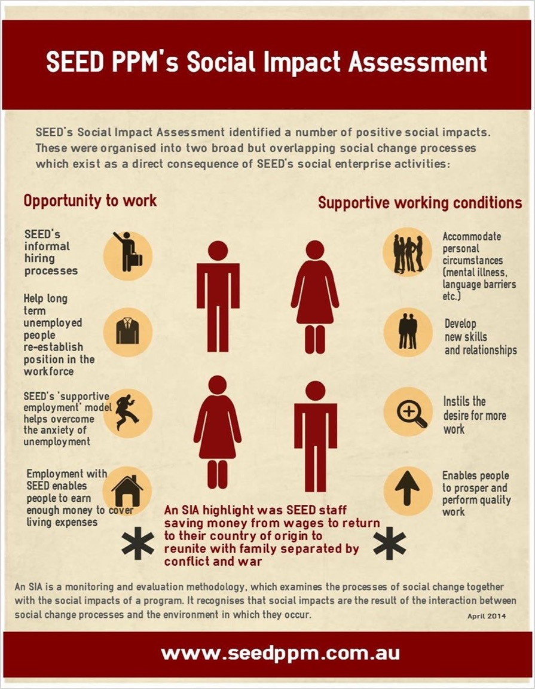

Slide 11
3.What’s your business model
Burkett, I. 2014, Business Model generation for Social Enterprise, Knode, p.7

Slide 12
4. Generating your Business model
Burkett, I. 2014, Business Model generation for Social Enterprise, Knode, p.9

Slide 13
Social Enterprise
For Profit Legal Structure |  |  |  | Not for Profits
Pty Ltd Company | Sole Trader | Partnership | Trading cooperative | Non -Trading cooperative | Incorporated Association | Company Ltd by Guarantee
Trading | Trading | Trading | Trading | - Can run enterprise | - For range of social and environmental purpose | Range of social and environmental purpose
Greater protection of personal assets |  |  | Resource sharing | - Resource sharing | Member driven | Not necessarily member driven
 |  |  | Member driven | Member driven
 |  |  | Share holders | Assets can’t be distributed to members | Assets can’t be distributed to members | Assets can’t be distributed to members

Slide 14
Resources
http://knode.com.au/
http://www.businessmodelgeneration.com/
http://www.spiral.org.au/
http://www.qsec.org.au/
http://www.qpilch.org.au/
http://www.earthlaws.org.au/

