Slide 1
The ‘collaborative economy’ and Australia’s Sharing Law Network
Michelle Maloney, National Convenor, AELA
26 June 2015

Slide 2
This presentation
AELA’s inspiration –deep ecology and the interconnectedness of the Earth community
Why we’re committed to strengthening Earth friendly organisations, through legal and governance support
The Australian Sharing Law Network
The Australian Handbook for Sharing Law and Earth Friendly Governance

Slide 3
AELA’s inspiration

Slide 4
Ecological crisis
Our starting point is the ecological crisis
In 2005, a report compiled by over 2000 scientists from ninety-five countries concluded that:
60% of global ecosystem services were "being degraded or used unsustainably" including fresh water, fisheries, air and water purification and the regulation of natural hazards and pests.
(Millennium Ecosystem Assessment, 2005)

Slide 5
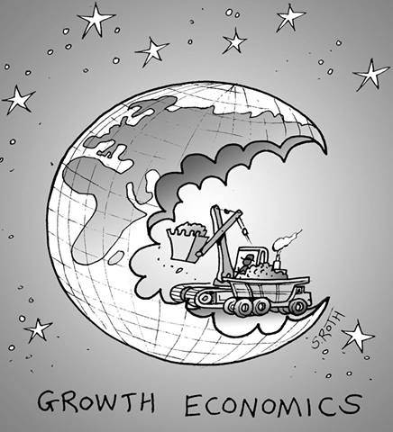
Consuming the Earth
We’re now using 1.5 earths
By 2030 we’ll need 2 earths
For the global population to live like North Americans, we’d need 4 planets
Global Footprint Network (2013)
“Humanity has used more resources since 1950 than in all of previous human history”
In the now ‘classic’ book on consumption –
Alan Durning ‘How Much is Enough? The consumer society and the future of the earth’ (1992)

Slide 6
IPCC Synthesis Report - 2014
Human influence on the climate system is clear, and recent anthropogenic emissions of greenhouse gases are the highest in history. Recent climate changes have had widespread impacts on human and natural systems.
CO2 concentrations have increased by 40% since pre-industrial times, primarily from fossil fuel emissions and secondarily from net land use change emissions.
IPCC Assessment Report 2014
http://www.ipcc.ch/pdf/assessment-report/ar5/syr/AR5_SYR_FINAL_SPM.pdf

Slide 7
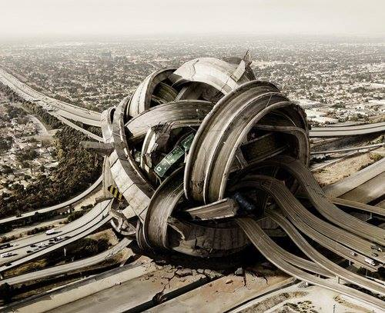
How can we respond to the ecological crisis?

Slide 8
AELA is inspired by the work of Thomas Berry (1914-2009)
Coined the term ‘Earth Jurisprudence’
Wrote ‘The Universe Story’ with Brian Swimme
- proposed that a deep understanding of the history and functioning of the universe is a necessary inspiration and guide for humanity
Thomas Berry

Slide 9
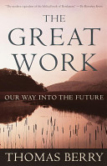
The Great Work: Our Way into the Future (1999)
Critique of the underpinning structures of industrialised society
Looked at all four of the fundamental establishments that control human affairs:
Law and Government
Legal system is supporting exploitation rather than protecting the natural world from destruction
Economics - neoliberal growth economics; power of corporations
Universities – perpetuate current system, teach and reward focus on consuming the earth
Religion - Perpetuate human dominion and alienation from nature.
Anthropocentrism + pro-growth

Slide 10
Economic –
Consumer capitalism
(Corporatism)
Legal, Political &
Institutional
Social/cultural
(consumer culture)
AELA’s approach is a response to “The Great Work” → “the ideas that lie beneath”
Beliefs, Ideology, culture - anthropocentrism +
pro growth

Slide 11
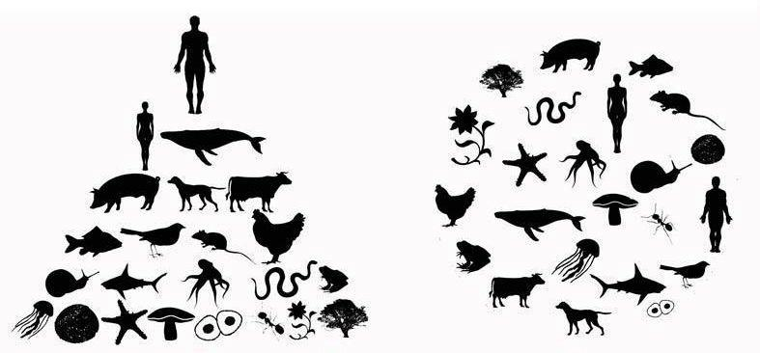
Earth jurisprudence calls for us to examine the root causes of the current crisis and shift all our governance systems from human centred to Earth centred
Human centred
Earth centred

Slide 12
Shifting to Earth centred law and governance means we need to ‘shift’ our economic system too

Slide 13
From AELA’s website:
“AELA recognises the fundamental role that the dominant economic system plays in supporting the destruction of the natural world. We also recognise the role that our legal system plays in creating, perpetuating and potentially challenging, this economic system.
We are working collaboratively with economic experts and community advocates, to promote analysis, understanding and responses to the current flawed economic system that dominates human activity and drives the deterioration of the Earth community. We are particularly keen to support the creation of small scale, community building economic alternatives that nurture human societies and the wider Earth community; this is one of the reasons we’re supporting the sharing economy in Australia by facilitating the Australian Sharing Law Network and developing the Australian Handbook for Sharing Law and Earth Friendly Governance.”

Slide 14
The sharing or ‘collaborative’ economy
The Sharing Economy (sometimes also referred to as the peer-to-peer economy, collaborative economy, collaborative consumption) is a socio-economic system built around the sharing of human and physical assets.
Increase community connections, self reliance, ‘social capital’
Increase community scale economies
Decrease living costs
Decrease resource use (reduce consumption)

Slide 15
Inspiration – Sustainable Economies Law Center (US)
SELC cultivates a new legal landscape that supports community resilience and grassroots economic empowerment. They provide essential legal tools so communities everywhere can develop their own sustainable sources of food, housing, energy, jobs, and other vital aspects of a thriving community.
Four areas
1) Shareable Transportation
2) Food and the Sharing Economy
3) Shareable Housing
4) Job Creation and the Sharing Economy
Focus on building co-operatives – see them as the best organisational model for participative democracy

Slide 17
Australian Sharing Law Network
Australian Earth Laws Alliance
UNSW - Professor Bronwen Morgan,
University of Melbourne, new clinic - Brad Jessup,
Environmental Justice Australia (formerly EDO Victoria) – Brendan Sydes
Strategies to create legal clinics and services along similar lines as SELC
We welcome your ideas, suggestions, questions

Slide 18
Australian Handbook for Sharing Law and Earth Friendly Governance
The Handbook will aim to provide an up-to-date overview of legal frameworks for creating effective organisational governance, and for nurturing sharing projects in Australia.
The Handbook will be particularly focussed on assisting grass roots, Earth friendly organisations who work to support people and planet.
Part 1 of the Handbook will include sections on legal and organisational structures, financial and fundraising models, community building, handling conflict and managing burn out.
Part 2 of the Handbook will focus on legal frameworks for building sharing projects in Australia, and has been inspired by the fabulous work of Janelle Orsi and her team at the Sustainable Economies Law Centre in California, and their book titled: ‘Practicing Law in the Sharing Economy’.

Slide 19
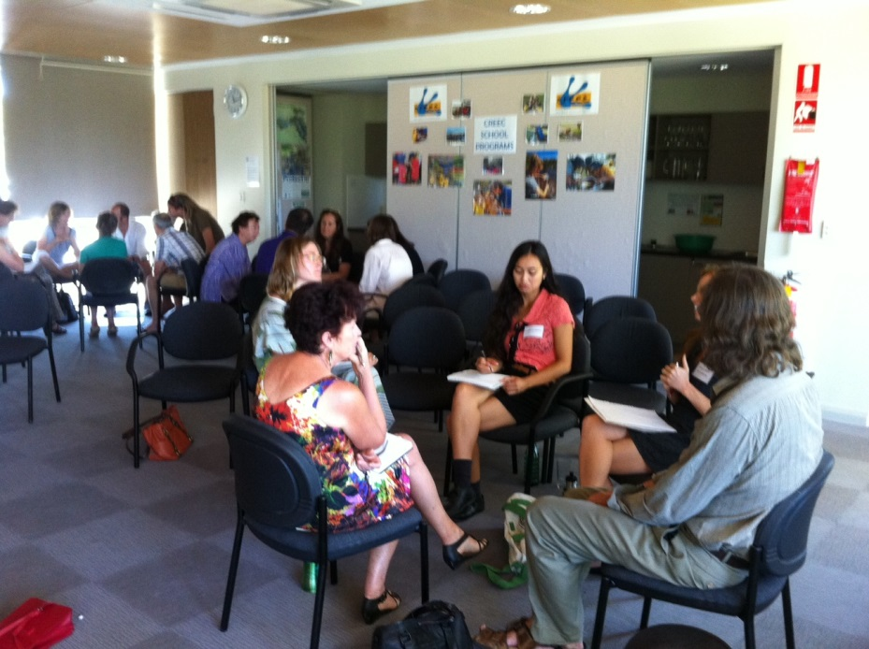
Supporting Earth Friendly Organisations
We’re looking forward to trialling ‘Legal Cafes’ in Brisbane from August onwards, to provide tailored information around specific legal issues
More information about this in the next session!
This is part of our effort to develop legal and governance services dedicated to Earth Friendly organisations
AELA invites everyone to share your views with us, about what types of legal and governance support will help your group, network and organisation

Slide 20
