Slide 1
Who are the EDO Qld?
Revel Pointon
Solicitor
EDO (Qld) Inc.

Slide 2
Who are EDO Qld?
Environmental Defenders Office (Qld)
not a government organisation
not government funded
not a private law firm
Non-profit Community Legal Centre
Expertise in Environmental Law
This material is for information purposes and is not legal advice.

Slide 3
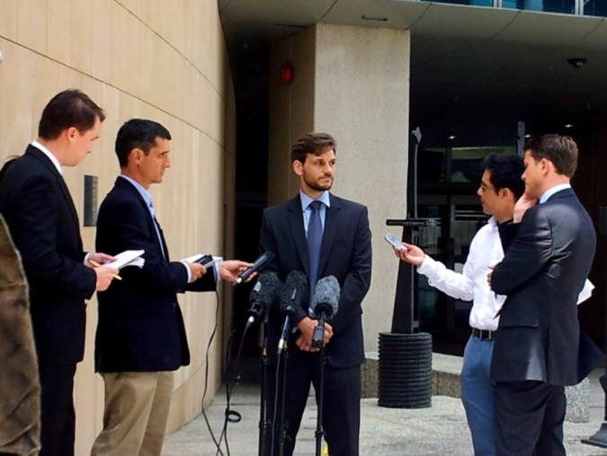
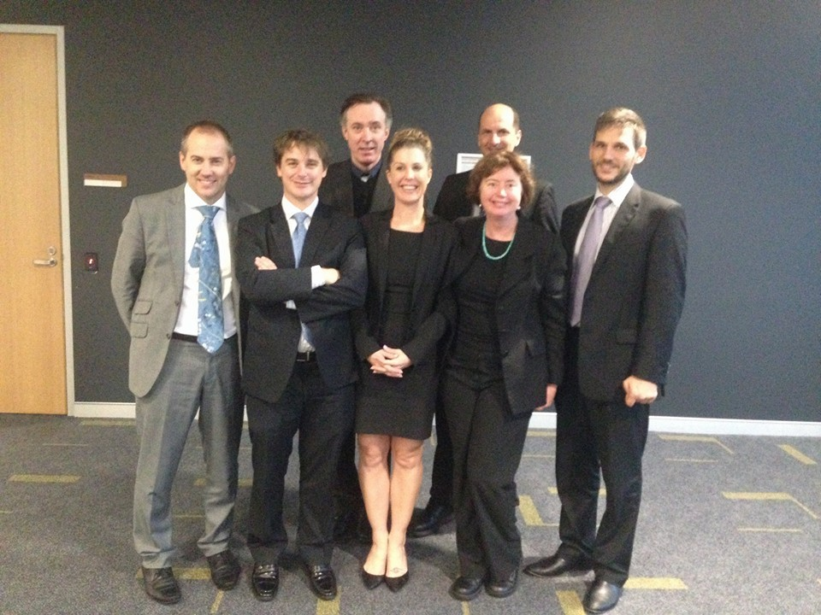
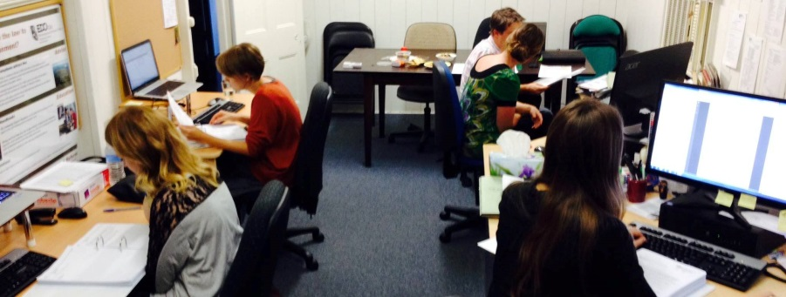
The EDO Qld team
This material is for information purposes and is not legal advice.

Slide 4
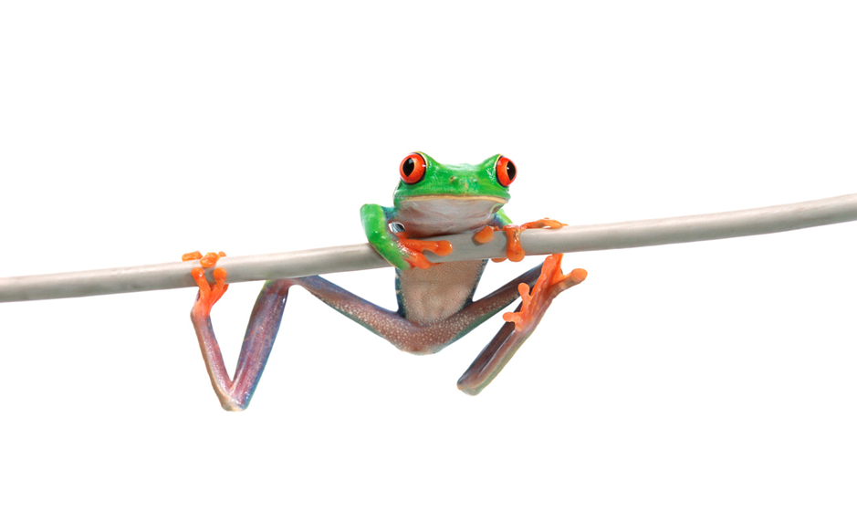
What do we do?
Legal advice;
Representation;
Legal education; and
Law reform.
...public interest
environmental law
This material is for information purposes and is not legal advice.

Slide 5
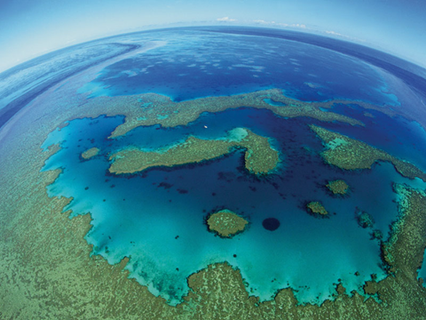
Environmental law
Legislation and common law which regulates the interaction between humans and the environment:
the natural environment;
the built or urban environment (planning laws).
Laws and policies concerning town planning, pollution control, conservation and remediation.
International, federal, state and local laws and policies.

Slide 6
We provide legal advice
Understanding laws and how they impact your region / environmental concern e.g. planning, koalas, vegetation etc
Preparing submissions and getting involved with decision making
Recent advices:
…. concerns over vegetation clearing, peaceful assembly, kangaroo culling, illegal mangrove clearing, pesticide use, public land protection, noise from freeway, run-off pollution from a tip, proposed filling in of migratory bird habitat, rerouting of a creek, environmental nuisance from unauthorised industry in residential area, protection of heritage properties; coal train noise; pollution from poultry farms; koala habitat protection; inappropriate development; how to protect open space from development…

Slide 7
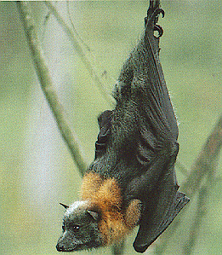
We provide legal representation
Flying Fox case: Protecting flying foxes in
Wet Tropics World Heritage Area from large-scale
electrocution without permits – Booth v Bosworth
Nathan Dam case: ensuring the
environment minister must consider downstream
impacts in federal environmental assessment
GBR dredging and dumping cases: NQCC (AAT) and Mackay Conservation Group (Federal Ct) against the dredging and dumping of dredge waste in the GBRMP; and Alliance to Save Hinchinbrook Inc. (Federal Ct) re. Caley Valley Wetlands dumping
Mega coal mine cases: (Land Services of) Coast and Country Association of Queensland Inc. actions in the Land Court against Carmichael, Alpha and Kevin’s Corner coal mines

Slide 8
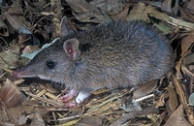
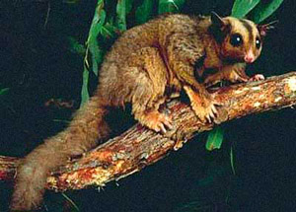
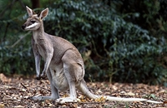
We undertake law reform and education
Law reform:
Preparing submissions to legislative changes
Legal education:
Presentations to community groups on any issue of planning and environment law - e.g. changes to laws, understanding development processes effecting their area/concerns etc.

Slide 9
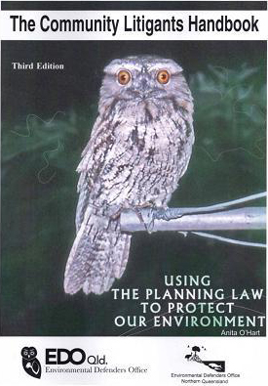
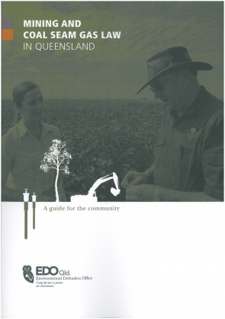
EDO Qld’s publications
This material is for information purposes and is not legal advice.

Slide 10
EDO Qld Advice Line
Free advice service for public interest environmental legal questions
Every Tuesday evening (but send through your questions anytime!)
Direct enquiries to:
edoqld@edoqld.org.au
07 3211 4466

Slide 11
Thanks for listening! Any questions? www.edo.org.au/edoqld facebook.com/EDO.Qld twitter.com/EDO_Qld
This material is for information purposes and is not legal advice.

