Slide 1
AELA’s “Legal Café”
Jordan Mathas-Carleton & Janelle Fabio, AELA
26 June 2015

Slide 2
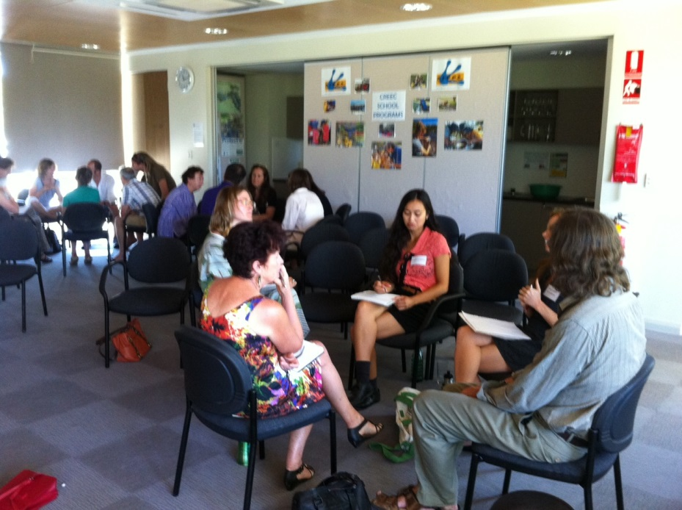
Supporting Earth Friendly Organisations
AELA is committed to supporting Earth friendly organisations
As part of this commitment, we’re going to trial a new initiative in Brisbane in August and November:
→“AELA’s Legal Café”

Slide 3
Inspired by SELC, but ‘made in Queensland’
One of the inspirations for AELA’s Sharing Law work, the Sustainable Economies Law Center (SELC), has been running legal cafes for several years
The idea is to create a friendly, open space for people to drop in and chat about their legal and governance issues
We’ll provide referrals, and help with follow up work where possible
AELA’s National Convenor, Michelle Maloney, joining the discussions at SELC’s Legal Café, March 2015 Oakland, the Bay Area/California

Slide 4
How will the Legal Café’s work?
We plan to hold them on a weeknight, in a friendly café in West End or Southbank (eg from 6pm to 8pm)
One in August, another in October or November
Each legal café will have a specific, focussed topic
We’re planning to focus our August Legal Café on housing – share housing, tiny housing – all things housing ☺
Our next Legal Café may focus on community gardens and land-sharing
Each “Café”
Will commence with a short talk by invited legal specialists and AELA volunteers
Involve discussion of ‘real’ case studies by legal specialists
Discussions between the lawyers and interested groups

Slide 5
We’d welcome your views!
AELA is in the early stages of building a dedicated legal and governance support services for organisations across Australia who are devoted to protecting and restoring our precious natural world
We’d welcome your views about:
Topics and issues for future Legal Cafes
Community groups that we should connect with and invite
Please visit us in the final part of this session, (down the back!) and tell us your thoughts ☺

Slide 6
Share your ideas/get in touch ☺
Visit our webpage
http://www.earthlaws.org.au/what-we-do-australia/sharing-law-network/
Visit our facebook discussion page (the link is on our webpage)
Send us an email – sharinglaw@earthlaws.org.au

