Slide 1

Responding to the Great Work: the Australian Earth Laws Alliance
Dr Michelle Maloney
Australian Earth Laws Alliance
Faith, Earth Ethics and Professional Life Seminar -18 August 2015
www.earthlaws.org.au

Slide 2
This presentation
About the Australian Earth Laws Alliance
  Our inspiration
  Our vision
  Our work
My personal journey co-creating AELA
Recent developments and the link between my personal beliefs and faith, and my professional life
Some questions for us to discuss together

Slide 3
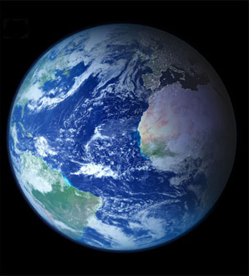
Ecological crisis
In 2005, a report compiled by over 2000 scientists from ninety-five countries concluded that:
60% of global ecosystem services were "being degraded or used unsustainably" including fresh water, fisheries, air and water purification and the regulation of natural hazards and pests.
(Millennium Ecosystem Assessment, 2005)

Slide 4
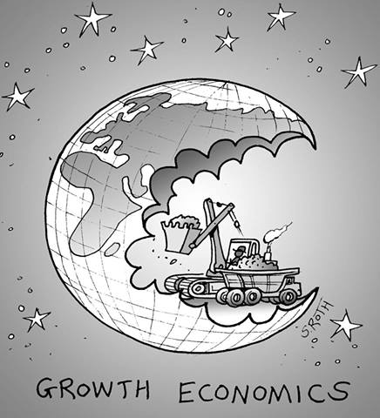
Consuming the Earth
We’re now using 1.6 earths
By 2030 we’ll need 2 earths
If the global population lived like ‘average’ Australians, we’d need 4.8 planets
  Global Footprint Network (2015)
“Humanity has used more resources since 1950 than in all of previous human history”
  Alan Durning ‘How Much is Enough? The consumer society and the future of the earth’ (1992)

Slide 5
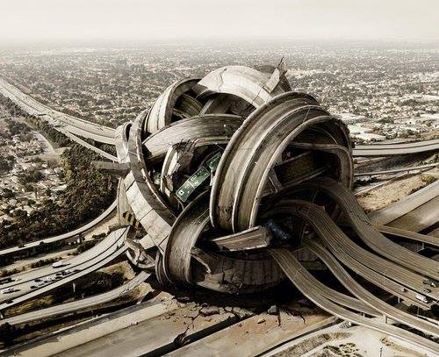
How can we understand the ecological crisis?

Slide 6
How did we get here?
“Perfect storm” began with Industrial Revolution, eye of the storm mid 20th Century
  Population growth
  Technological innovation (powered by cheap fossil fuels)
  Resource consumption/pollution
  Global governance – Empire + corporations/governments
  Our anthropocentric world view
Great books about how we got here
  Karl Polanyi, The Great Transformation
  Robert Lekachman, The Age of Keynes.

Slide 7

Human responses
Current ecological crisis is pushing humanity to search for new ideas, different ways of thinking, better ways of caring for our planet
  Science, politics, economics, philosophy, ethics, spirituality, law and governance

Slide 8
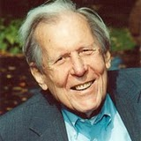
The work of Thomas Berry (1914-2009)
Coined the term ‘Earth Jurisprudence’
Deep ecology, earth philosophy
  Began his career as a Catholic priest
  Cultural historian, eco-theologian/ cosmologist
  Earth scholar
His Legacy
  Has inspired hundreds of thousands of people
  Catalyst for movements around eco-spirituality
  Latter years, examined root problems of western governance and called for rights of nature
Thomas Berry

Slide 9
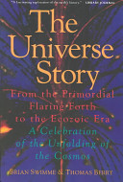
The Universe Story (1994)
Berry’s book with mathematical cosmologist Briane Swimme - ‘The Universe Story’ - proposed that a deep understanding of the history and functioning of the evolving universe is a necessary inspiration and guide for humanity

Slide 10
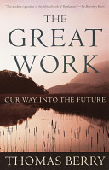
The Great Work: Our Way into the Future (1999)
Critique of the underpinning structures of industrialised society
Looked at all four of the fundamental establishments that control human affairs:
Law and Government
  Legal system is supporting exploitation rather than protecting the natural world from destruction
Economics - neoliberal growth economics; power of corporations
Universities – perpetuate current system, teach and reward focus on consuming the earth
Religion - Perpetuate human dominion and alienation from nature.
Anthropocentrism + pro-growth

Slide 11
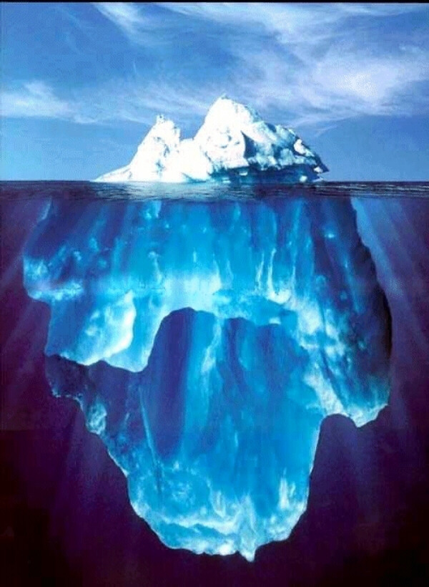
Economic –
Consumer capitalism
(Corporatism)
Legal, Political &
Institutional
Social/cultural
(consumer culture)
“the ideas that
lie beneath”
Beliefs, Ideology, culture -
anthropocentrism +
pro growth

Slide 12
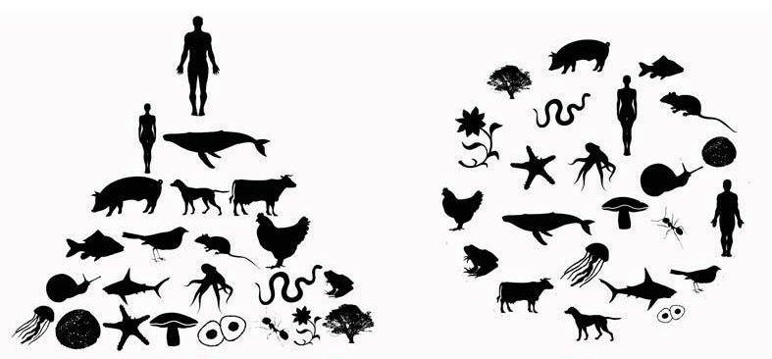
Earth jurisprudence calls for us to examine the root causes of the current crisis and shift all our governance systems from human centred to Earth centred
Human centred
Earth centred

Slide 13
Earth jurisprudence
An emerging philosophy of law and human governance that is based on the idea that humans are only one part of a wider community (the Earth community) and the welfare of each member of this community is dependent on the welfare of the earth as a whole
Interdependence, interconnectedness

Slide 14
What is jurisprudence?
Jurisprudence = study and theory of law; helps to obtain a deeper understanding of law – legal reasoning, legal systems, legal institutions
There are different types of jurisprudence; different ‘theories’ of law
  Eg feminist, Marxist, Earth jurisprudence

Slide 15
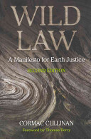
‘Wild Law: A Manifesto for Earth Justice’ – Cormac Cullinan (2002)
Response to Berry’s work
Direct call to the legal profession to embrace Earth Jurisprudence and earth-centredness
(not just about ‘the wild’ or wilderness)

Slide 16
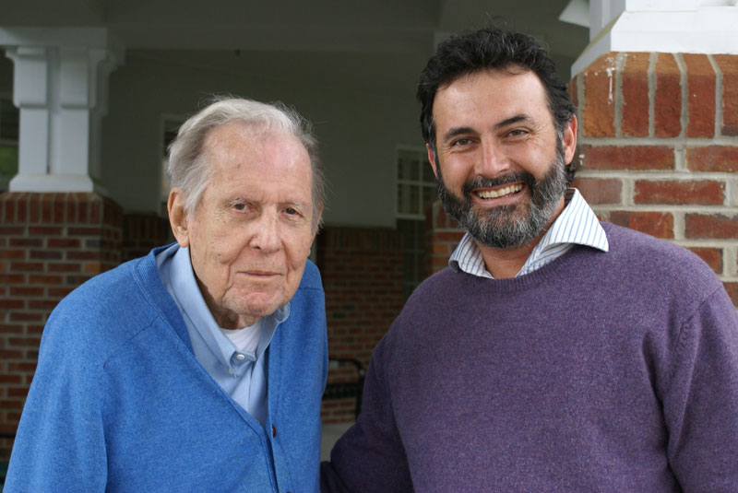
Wild laws regulate humanity in accordance with Earth Jurisprudence
Cullinan suggests law needs to be creatively reinterpreted, allowed to be imaginative, wild; reconnected to our biophysical reality
Looks to systems theory, quantum physics
What can we learn from indigenous knowledge systems?
“flashes” of wild law exist in present laws and can be built on – but we also need to rethink and create new systems
Thomas Berry and Cormac Cullinan

Slide 17
How does Earth jurisprudence differ from existing environmental law?
Environmental law has made great gains (eg air, water, protected areas) and has held off many destructive developments
→ Earth Jurisprudence argues environmental law just mitigates around the edges of the problem
→ Anthropocentrism + pro-growth economics = pro development legal framework
Despite the proliferation of environmental laws globally during 20th Century, the natural world continues to deteriorate

Slide 18
Elements of Earth Jurisprudence ☺
Current western legal system
Earth Jurisprudence
Human laws are the highest authority
Nature is a commodity for human use – property, other law reflects this
Rights for humans, corporations, ships - but not natural world
Pro-growth ideology
Western legal systems often reject cultural diversity (eg frequent exclusion of indigenous knowledge and lore)
‘Great Law’ - laws of the natural world ‘higher’ than human laws
‘Earth Community’ - community of interconnected subjects
Rights of nature
Living within ecological limits
Encourages diversity in human governance – cultural pluralism, indigenous knowledge, Earth democracy

Slide 19
AELA’s work
A ‘professional’ response to the ecological crisis
and the call of deep ecology
A response to the failings of our professional
discipline to nurture the Earth community

Slide 20
The Australian Earth Laws Alliance: our evolution
Conferences brought environmental lawyers, philosophers, community activists together
  2009 – Wild Law, Adelaide
  2010 – Keeping the Fire, Wollongong
  2011 – Building Theory and Practice, Brisbane
  2013 – Living within our ecological limits, Brisbane
By our 2011 conference, core group decided to create a permanent space to ‘hold’ wild law and earth jurisprudence
Incorporated March 2012
Board of Management, membership of around 150 people, 2000 people on our mailing list,
20-30 active volunteers at any time (research, admin, events, projects)

Slide 21
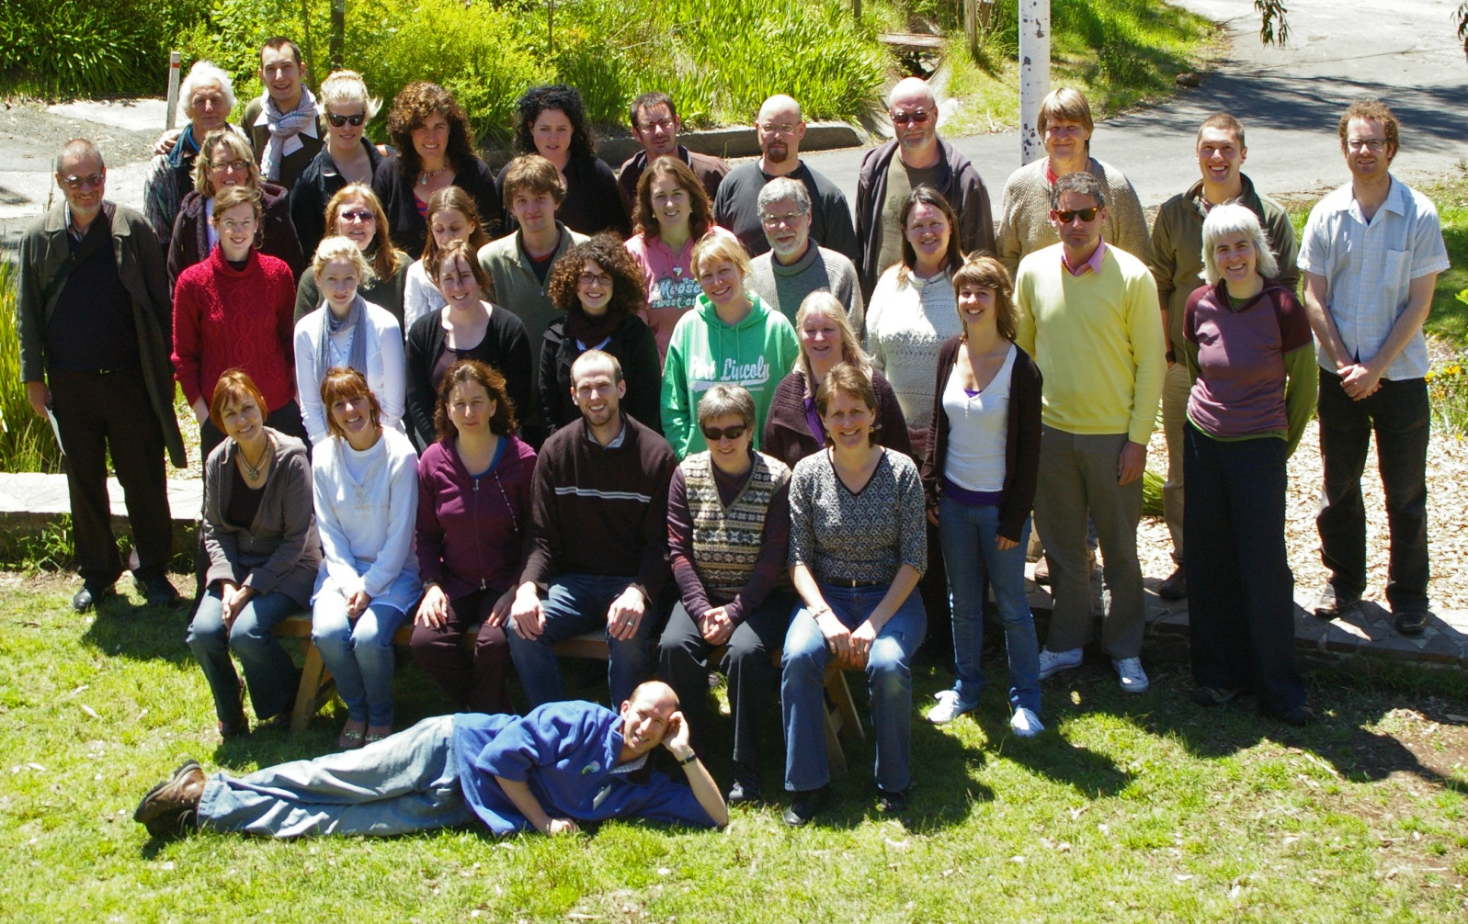
Australia’s first Wild Law Conference – Adelaide 2009
Notes:
Most of us met at 2009 Wild Law Conference
Again in 2010 – conference in Wollongong
By the time I volunteered to run the 2011 conference, we had formed into a collegial group – steering committee for conference; idea for AWLA in early 2011
Garnered interest in having such an organisation at 2011 conference in Brisbane
‘officially’ became an organisation in only March this year

Slide 22
AELA’s mission
To promote the understanding and practical implementation of Earth centred law, governance and ethics in Australia (Earth jurisprudence)
AELA carries out its work by supporting multi-disciplinary teams of professionals engaged in research, education, publications, community capacity building and law reform.
Network of lawyers, other professionals, community members, students
“Membership participation” model
(ie everyone can get involved, not a ‘service delivery’ model)

Slide 23
AELA’s vision
AELA’s vision is to help create human societies that live within their ecological limits and nurture the health of the wider Earth community.
Our vision includes a legal and governance system built around nurturing (not destroying) the Earth

Slide 24
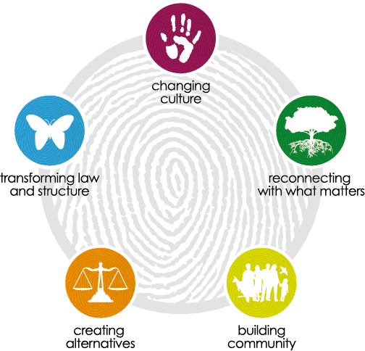
AELA’s five core themes of work

Slide 25
AELA’s five core themes of work
Education
“Earth Arts”
Cross cultural
Ethics -
Earth Charter,
Science,
Traditional
knowledge,
“Future Dreaming”
Ecospirituality
Rights of nature
Community rights
Ecocide
Sharing law
Alternative legal,
economic &
political models
Tribunal for Rights of Nature
Wild Law Judgments Project
Building networks &
supporting
community
Organisations
Governance Services
Legal Cafes

Slide 26
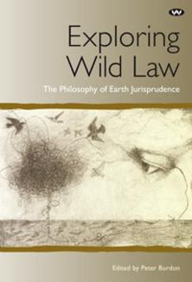
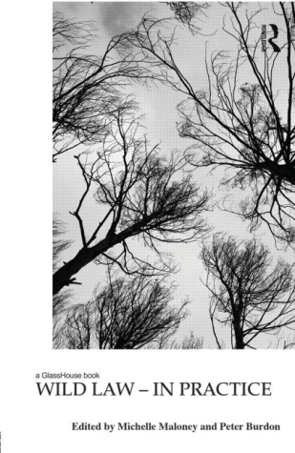

Slide 27
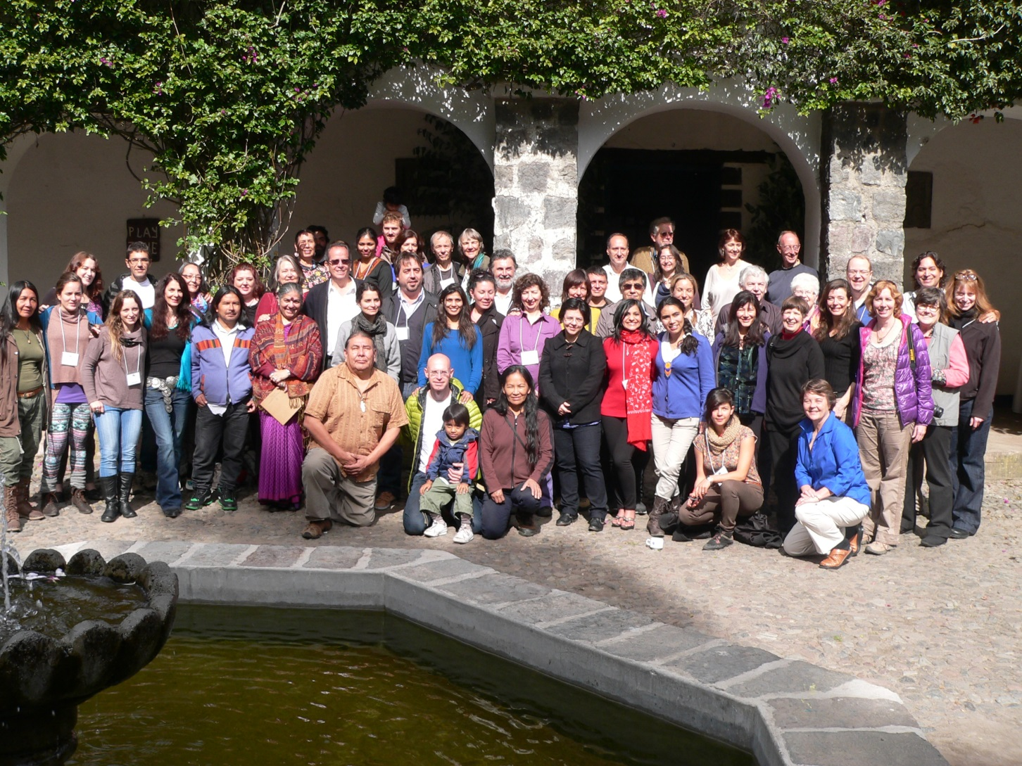
Australian Earth Laws Alliance &
Global Alliance for the Rights of Nature

Slide 28
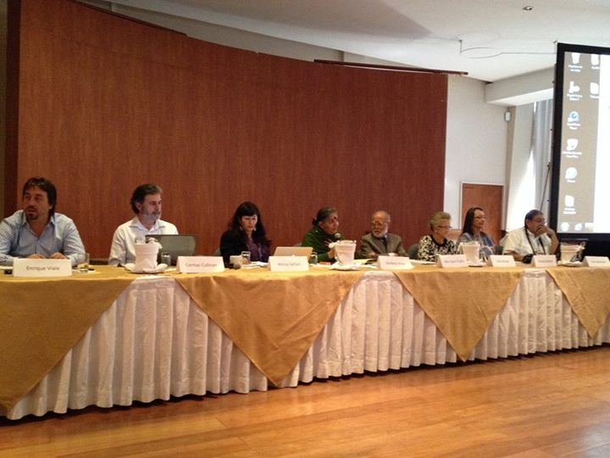
International Tribunal for the Rights of Nature and Mother Earth
First hearing - 17 January 2014, Quito
Notes:
The international panel of judges sitting on the Tribunal includes:
Alberto Acosta, economist and former President of the Constituent Assembly from Quito, Ecuador
Tantoo Cardinal, actress (e.g., Dances with Wolves) from the Tar Sands of Canada
Blanca Chancoso, Kichwa leader and educator from Cotacachi, Imbabura, Ecuador
Cormac Cullinan, lawyer and author (Wild Law), Earth Democracy Coop, Cape Town, South Africa
Tom Goldtooth, Dine’/Dakota, director of Indigenous Environmental Network from Minnesota, US
Julio César Trujillo, constitutional lawyer for Yasunidos from Quito, Ecuador
Elsie Monge, human rights activist and president of CEDHU y FIDH from Quito, Ecuador
Atossa Soltani, founder and director of Amazon Watch from Washington, DC, US
Enrique Viale, environmental lawyer from Buenos Aires, Argentina
Native rights activist Casey Camp-Horinek (Ponca from Oklahoma, US) andPatricia Gualinga, an indigenous of the Amazon and director of Sayaku, will provide expert witness testimony on the critical importance of Rights of Nature.Carlos Pérez will provide testimony as to his recent actions in defense of Mother Earth, the reasons for his actions and its consequences.

Slide 29
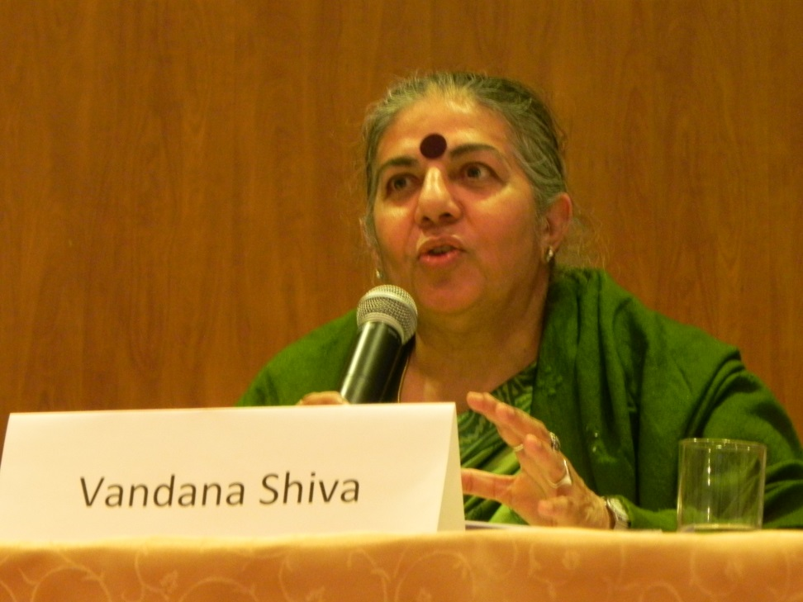
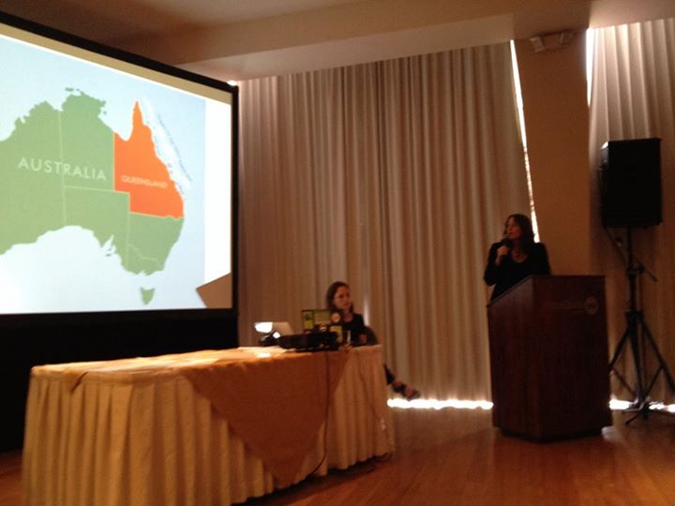
International Tribunal for the Rights of Nature and Mother Earth
Vandana Shiva, President
of the first Tribunal
Michelle Maloney, AELA’s Convenor,
Speaking for the Reef at the Tribunal
Quito, January 2014

Slide 30
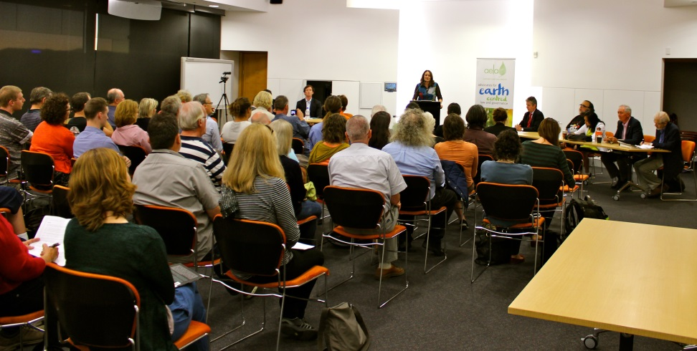
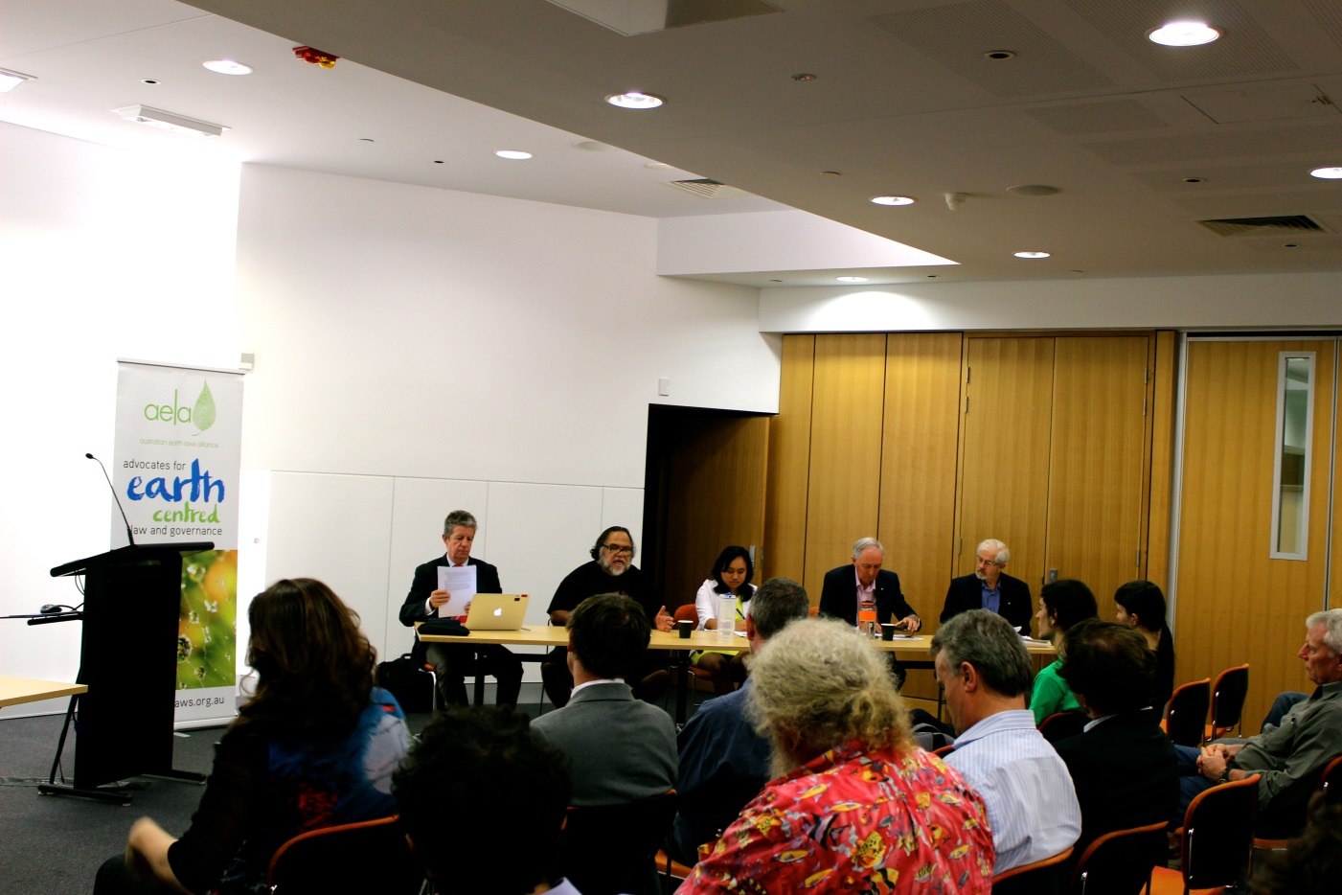
Australian Rights of Nature Tribunal
Brisbane 15 October 2014
Great Barrier Reef

Slide 31
My personal journey
co-creating AELA
Human centred
Earth centred

Slide 32

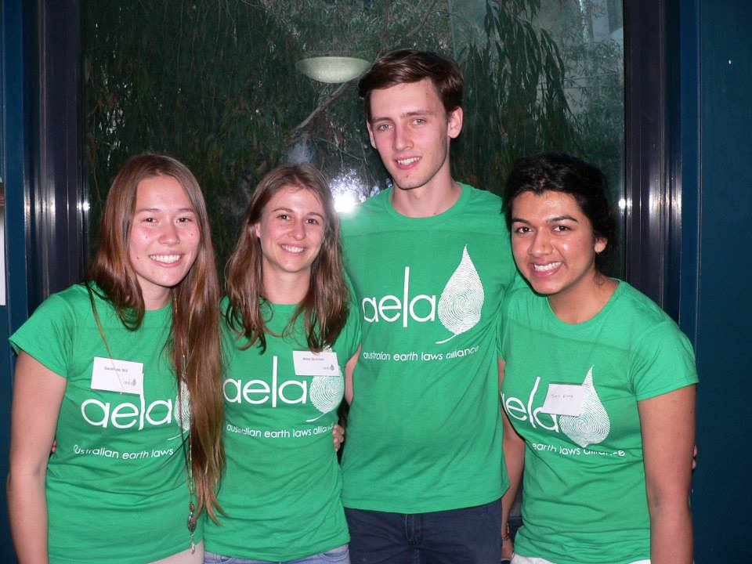
Personal journey
Passionate about ‘the environment’ since childhood
Studied politics and law at ANU to focus on environmental law
Grew frustrated with the law
It wasn’t until 2009 that I “found” the ‘Universe Story’ and ‘The Great Work’ – this work, and new colleagues, inspired the creation of AELA
AELA is an expression of my personal beliefs and professional responsibilities
Nurturing a new generation of Earth lawyers is a critical part of our work

Slide 33
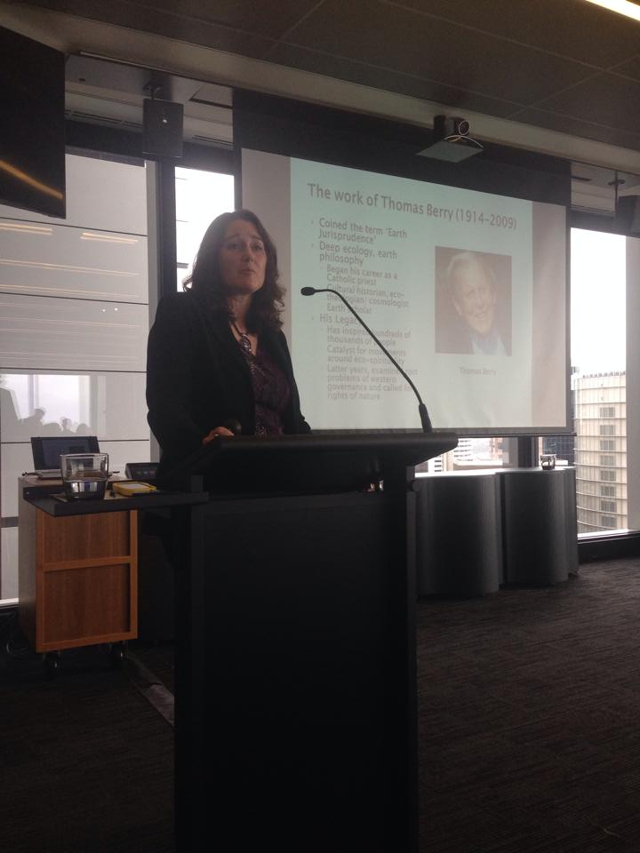
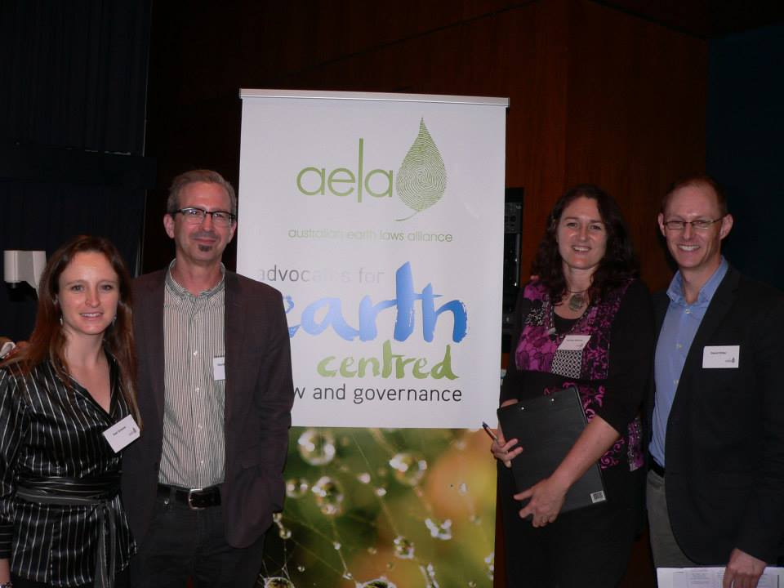
When my cancer diagnosis in May this year changed my life, from a busy and active public life …

Slide 34
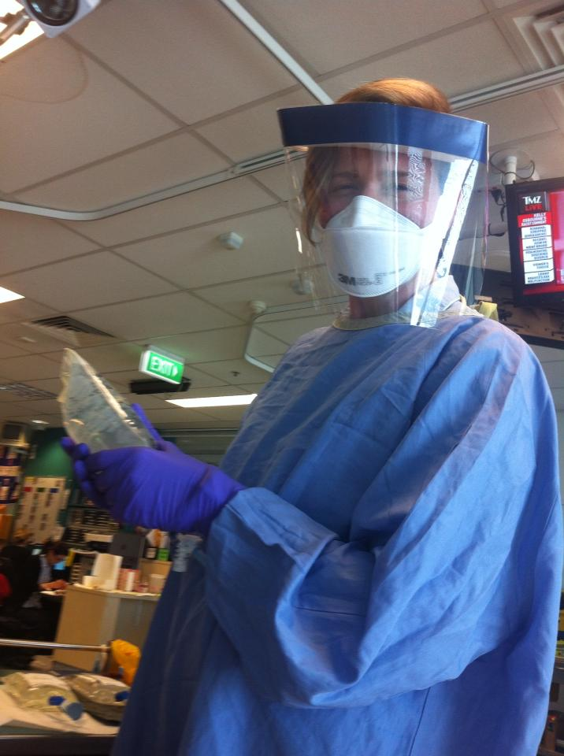
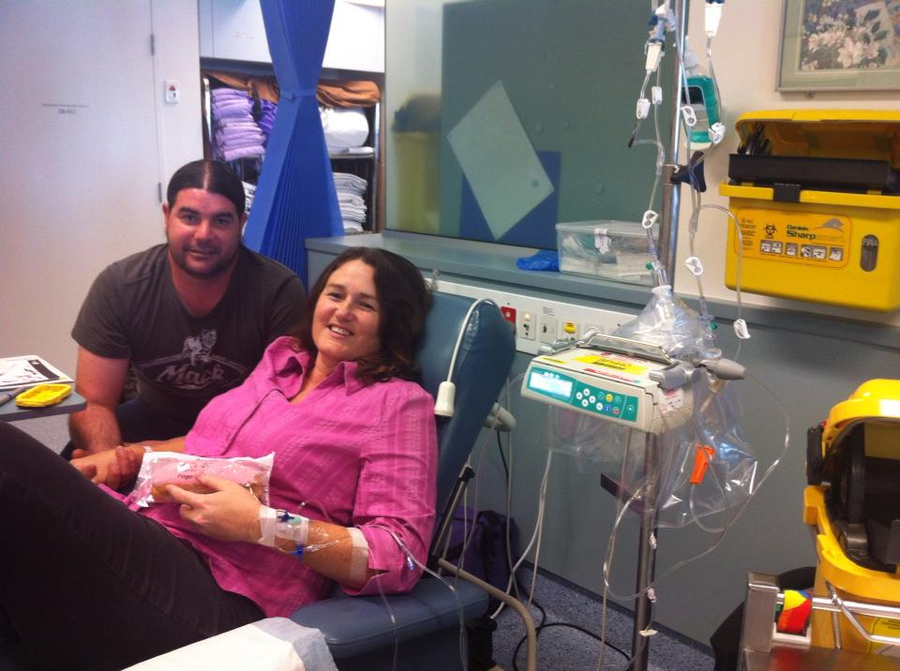
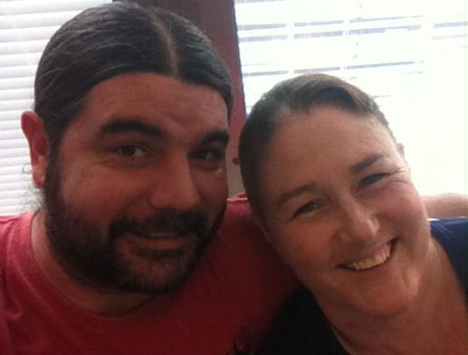
To a quieter life of hospital visits and being unwell …

Slide 35
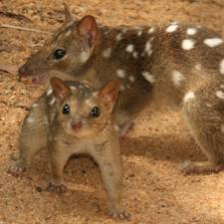
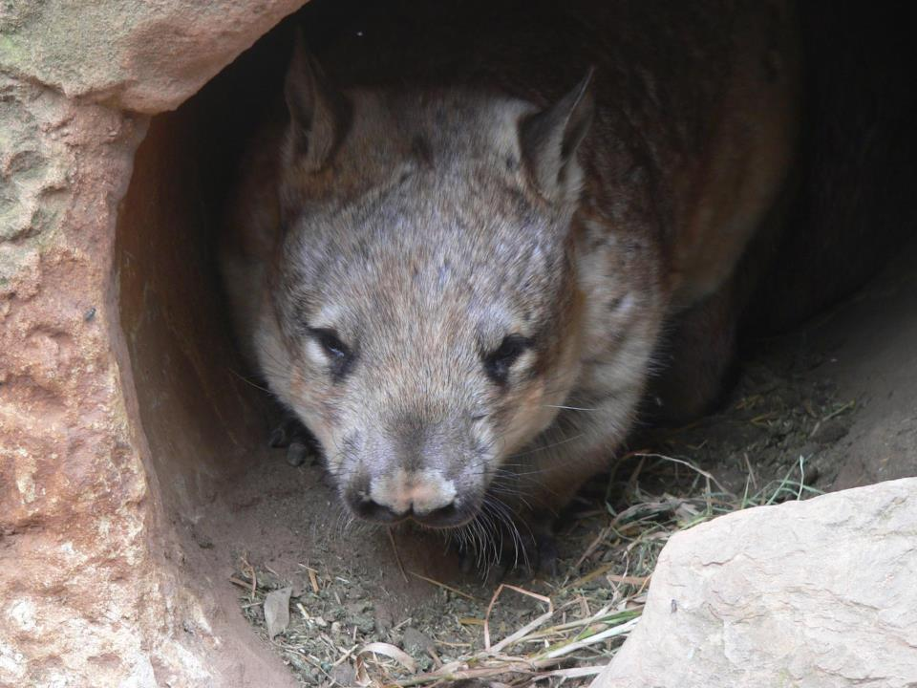
My belief in the Universe Story and my humble place in the world made it easier to accept and understand cancer. It also makes me super grateful to be receiving the level of care I’m receiving. As a human I am privileged with medical care – but I have no greater right to be here than a quoll or a wombat. This perspective helps me deal with the bad days and to look forward to the good days ☺

Slide 36
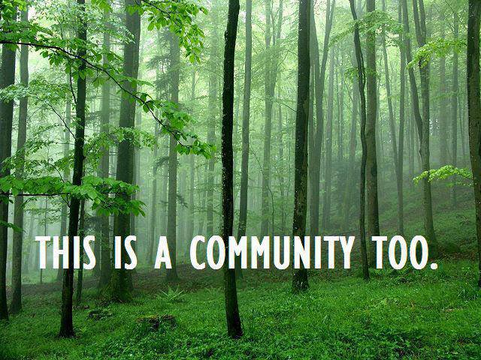

Slide 37
Thank you for your time ☺
www.earthlaws.org.au
Contact Michelle Maloney – convenor@earthlaws.org.au
Email us your suggestions for future ecospirituality events: ecospirituality@earthlaws.org.au
Find us on facebook
Twitter @earthlawsaus

Slide 38
Questions for discussion
What sources do you turn to reaffirm and deepen your connection to life?
How do you find strength in the face the difficult emotions stirred by the ecological crisis?
What gives you motivation to work towards a more beautiful world?
What do you think your profession could do differently, to be more Earth centred?

