Slide 1
Challenging Growth Economics
Samuel Alexander
Melbourne Sustainable Society Institute
Office for Environmental Programs

Slide 2
Overview
Introduction
What is growth?
Evidence of growth
The case for growth
Where are we today?
Are there ‘limits to growth?’
Degrowth to a steady-state economy
Policy considerations
Questions, comments, discussion

Slide 3
What is Growth?
If one is to be for or against ‘growth’ it is important to know what that term means:
Extensive or quantitative growth (i.e. increased energy/resource use)
Intensive or qualitative growth (i.e. increased efficiency / productivity per unit of energy/resource)
Increases in gross domestic product (GDP)
Increases in human population
Increases in wellbeing or utility
These are all legitimate ways to understand growth but they are not synonymous.
One form of growth may or may not lead to another form. Some forms may have limits, others may not.

Slide 4
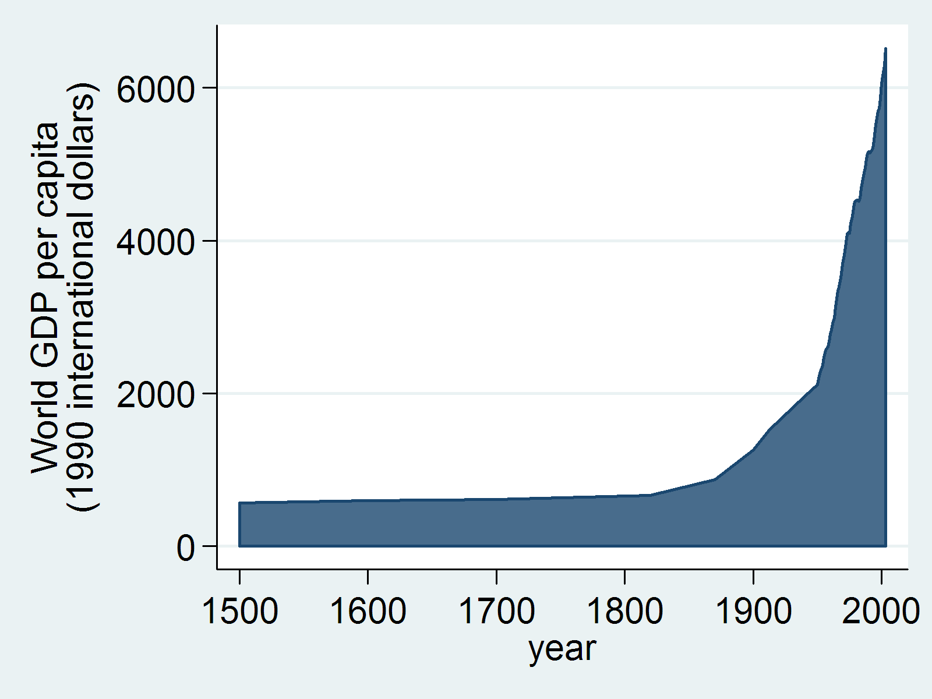
GDP per capita in history
Graph from: http://commons.wikimedia.org/wiki/File:World_GDP_per_capita_1500_to_2003.png
World average GDP per capita 1500 to 2003. Data extracted from Angus Maddison's "World Population, GDP and Per Capita GDP, 1-2003 AD

Slide 5
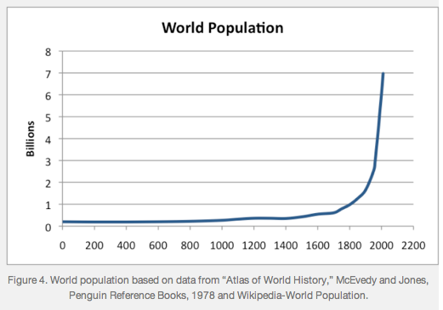
Population growth in history
Graph from: http://ourfiniteworld.com/2013/05/15/what-would-it-take-to-get-to-a-steady-state-economy/

Slide 6
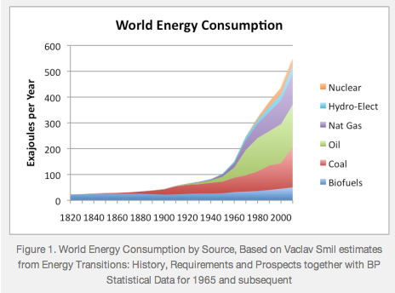
Energy consumption in history
Graph from: http://ourfiniteworld.com/2012/03/12/world-energy-consumption-since-1820-in-charts/
In this graph, the ‘biofuels’ category includes all renewables.

Slide 7
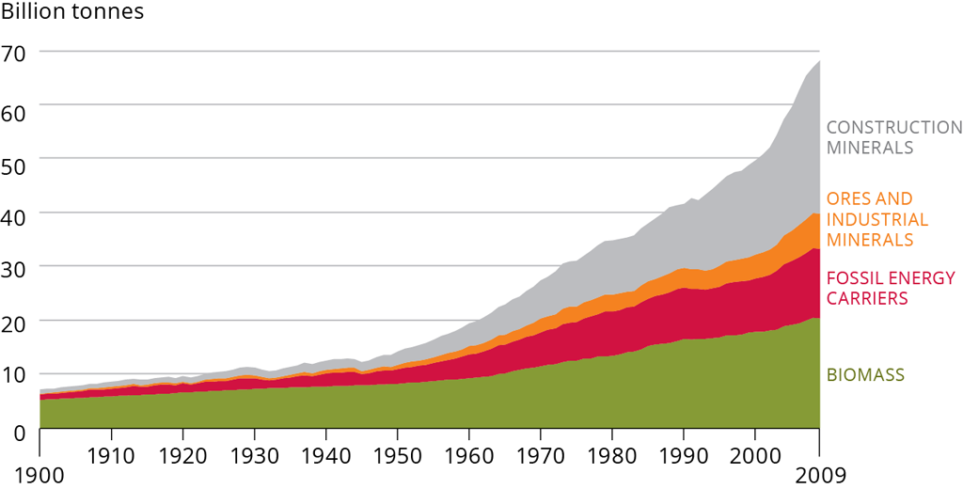
Resource Extraction in History
Graph from: http://www.eea.europa.eu/soer-2015/global/competition

Slide 8
THE CASE FOR GROWTH
In conditions of material destitution it is quite understandable why getting richer in material terms is likely to contribute to increased quality of life.
Furthermore, even in rich countries, money can be used to satisfy our most pressing desires.
Growth in GDP is also widely considered a necessary path to poverty alleviation (‘a rising tide lifts all boats’)
Growth in GDP can also be considered the path to environmental sustainability; that is, it will allow us to afford the best ‘eco’ technologies (solar panels, efficient appliances, electric cars) and fund important environmental protection programs, etc.
In short, just aim for growth and use the money to solve the problems that growth produces.

Slide 9
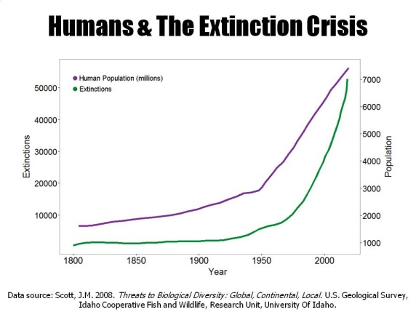
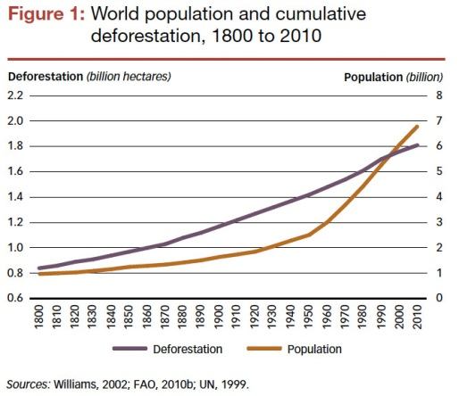
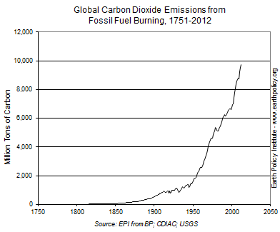
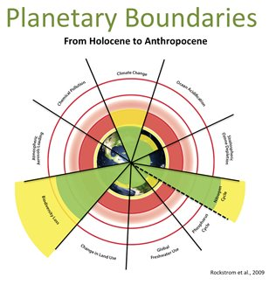
ENVIRONMENTAL IMPLICATIONS
Graphs from: http://www.biologicaldiversity.org/programs/population_and_sustainability/extinction/ and http://rainforests.mongabay.com/general_tables.htm and http://www.earth-policy.org/indicators/C52 and http://www.vfrc.org/getdoc/875bc2b6-0721-4026-ba42-ecb11856a6ce/planetary_boundaries

Slide 10
Are there ‘limits to growth’?
Early critics were Malthus and J.S. Mill, but the modern movement gained momentum with the 1972 publication of Limits to Growth, sparking a controversy that has yet to subside.
Why might there be limits to growth?
The global economy is in gross ecological overshoot
There are billions who need to develop their economic capacities in some form to attain a dignified standard of living
It is expected that we will have 9.5 billion people by mid century and 11 billion by 2100.
There is even evidence suggesting that high consumption lifestyles are failing to fulfil their promise of a happy and meaningful life.
In light of all this – should the richest nations still be pursuing growth in GDP? Could we live more on less?
In response to these challenges, there is an emerging ‘degrowth’ movement argues for a process of ‘planned contraction’ of energy and resources demands which would culminate in a ‘steady state’ or ‘post-growth’ economy.

Slide 11
Arguments against ‘limits’
There are several overlapping arguments given for why the ‘limits to growth’ analysis is wrong:
Markets
Technological innovation
Design improvements
Efficiency
Decoupling
Green growth
Returning to earlier definitions, the growth advocates argue that we can keep growing qualitatively (increase efficiency) and keep growing in terms of GDP, without growing quantitatively (move to a post-industrial, service economy).
They conclude that the ‘limits to growth’ school is flawed. We can and should keep pursuing GDP growth.
Coherent in theory, but what of the reality?

Slide 12
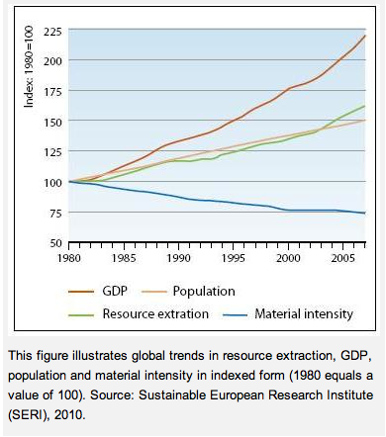
Relative decoupling not leading to absolute decoupling
This graph shows that intensity is dropping (due to efficiency improvements), but overall resource extraction increasing. Graph from: http://www.eea.europa.eu/data-and-maps/indicators/total-primary-energy-intensity-1/assessment

Slide 13
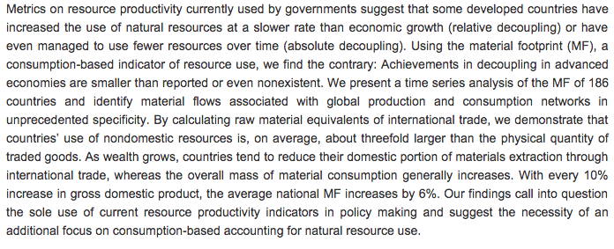
Material footprint of nations
Abstract from ‘The Material Footprints of Nations’, published in the Proceedings of the National Academy of Sciences in the United States (2015), based on the most comprehensive economic input-output framework of the world economy.
http://www.pnas.org/content/112/20/6271.abstract

Slide 14
The arithmetic of growth
When we read United Nations reports, or government reports, or hear the promises of politicians on the left and the right, it seems that the basic vision of global development is that the rich nations keep growing in terms of GDP and, in accordance with justice, over coming decades the poorest attain a similar standard of living, all done in a way that is magically sustainable.
If the developed nations – say the OECD nations – grew by 2% over coming decades and by 2050 the global population had achieved a similar standard of living, the global economy would be 15 times larger than it is today (Jackson, 2009). If it grew at 3% from then on it would be 30 times larger than the current economy by 2073, and 60 times larger by the end of this century.
Note that every nation would prefer 3% growth to 2%; or 4% to 3%, etc.
The exponential function exposes the fantasy of growth economics. The extent of decoupling required is just too great.

Slide 15
Critique of GDP
GDP counts all expenditure as a contribution to ‘good growth’ even if it isn’t. Surely, some expenditure contributes to social wellbeing, and some doesn’t.
All these things are counted as positive contributions to GDP:
Cleaning up oil spill or natural disaster
Cutting down old growth forests
Hiring more divorce lawyers, couples living apart needing more houses, furniture, etc.
Increased crime requires purchases of alarms / bars on windows
More people paying for sex, more on anti-depressants, more diet pills purchased, etc.
Work an extra 20 hours each per week
No distinction between bikes and SUVs, solar panels or flat-screens, organic food or KFC
Decline in community trust / engagement – not captured, despite growth
Growth in GDP – but most benefits going to top few percent
We need far better indicators for progress (see, for example, the Genuine Progress Indicators and the Index for Sustainable Economic Welfare).
It could well be that we are now in an age of ‘uneconomic growth’, where the costs of growth outweigh the benefits.

Slide 16
Degrowth to a steady state ECONOMY
Degrowth is first and foremost a macroeconomic framework focused on the developed nations that calls for ‘planned contraction’ of the energy and resource demands of the economy.
Degrowth, therefore, is to be distinguished from recession, which is ‘unplanned economic contraction’.
In order to reach a sustainable and just level in a world of seven billion people, the degrowth required is incompatible with continued growth in GDP (for the reasons already outlined).
Given the crudeness of GDP as a measure of progress, a degrowth transition need not reduce social wellbeing and, in fact, there are many reasons to think that a transition beyond consumer lifestyles can be in our self-interest. But this means reimagining ‘the good life’ and embracing lifestyles of material sufficiency.
Degrowth is phase of adjustment, not a permanent contraction. Ultimately the aim would be to reach and maintain a ‘steady state economy’ that operates within the sustainable carrying capacity of the planet. There is no reason why a degrowth economy cannot learn how to use its limited resources in more efficient ways.
The poorest nations on the planet need to develop their economic capacities in some form, although it is important that a new mode of development is embraced. It would be catastrophic to try to turn the global South into the global North. As the poorest nations achieve a dignified and sustainable standard of living, they too will need to stop increasing their energy and resource demands and also create a ‘steady state economy’.

Slide 17
I = PAT
The I = PAT equation can be a useful way to understand why growth and consumption are marginalised by the growth paradigm.
I = environment impact
P = population
A = affluence (or per capita income)
T = technology (or the efficiency with which each unit of economic output is produced)
Note that since population and affluence are ‘taboo’ subjects that politicians don’t want to touch, it follows that responding to environmental problems must be solved via technology and efficiency. But we’ve seen this isn’t leading to reduced impacts, because efficiency improvements tend to be reinvested in more growth, more consumption.
It follows, I contend, that we need to be brave enough to confront A and P (as well as exploit appropriate technologies).
As the title of this conference implores: let’s talk about consumption.

Slide 18
Policies for a post-growth economy
Adopt alternative indicators to progress (e.g. genuine progress indicator)
Working hour reductions to ensure full employment in a contracting economy
Transition swiftly to renewable energy (paid for by carbon tax?) but just as important facilitate significant energy demand reduction
Public relations campaign to promote post-consumerist lifestyles
Distributive justice: if we cannot solve poverty by baking an ever-larger pie, it follows that it must be solved through redistributive policies (slicing the pie differently)
Population policies (education, family planning, free provision of contraception, and perhaps there may be a need for command-and-control policies… don’t be outraged unless you have some ideas about how to avoid the population bomb).
Banking and finance reform (not my area of expertise but necessary to create systems that don’t implode in the absence of growth)
Many, many, many more details required to develop a full policy framework for a post-growth or degrowth economy.

Slide 19
Closing comment
If governments are unlikely to embrace a post-growth policy agenda, it follows that the movement for change must be driven from the grassroots.
What can individuals, households, and communities do to help build a post-growth economy ‘from below?’ Raise awareness and prefigure the alternative ways of life and show them to be good.
‘To change something, build a new model that makes the old model obsolete.’ – Buckminster Fuller
When/if the social movement gets large enough, then we must try to build new systems and structures that will replace the existing regime as it deteriorates over coming years and decades.
Crisis as opportunity in an age of limits

Slide 20
Further reading
Last year I published two books of collected essays on degrowth and voluntary simplicity (pdfs freely available online):
Samuel Alexander, Prosperous Descent: Crisis as Opportunity in an Age of Limits (2015)
Samuel Alexander, Sufficiency Economy: Enough, for Everyone, Forever (2015)
And my ‘utopia of sufficiency’: Samuel Alexander, Entropia: Life beyond Industrial Civilisation (2013)
See also: www.simplicityinstitute.org

