Slide 1
Falling in Love with the Earth
“Only when we’ve truly fallen back in love with the Earth will our actions spring from reverence and the insight of our interconnectedness”.
– Thich Nhat Hanh’s statement on Climate Change for the United Nations, 2015.
https://plumvillage.org/letters-from-thay/thich-nhat-hanhs-statement-on-climate-change-for-unfccc/
Emma Brindal, WiseEarth Education
E: wiseeartheducation@gmail.com
W: https://wiseeartheducation.com/

Slide 2
Key points
Our education system (and our society) is out of balance, with an emphasis on rational ways of knowing and disregard of intuitive ways of knowing - which is disconnecting us from the Earth.
We need to fall in love with the Earth once more.
There are many practices that educators (and anyone who cares about the Earth) can use to foster this shift.

Slide 3
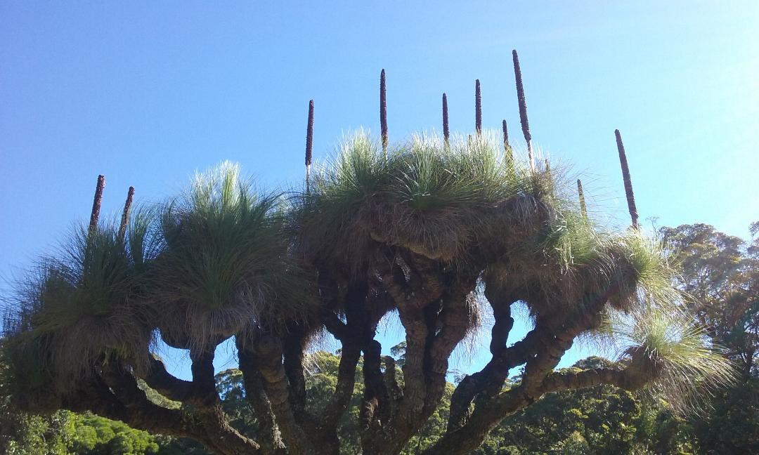

Slide 4
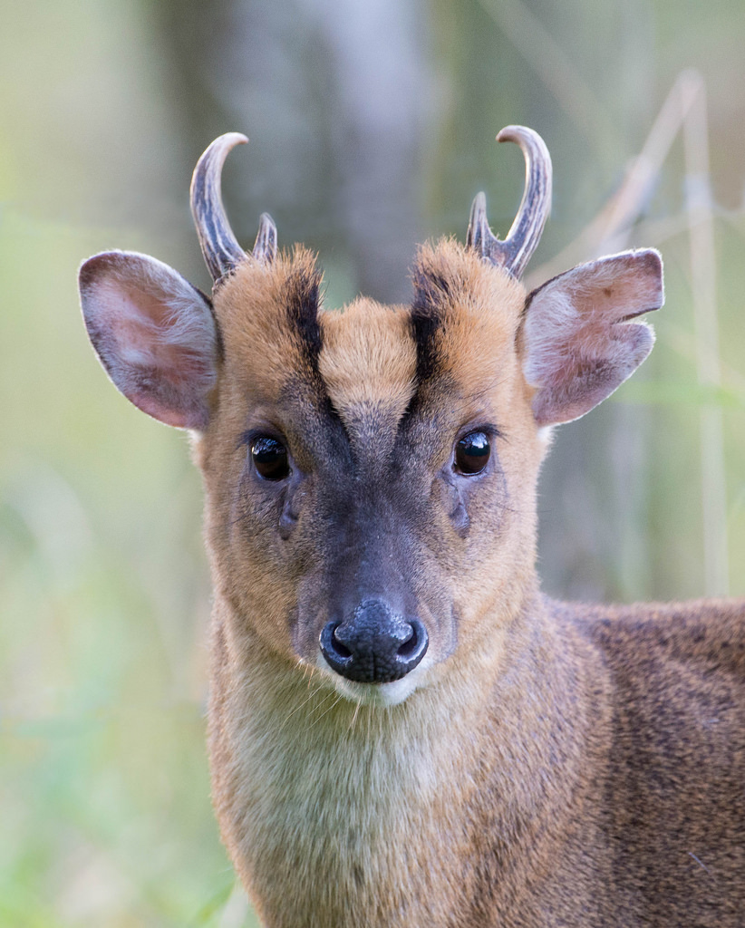

Slide 5
Encounter
“Encounter is when ... you actually meet the being, as the being coming forth from itself, as itself, revealing itself to you in a way that is beyond your intellect, in a way that is much more deeply intuitive and much harder to express... In fact scientific language isn’t appropriate to explain this encounter. It’s poetry that does it. It’s a poetic encounter.”
Dr Stephan Harding in ‘Encountering another Being’ video.
http://www.flemingpolicycentre.org.uk/seed-beneath-snow/
Stephan Harding is the author of ‘Animate Earth’

Slide 6
How do you experience ‘encounter’?

Slide 7
Nature Connection work
Jon Young & the 8 Shields Institute http://8shields.com/
Core routines of Nature Connection:
Sit spot
Story of the Day
Questioning and Tracking
Animal forms
Wandering
Exploring Field guides
Journalling
Survival living
Mind’s Eye Imagining
Listening for bird language
Thanksgiving
These core routines connect us to nature and to ourselves.
Young, J., Haas, E., & McGown, E. (2010). Coyote's guide to connecting with nature, 2nd edition. Shelton, Wash: OWLLink Media.

Slide 8
Learning about the Web of Life
‘Nature names’ are a wonderful way for people to connect with a particular being.
Follow up activities can demonstrate how each being is connected to others in that ecological community.

