Slide 1
Cultivating Ecological Ethics Through the Arts
Australian Earth Laws Alliance
Inspiring Earth Ethics Conference | 23-24 Nov 2017, Brisbane
James K. Lee
Music > Film & TV > Environmental Management

Slide 2
Contents
Which arts/artforms, and by whom?
Why should we involve the arts in earthly engagements?
art as a process of enquiry
art to dissolve binary thinking
How do the arts inspire and build earth ethics?
What are the challenges?
Summary

Slide 3
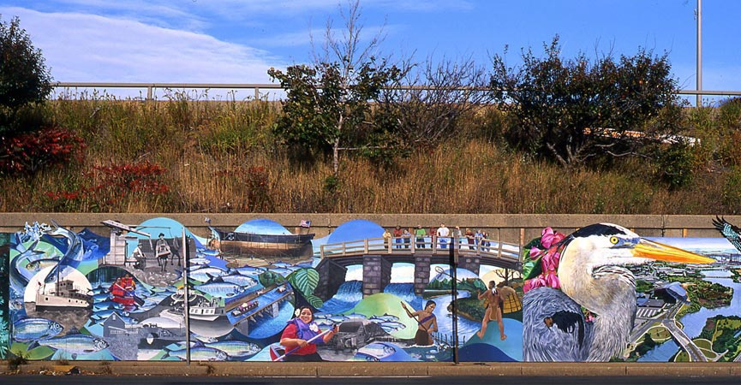
Mystic River Mural
Mural Project directed by David Fichter with Somerville High School students, sponsored by the Somerville Arts Council, Somerville MA, USA

Slide 4
Why should we involve the arts in earthly engagements?
“Art is familiar to most people as a source of entertainment, illustration, decoration.
“It is less familiar as a knowledge system and source of creative options that take equal place with other forms of systems theory and modeling.”
- Aviva Rahmani
(Ingram, 2012, pp. 31-21)

Slide 5
“Arts-informed research ... may trump conventional forms of research when it comes to generating questions or raising awareness of complex subtleties that matter.
“Arts-informed research ... may trump conventional forms of research when it comes to generating questions or raising awareness of complex subtleties that matter.
“The deep strength of using arts in research may be closer to the act of problematizing traditional conclusions than it is to providing answers in containers that are watertight.
“In this sense, the products of this research are closer in function to deep conversation and insightful dialogue than they are to error-free conclusions.”
- Elliott Eisner
(Eernstman and Wals, 2013, p. 1650)

Slide 6
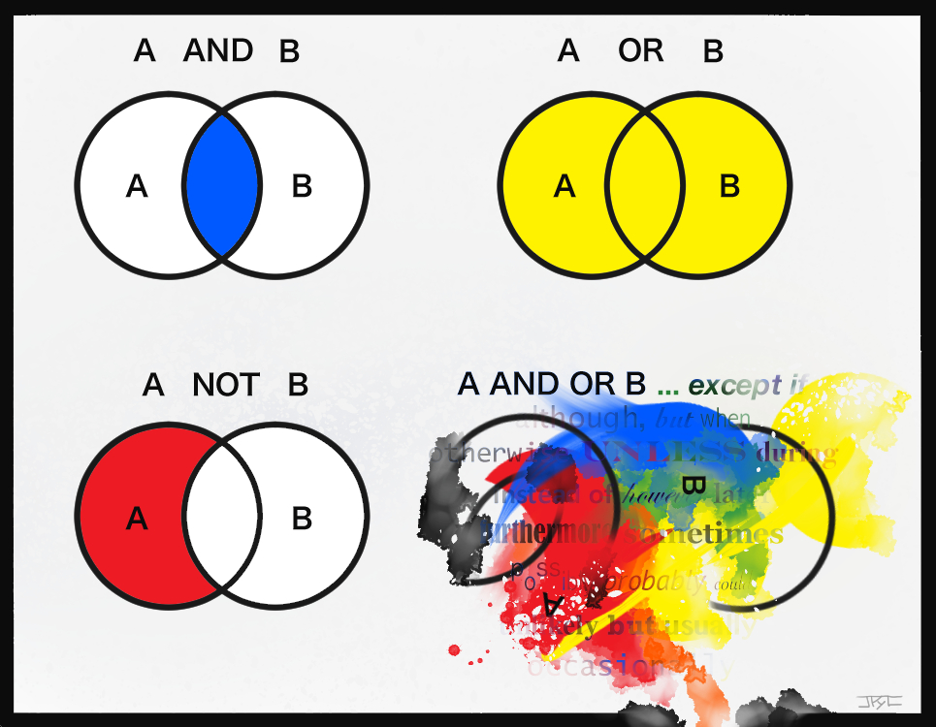
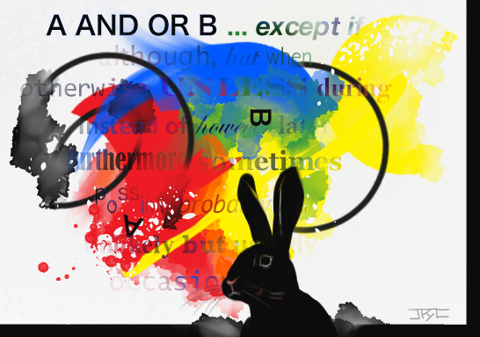

Slide 7
Integrating and embodying different kinds of knowledge, values and perspectives.
Communicating and translating complexity.
Fostering social reflexivity, public deliberation and understanding.
Building socio-ecological identities and ecological consciousness.
Fostering engagement and emotional commitment leading to action.
(adapted from Heras and Tàbara, 2014)
Mural Project directed by David Fichter with Somerville High School students, sponsored by the Somerville Arts Council, Somerville MA, USA

Slide 8
Summary
The arts provide:
inclusivity through the choice of voice, openness to other knowledge
processes of enquiry
a disruption of dominant problem frames and the path-dependent solutions they commonly generate
a refocussing of attention towards the “complex subtleties that matter”
space to sit with uncertainty, complexity, contradictions, fuzziness – and find new perspectives within that space

Slide 9
References
Curtis, D. J., Reid, N., & Reeve, I. (2014). Towards ecological sustainability: observations on the role of the arts. S.A.P.I.EN.S., 7(1), 15pp.
Eernstman, N., & Wals, A. (2013). Locative Meaning-making: An Arts-based Approach to Learning for Sustainable Development. Sustainability, 5(4), 1645-1660.
Heras, M., & Tàbara, J. D. (2014). Let’s play transformations! Performative methods for sustainability. Sustainability Science, 9(3), 379-398.
Ingram, M. (2012). Sculpting Solutions: Art–Science Collaborations in Sustainability. Environment: Science and Policy for Sustainable Development, 54(4), 24-34.
Song, Y. I. K., & Gammel, J. A. (2011). Ecological mural as community reconnection. International Journal of Art & Design Education, 30(2), 266-278.

