Slide 1
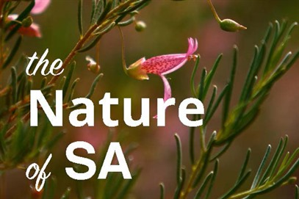
Vicki-Jo Russell AM
Nature of SA: a new nature conversation
Inspiring Earth Ethics:
Linking Values to Action
Earth Ethics Conference, 2017, Brisbane

Slide 2
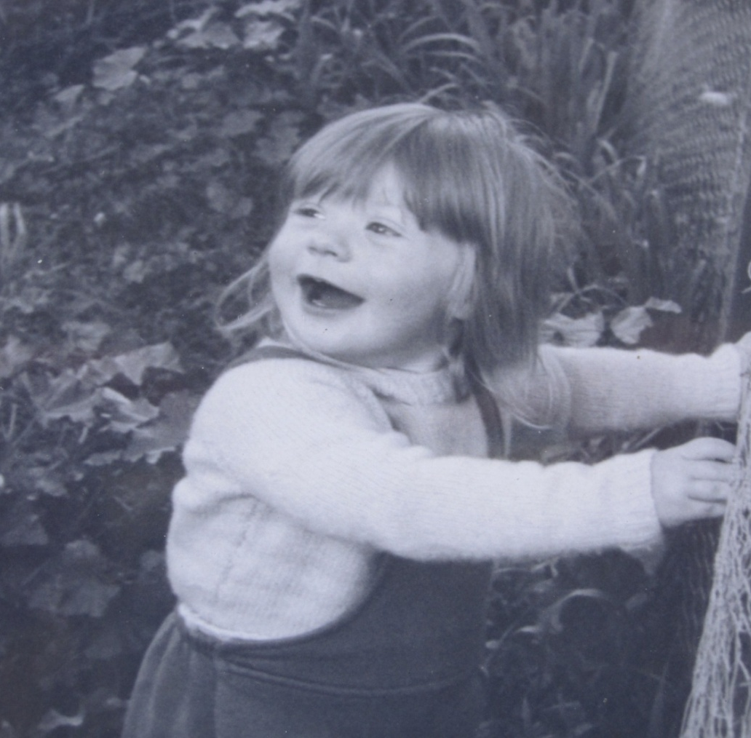
I’m Vicki-Jo I've always loved nature
Notes:
Like any great love affair my love has evolved over time
I have always had fun and adventure
I have loved the way it makes me feel
There is so much to learn and I will die still ignorant and curious
I understand my life relies upon it
I think so much better in nature and it tests me to be clear on what matters
Nature has connected me to the best of friends and my partner
In nature I can be myself – and I am old enough to know how much that is worth
So even though there have been some very dark days I know its one of the great relationship of my life

Slide 3
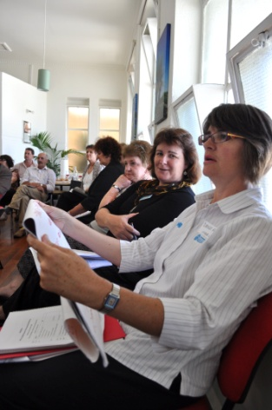
What is the Nature of SA?
Partnership project that gives permission to think differently about how we approach nature conservation – to be effective now and in the future.
Nature that thrives and wellbeing outcomes through nature connections.

Slide 4
How did it come about? SA strategy review

Slide 5
Case for change
Stand on the shoulder of giants however...
So much has and will change - even much more of the same won’t work
Public values not reflected in investment, policy or priorities
Despair increasingly normalised – Common Cause insights offer new hope
Literature increasingly challenging efficacy of current approach from glyphosate to governance

Slide 6
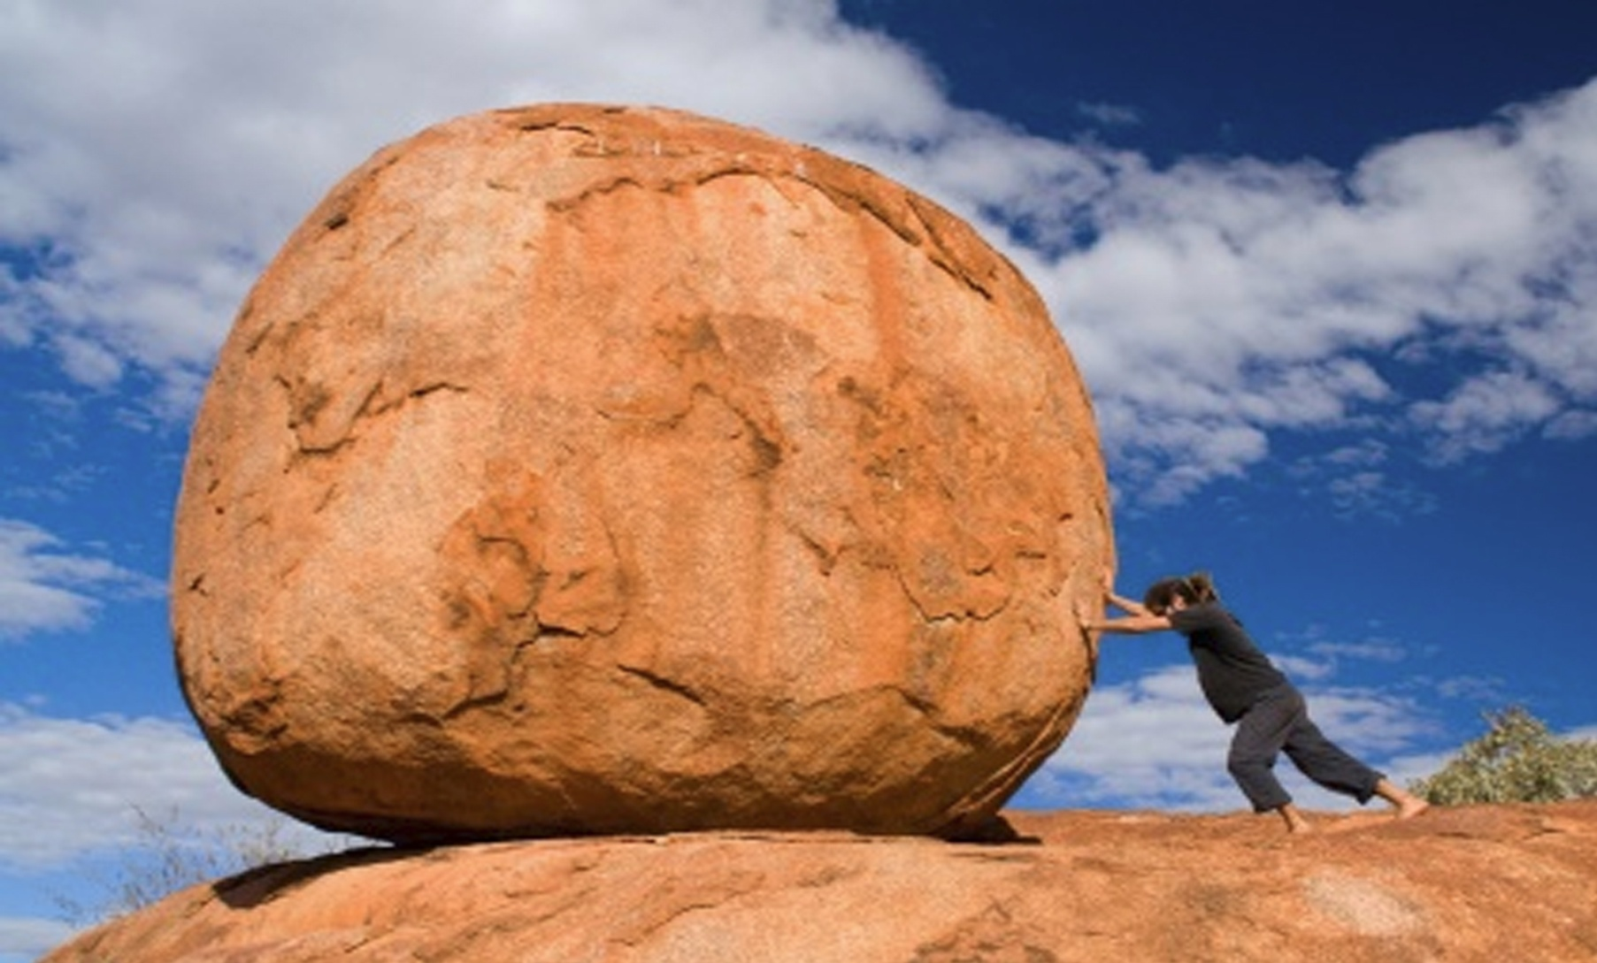
Consultation defined a series of shifts

Slide 7
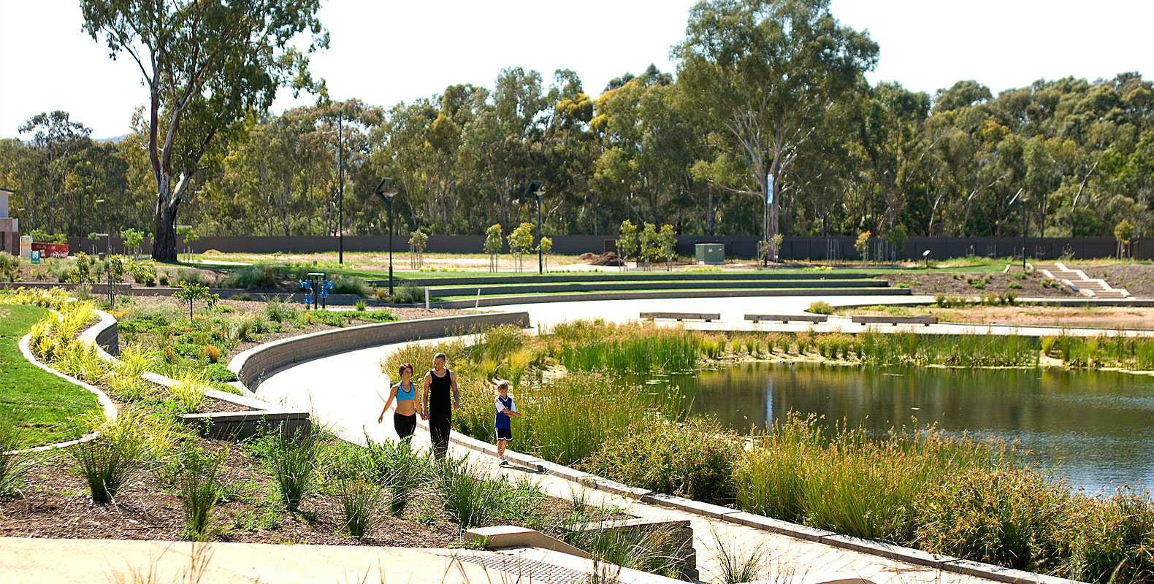
Value nature wherever it is

Slide 8
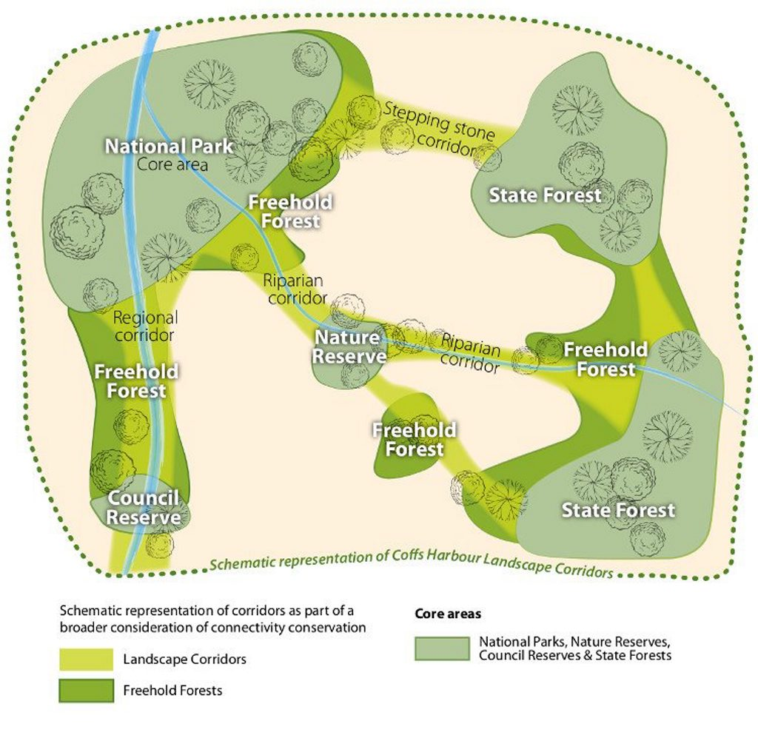
Do more and refine what will work

Slide 9
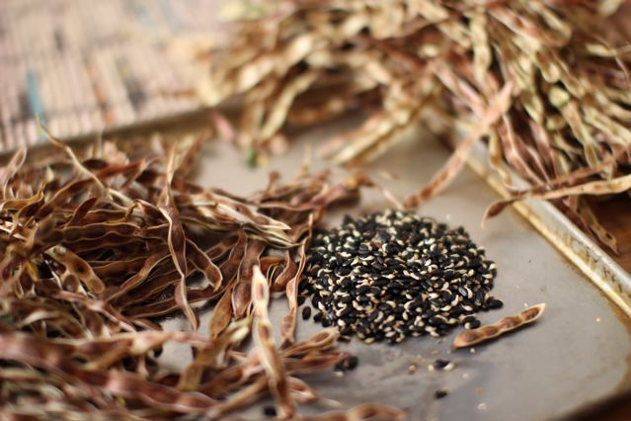
Some things need to be done differently

Slide 10
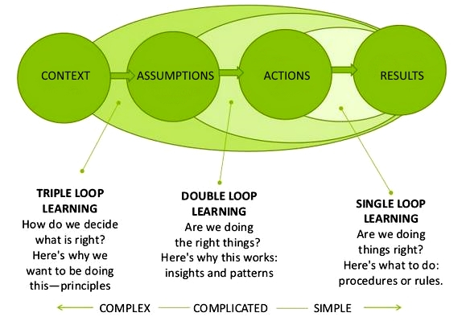
Change to learn and learn to change

Slide 11
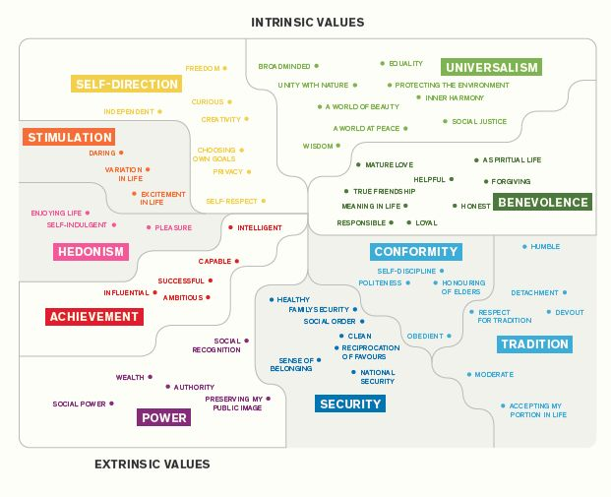
Speak to intrinsic values not loss

Slide 12
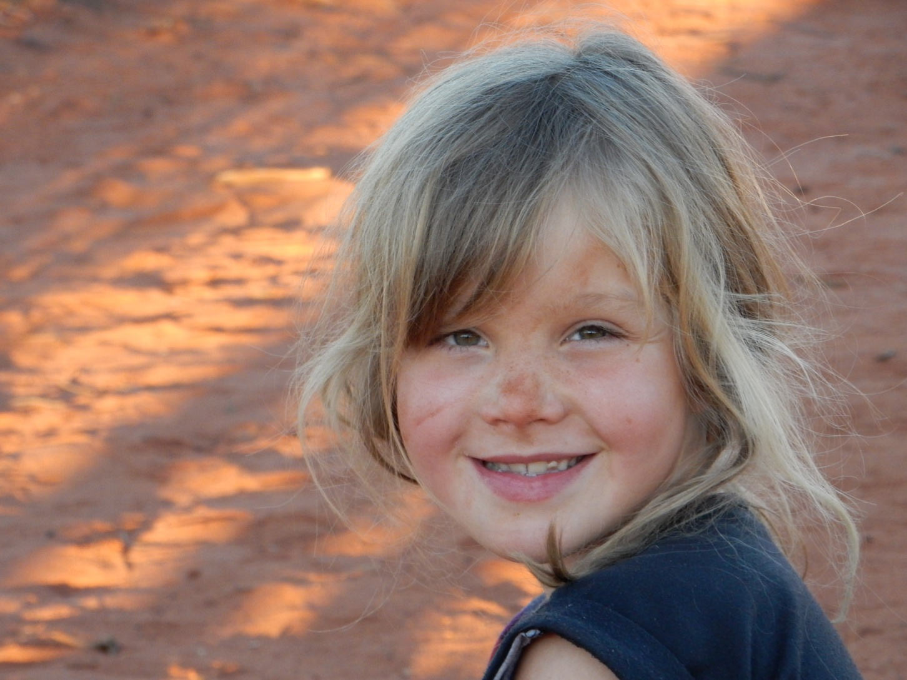
Make our connections more visible

Slide 13
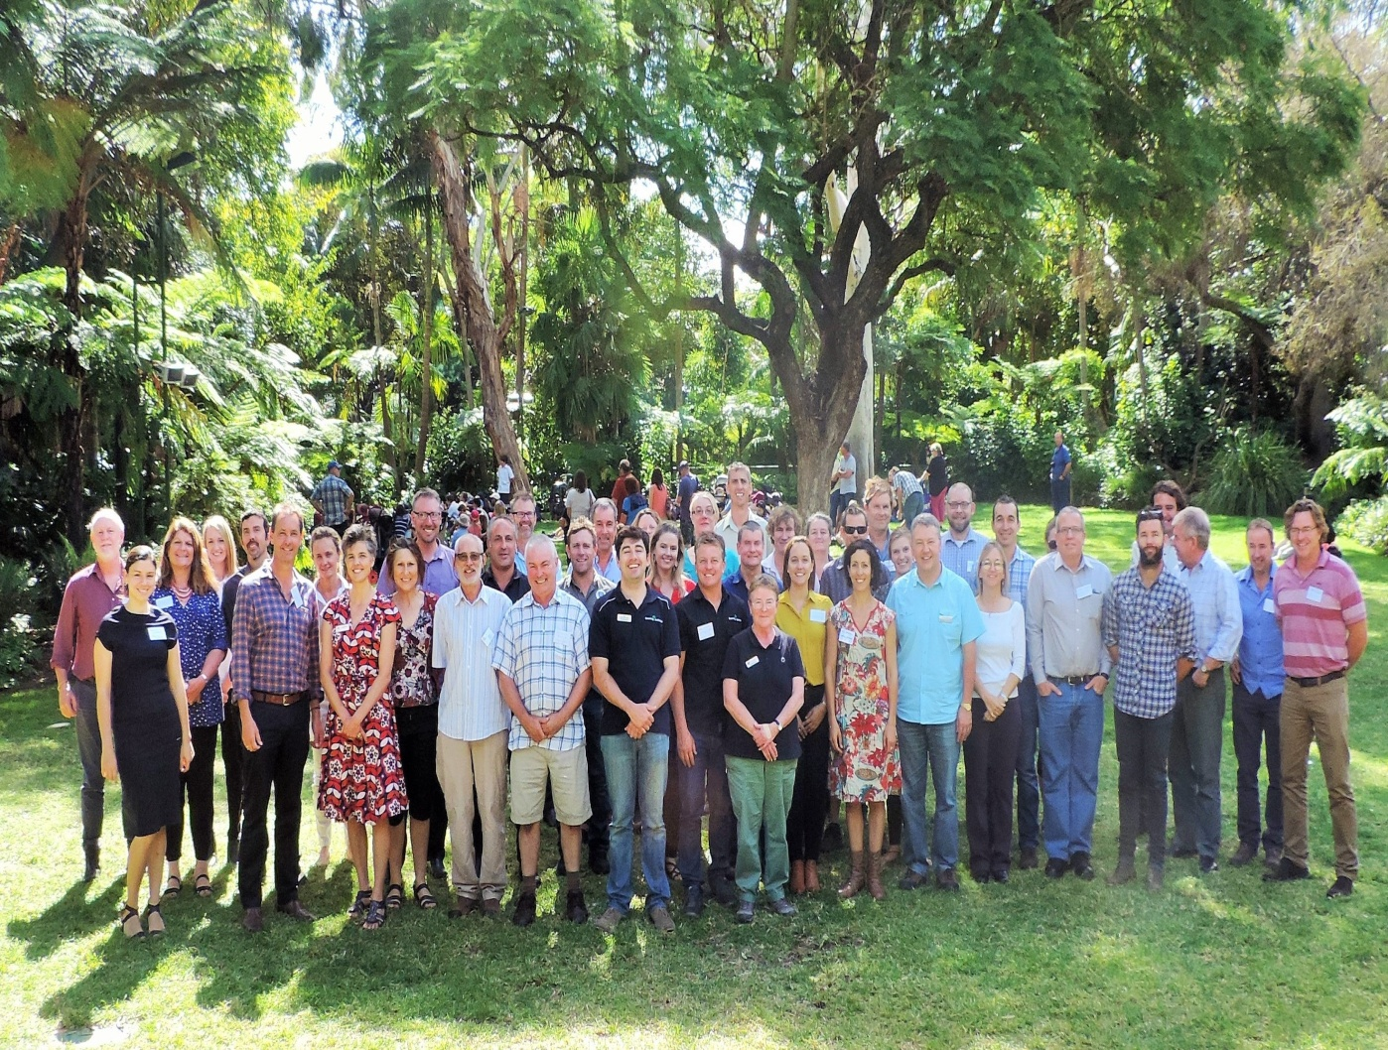
Support collaborative governance – long term horizons at effective scales

Slide 14
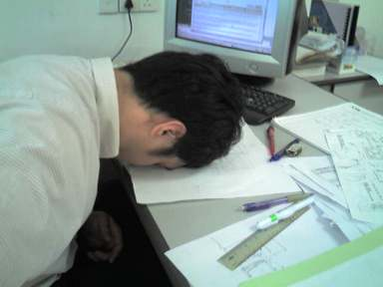
Sector resilience and diversity
“ One of the penalties of an ecological education is that one lives alone in a world of wounds.”
Prof Aldo Leopold
Personal
Organisational
Workforce
Community

Slide 15
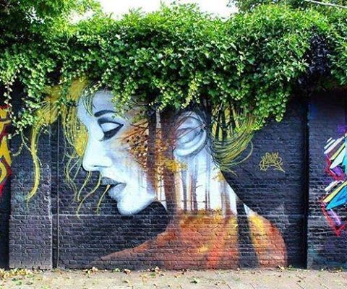
Making it real – Amongst It

Slide 16
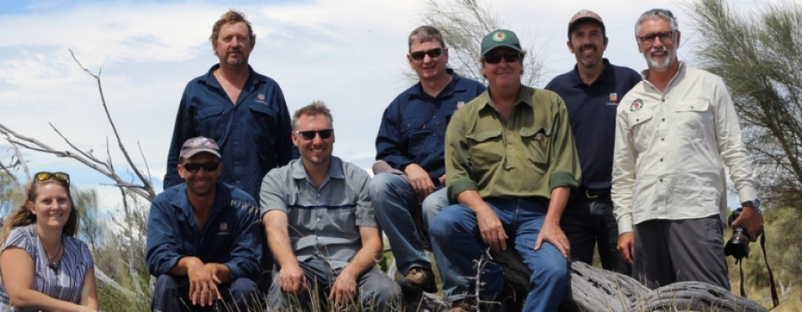
Making it real – Prospectus

Slide 17
Who we are
Project Partners – SA Environment Dept, eNGO Nature Alliance and SA Primary Industries Dept
Project Sponsors – CEO Env Dept, CEO Conservation SA, NRM Presiding Members
SA NRM Research and Innovation Network
The Aus Centre for Social Innovation (TACSI)
Australian Resilience Centre
Participating observers

Slide 18
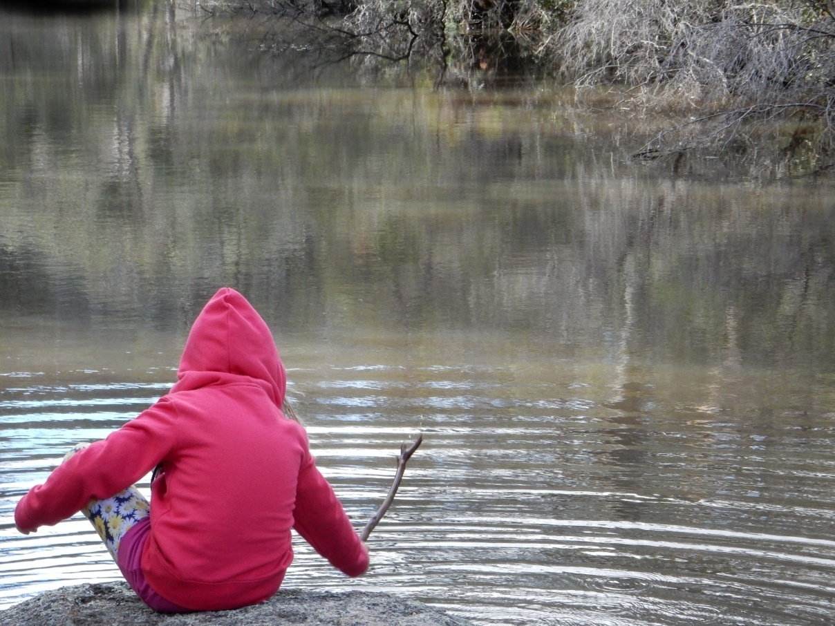
Thank you and stay connected
The Nature of SA emails:
Jill.Woodlands@conservationsa.org.au
Liz.Matthews@sa.gov.au
The Nature of SA websites: www.natureofsa.org
www.amongstSA.org.au

