Slide 1
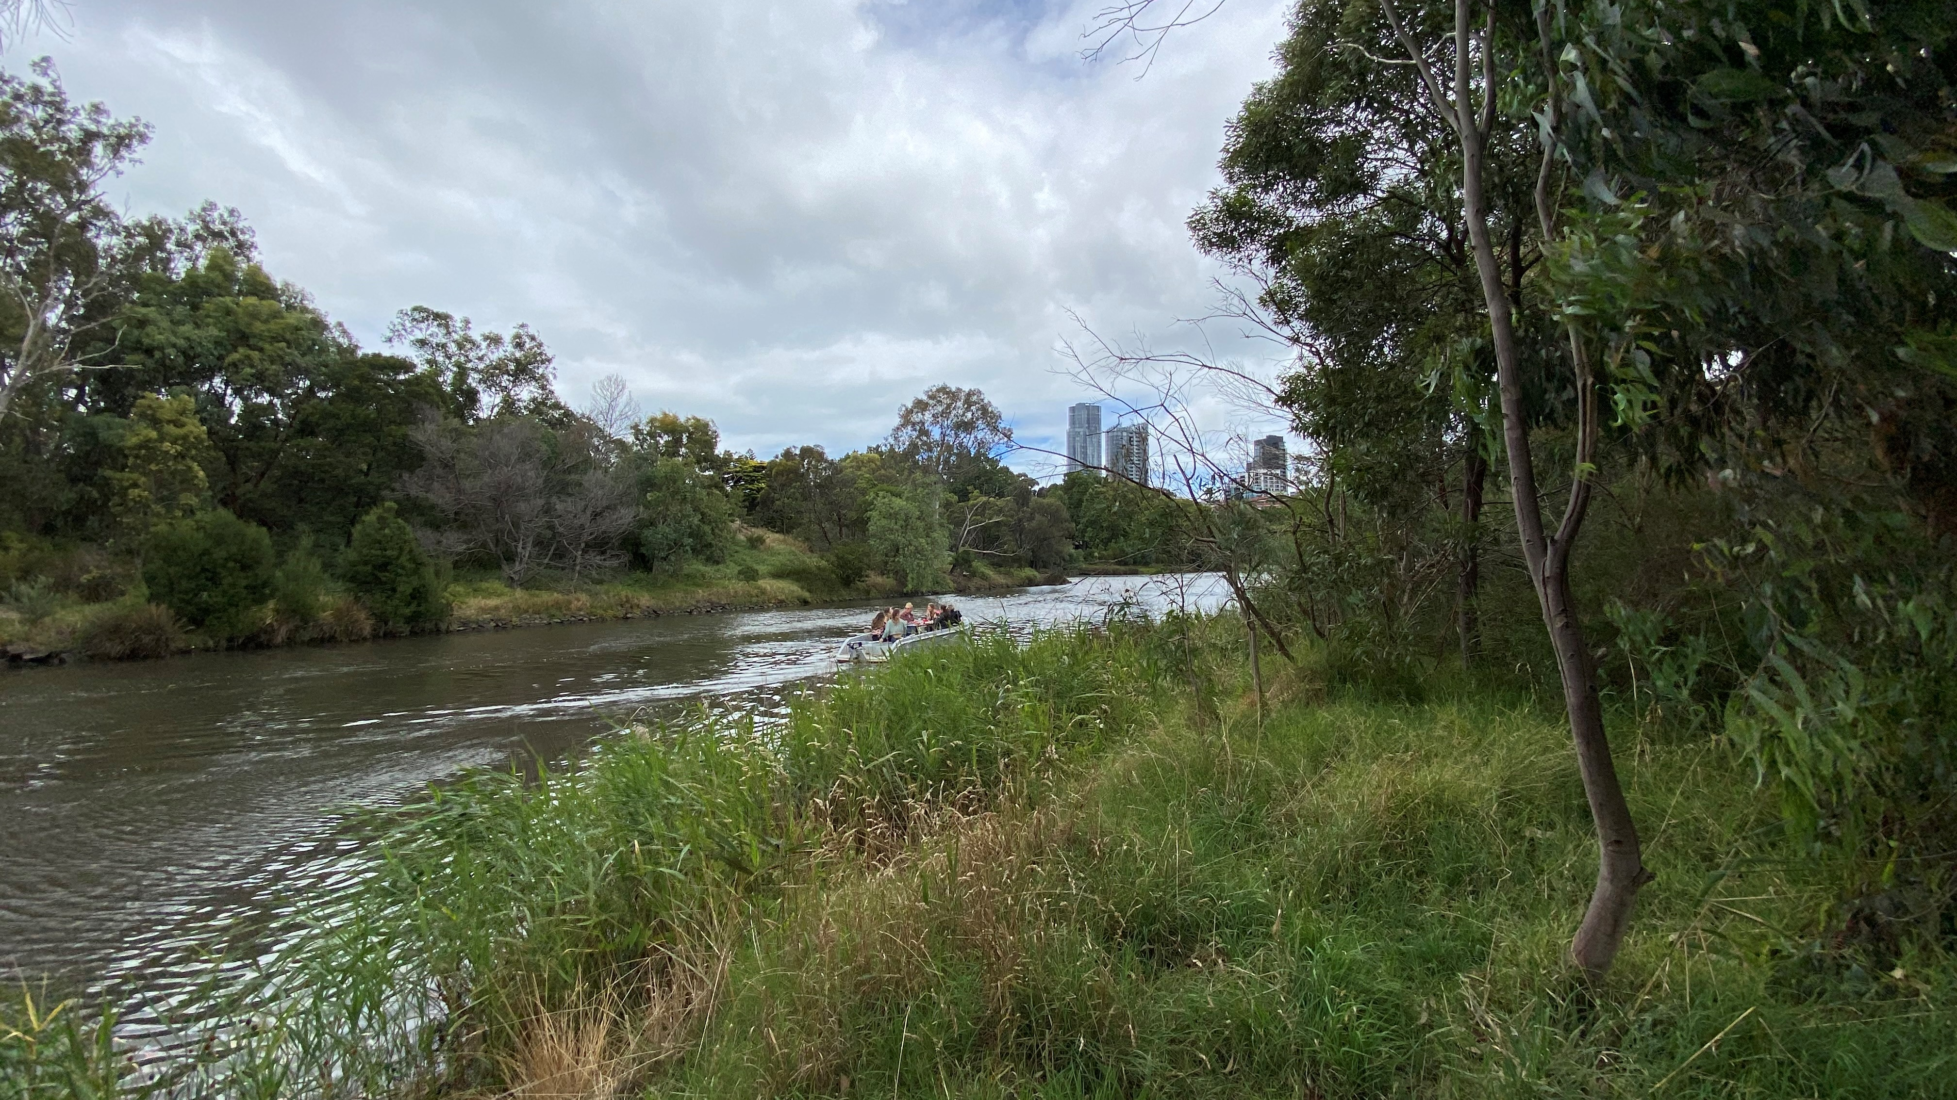

Reshaping the human relationship with water: what happens when a river becomes a person?
Dr Erin O’Donnell

Slide 2
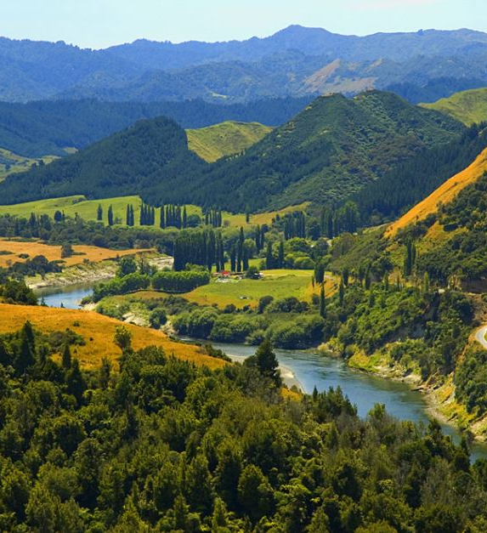
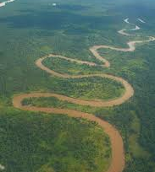
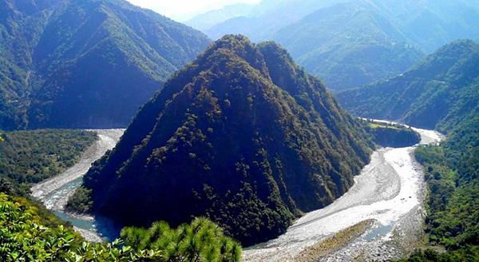
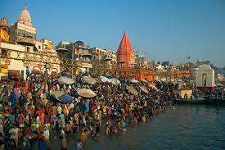
Rivers around the world have become ‘persons’
Whanganui River,
Aotearoa
New Zealand
Río Atrato,
Colombia
Ganga and Yamuna
rivers, India
Followed by: rivers and lakes in Australia, Bangladesh, Mexico, and the USA
Notes:
Campaigns underway for others – River Ethiope, River Nile, Margaret River (WA), Martuwarra (WA), Colorado River

Slide 3

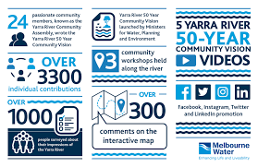
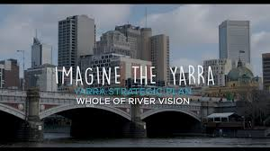
Birrarung Yarra as a living entity: an Australian first
New legislation in 2017
Birrarung Council: voice of the river
Advice and advocacy role
  Advise the Minister for Water
  Advocate for the interests of the river
  Speaking for the river, and with the river

Slide 4

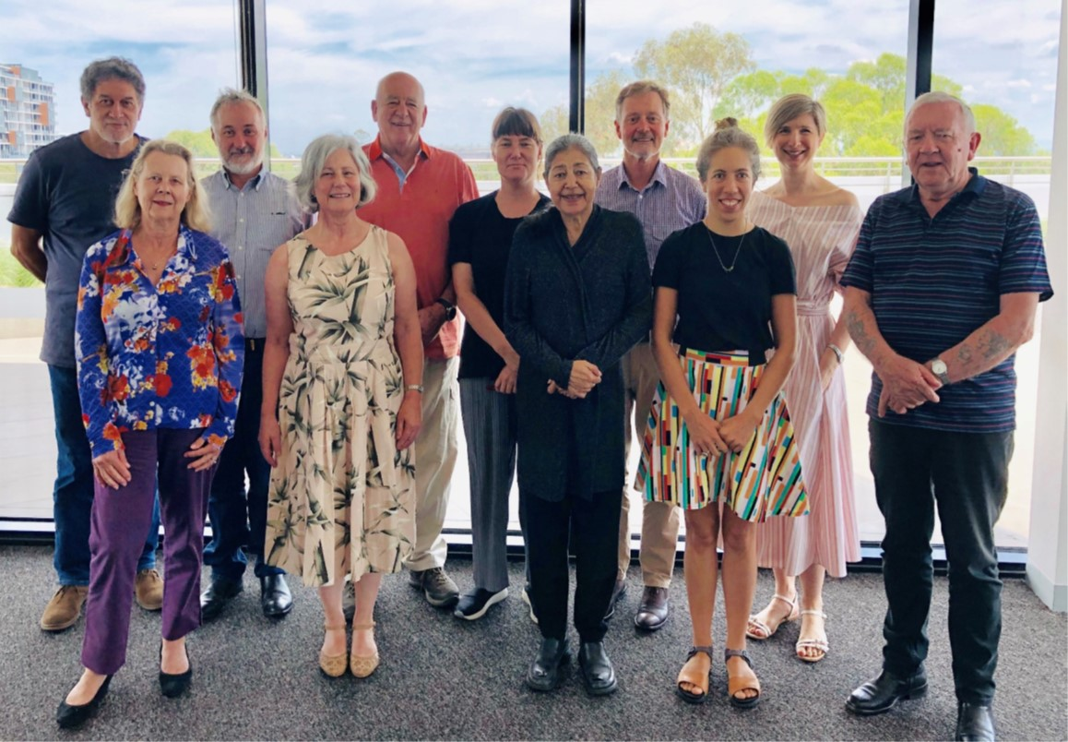
Birrarung Council: a voice for the river…
The Birrarung Council will champion the interests of the Yarra River as one, living and integrated natural entity, reflected in the 50 year Community Vision and the Wurundjeri Water Policy (Nhanbu narrun ba ngargunin twarn Birrarung)
…but the river has no legal rights

Slide 5
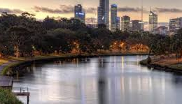
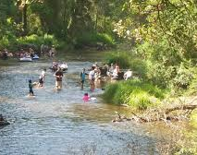
New narratives
From the river: water supply, drainage, sewage, stormwater, amenity
For the river: now the river has a voice and its interests have a champion
With the river: the river is a partner in its own management, and we all work together

Slide 6
Rivers recognised as beings in law: differences matter
Legal person
Subject of rights
Living person
Living being or entity
Notes:
Different legal constructions which all have different legal meanings, legal powers and rights
However, rivers are often a combination, and in many cases, reflect pluralist understandings of what rivers are and the human relationship to, and with, rivers

Slide 7
Examples of rivers as beings in law
Río Atrato, Colombia
‘entidad sujeto de derechos’ [an entity that is the subject of rights], including rights to ‘protection, conservation, maintenance and restoration’
Whanganui River
‘an indivisible and living whole’ and ‘a legal person and has all the rights, powers, duties, and liabilities of a legal person’.
Ganga and Yamuna Rivers
‘juristic/legal persons/living entities having the status of a legal person with all corresponding rights, duties and liabilities of a living person’
Turag and all Bangladesh rivers
The court recognised all rivers as legal persons and living entities

Slide 8
Australian examples
Martuwarra Fitzroy River
‘The Fitzroy River is a living ancestral being and has a right to life’
Birrarung Yarra River
The river and the associated land are ‘one living and integrated natural entity’

Slide 9
River guardians
Río Atrato, Colombia
One man and one woman from 7 villages plus representative from Ministry for Environment
Whanganui River
Te Pou Tupua (‘face’) advised by Te Karewao
Te Kōpuka (strategy group)
Ganga and Yamuna Rivers
Uttarakhand government officials (appealed)
Turag and all Bangladesh rivers
National River Protection Commission
Birrarung/Yarra River
Birrarung Council – the ‘voice’ of the river
Martuwarra/Fitzroy River
Martuwarra Fitzroy River Council (no govt recognition)

Slide 10
Rights in law but no rights to water and limited role in water management
Rights to water
Río Atrato
No property rights
Whanganui River
Legislation does not affect existing water rights
Ganga and Yamuna
No water rights
Turag and other rivers
No water rights
Martuwarra
No water rights
Birrarung
No water rights (VEWH)
Water management
Río Atrato
New institutions to support guardians
Whanganui River
New institutions arrangements but limited affect on water
Ganga & Yamuna
No new arrangements
Turag and other rivers
NRPC limited influence
Martuwarra
No statutory role
Birrarung
Minimal role

Slide 11
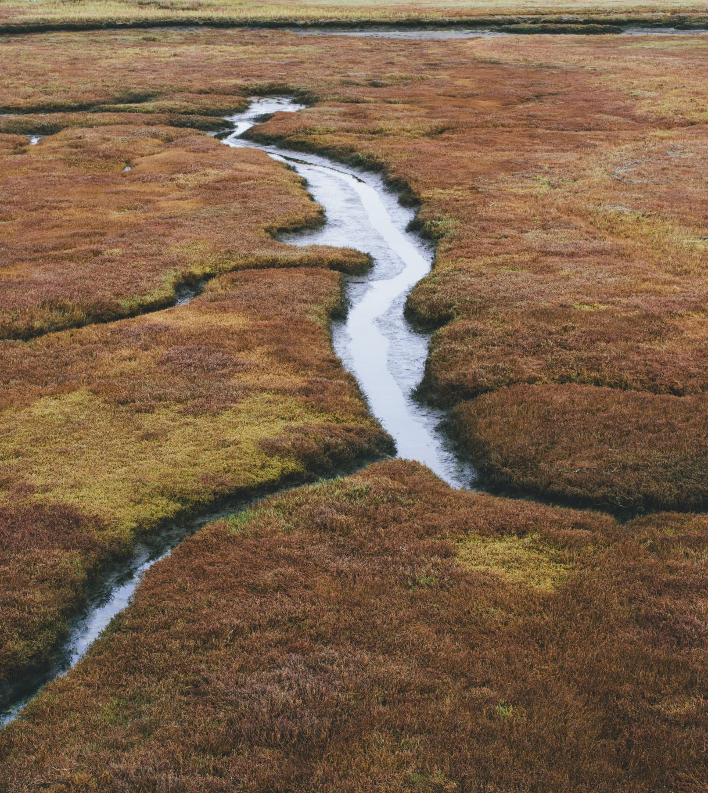
Rivers as legal or living persons
Potentially transformative for our relationship with rivers
Shifts the conversation from: ‘what do we want from the river?’ to ‘what do we want for the river, and how do we get there with the river?’
But without rights to water and a role in water management, we’re still selling rivers short

